Slide 1
A Dynamic Energy Budget model of fish bioenergetics under exposure to realistic PCB and PBDE mixtures: consequences for life-history traits
Khaled Horri, Sébastien Alfonso, Xavier Cousin, Catherine Munschy, Véronique Loizeau, Lucette Joassard, Didier Leguay, Salima Aroua, Marie-Laure Bégout, Bruno Ernande
Fifth International Symposium on DEB theory
May 31- June 2, Tromsø Norway
Khaled.Horri@ifremer.fr

Slide 2
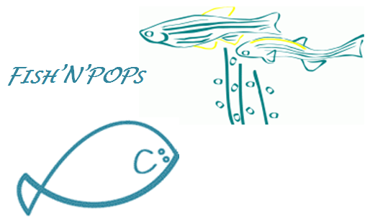
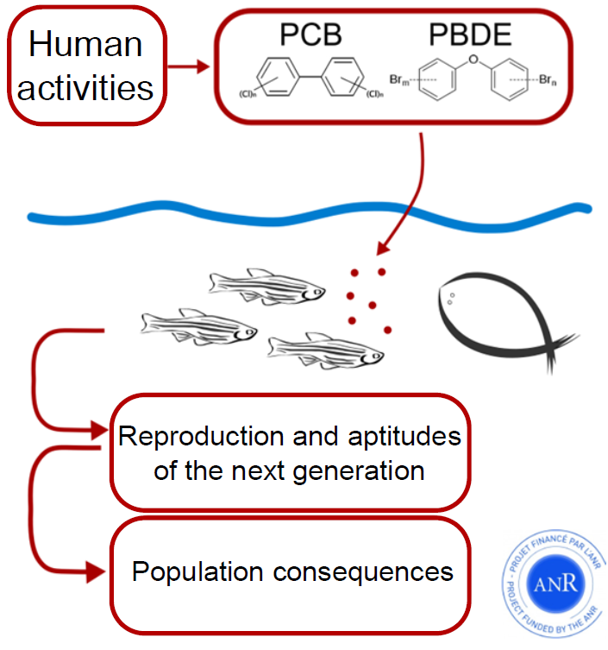
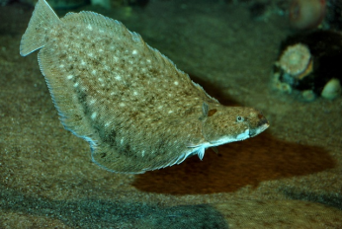
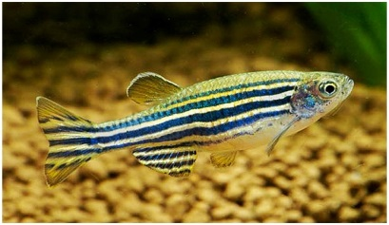
Context and objectives
PCBs/PBDEs
Concentration and composition = environment
PCBs or PBDEs
reproduction, growth,
survival…etc
?
Common sole
Solea solea
Zebrafish
Danio rerio

Slide 3
Effects of a realistic PCB and PBDE mixture on life-history traits
Increase in growth
Delayed spawning probability
Decrease in reproductive outputs
The metabolic basis of the effects of PCB and PBDE?

Slide 4
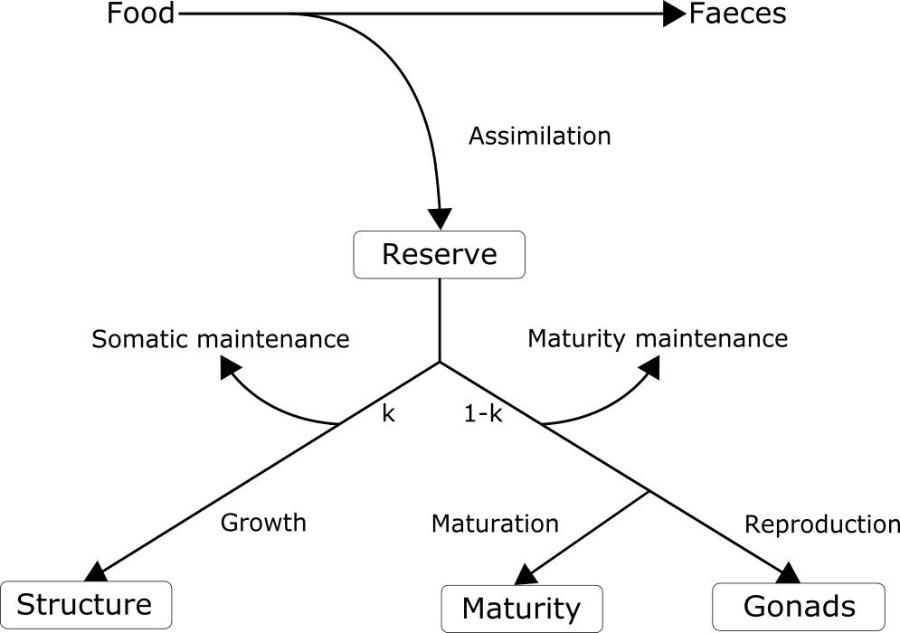
?
?
?
?
?
?
?
?
What are the physiological modes of action of PCB and PBDE?

Slide 5
Materials & Methods
Experimental design (Ifremer La Rochelle)
Zebrafish populations
control
exposed
Tank 1 (n=30)
Tank 1 (n=30)
Replicates
Tank 2
Tank 2
Tank 3
Tank 3
Tank…8
Tank…8

Slide 6
Fish exposure and traits monitoring
d0
5 dpf
Fertilization
Chronic exposure to PCBs/PBDEs (1st meal)
117 dpf
180 dpf
Euthanasia
Reproduction monitoring
Euthanasia
362 dpf
57 dpf
Growth monitoring
PCBs/PBDEs ≈ [ ]
dpf: days post fertilization

Slide 7
Modeling approach
Dynamic Energy Budget model
12 fitted parameters => covariation method
Parameters | Description
$$f$$ | Scaled functional response
$$δ_{M}$$ | Shape coefficient for juveniles and adults
$$\left\{{\dot{p}}_{Am}\right\}$$ | Maximum area specific assimilation rate
$$\dot{v}$$ | Energy conductance
$$κ$$ | Fraction of energy allocated to somatic maintenance and growth
$${\dot{K}}_{J}$$ | Maturity maintenance rate coefficient
$$\left[{\dot{p}}_{M}\right]$$ | Volume specific somatic maintenance costs
$$\left[E_{G}\right]$$ | Cost of synthesis of a unit of structure
$${ E}_{H}^{b}$$ | Cumulated energy invested in maturity at birth
$${ E}_{H}^{j}$$ | Cumulated energy invested in maturity at metamorphosis
$${ E}_{H}^{p}$$ | Cumulated energy invested in maturity at puberty
$${\ddot{ h}}_{a}$$ | Weibull aging acceleration

Slide 8
Experimental data for calibration
Growth: size at age
Reproduction: cumulative egg number at age
Age and size at life-history transitions: birth, metamorphosis, puberty

Slide 9
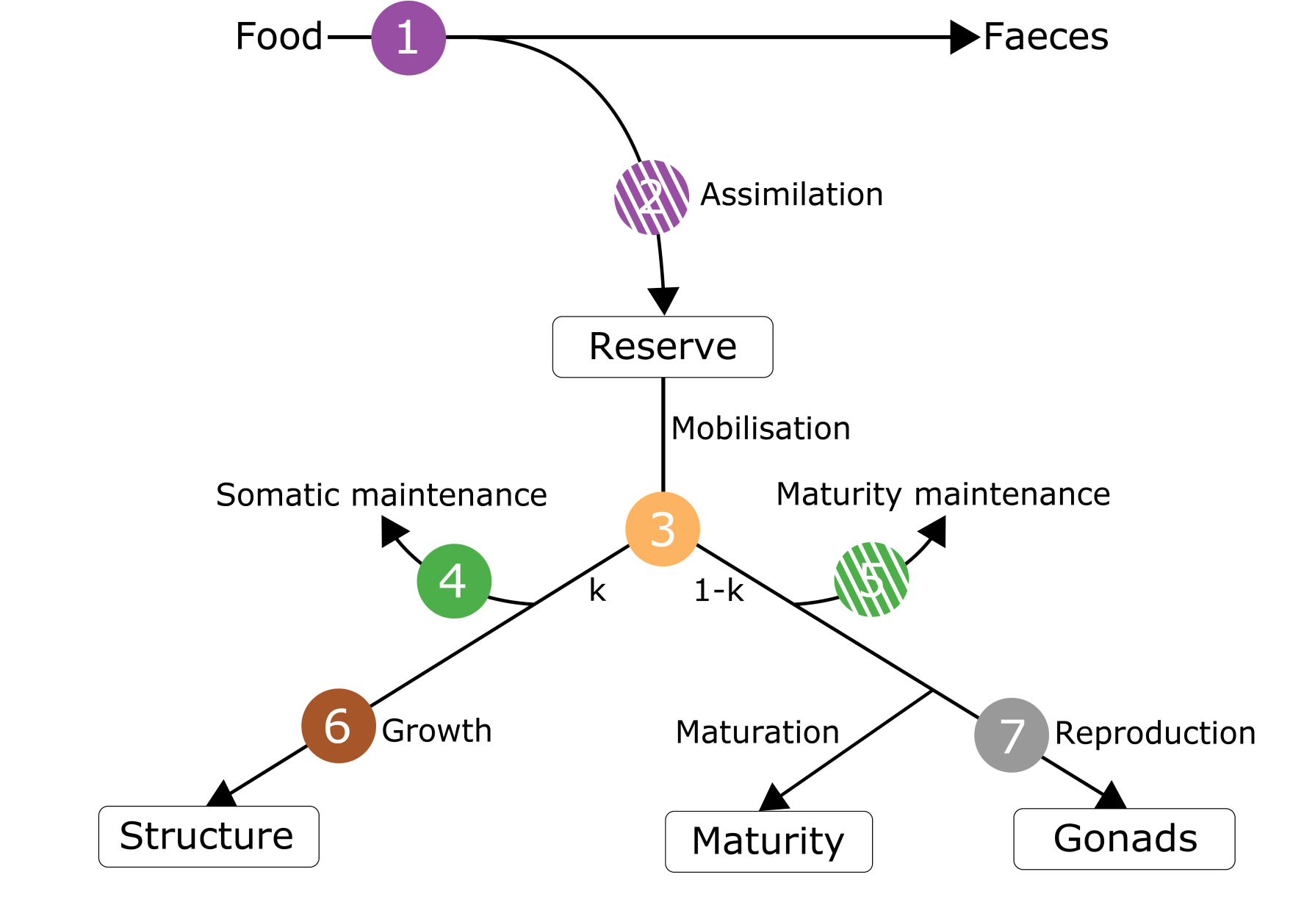
Physiological modes of action (PMOA) of PCB and PBDE
$$f$$
$$\left\{{\dot{p}}_{Am}\right\}$$
$$κ$$
$$\left[{\dot{p}}_{M}\right]$$
$${\dot{K}}_{J}$$
$$K_{R}$$
$$\left[E_{G}\right]$$

Slide 10
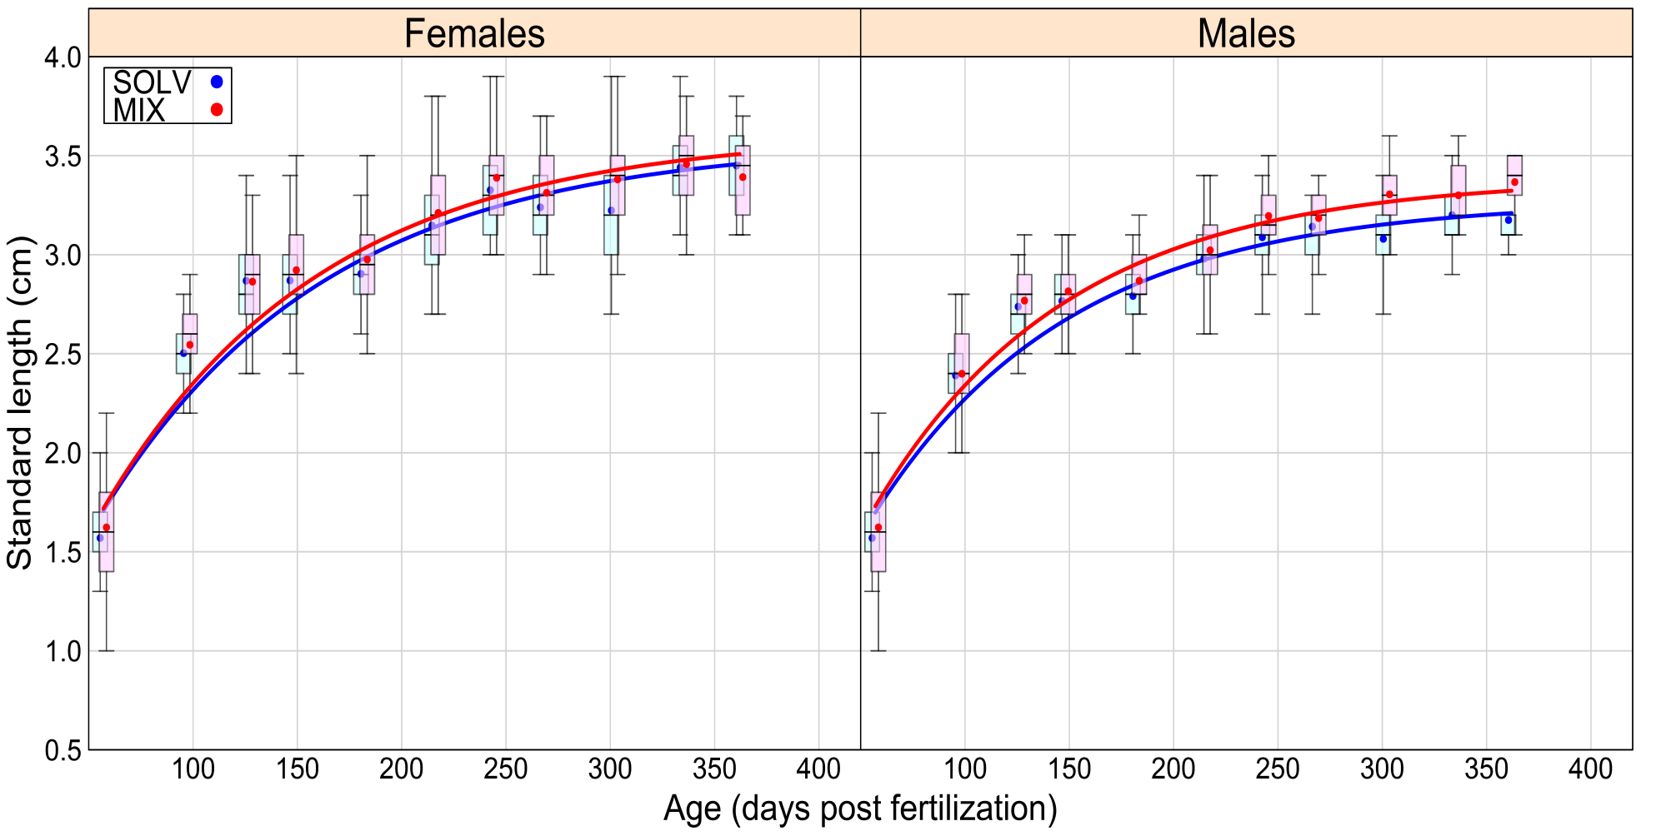
Results & discussion
Effect of PCB and PBDE on life-history traits
Length at age
$fSOLV$= 0.93
$fMIX$= 0.89
$fSOLV$= 0.85
$fMIX$= 0.85
Relative error
SOLV= 0.036
MIX=0.031
Relative error
SOLV= 0.028
MIX=0.022
$L_{i} SOLV$= 3,86 cm
$L_{i} MIX$= 4,08 cm
$L_{i} SOLV$= 3,85 cm
$L_{i} MIX$= 4,02 cm
Higher growth in exposed fish

Slide 11
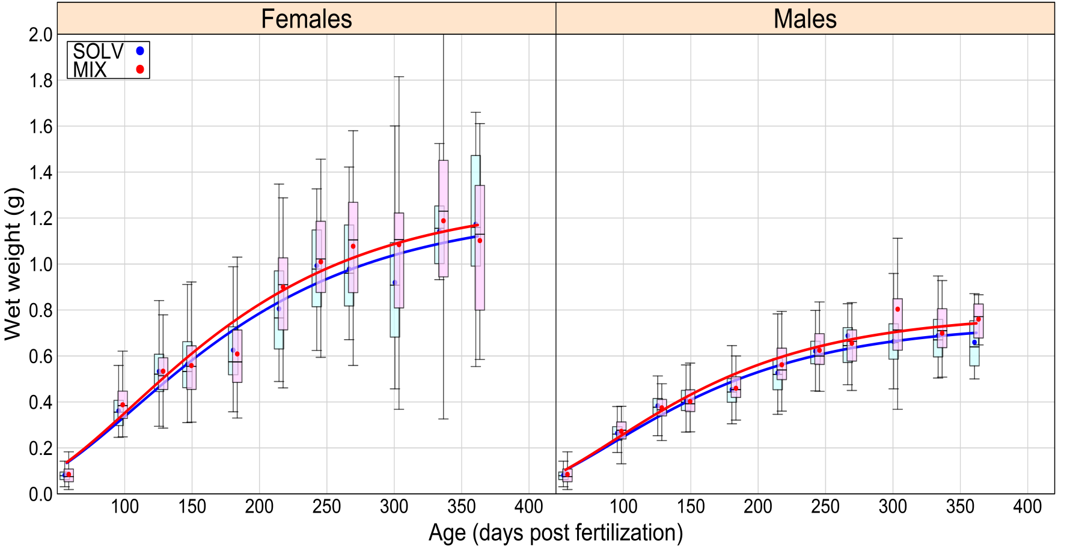
Weight at age
$W_{wi} SOLV$= 1,61 g
$W_{Wi} MIX$= 1,93 g
$W_{wi} SOLV$= 1,30 g
$W_{Wi} MIX$= 1,41 g
Relative error
SOLV= 0.072
MIX=0.067
Relative error
SOLV= 0.052
MIX=0.062
$fSOLV$= 0.93
$fMIX$= 0.89
$fSOLV$= 0.85
$fMIX$= 0.85
Higher growth in exposed fish

Slide 12
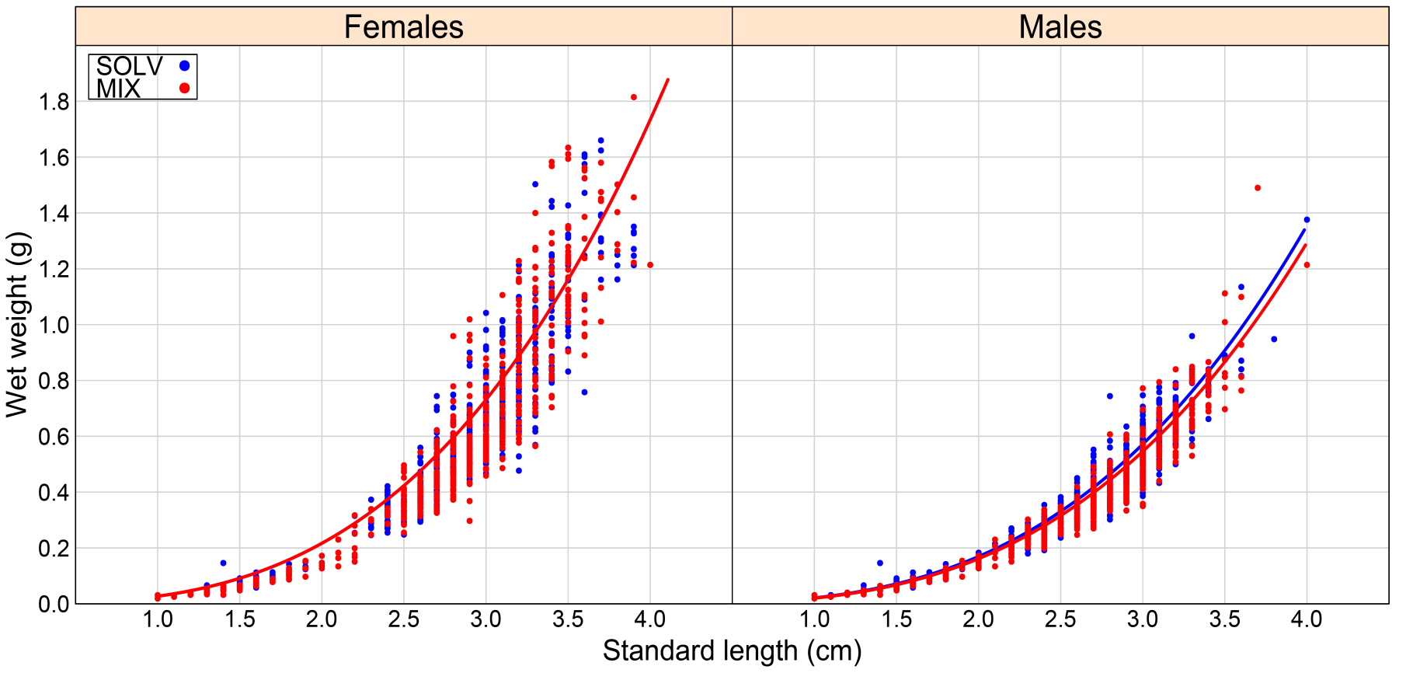
Weight-length relationship
Relative error
SOLV= 0.065
MIX=0.083
Relative error
SOLV= 0.049
MIX=0.052
$fSOLV$= 0.93
$fMIX$= 0.89
$fSOLV$= 0.85
$fMIX$= 0.85
No PCBs/PBDEs effect on fish condition

Slide 13
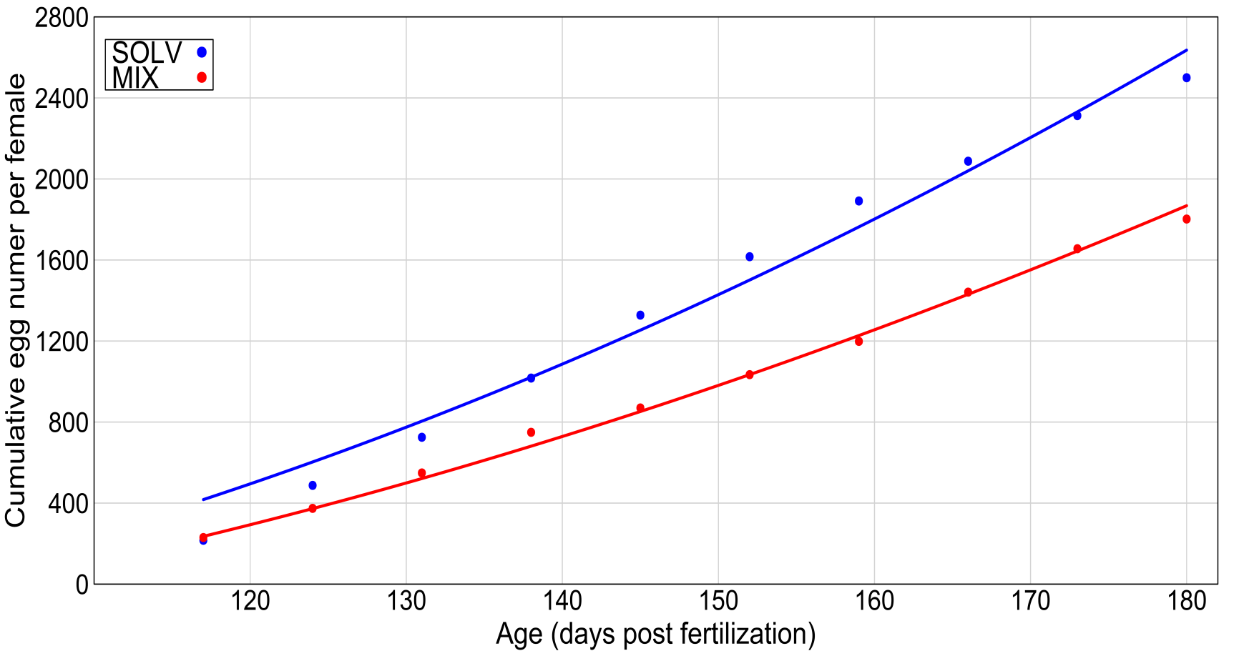
Reproductive outputs
$R_{m} SOLV$= 138 eggs
$R_{m} MIX$= 111 eggs
Relative error
SOLV= 0.065
MIX=0.024
$fSOLV$= 0.93
$fMIX$= 0.89
Reduced reproductive outputs in exposed fish

Slide 14
Effect of PCB and PBDE on DEB parameters
Symbol | Female | Male
 | % of change under stress | % of change under stress
$$f$$ | -3.99 | -0.86
$$\left\{{\dot{p}}_{Am}\right\}$$ | 0.12 | -3.44
$$κ$$ | 8.56 | 8.74
$${\dot{K}}_{J}$$ | -1.15 | -1.46
$$\left[{\dot{P}}_{M}\right]$$ | 1.33 | 0.16
$$\left[E_{G}\right]$$ | 0.09 | 0.09
% of change under stress= 100*(MIX-SOLV)/SOLV

Slide 15
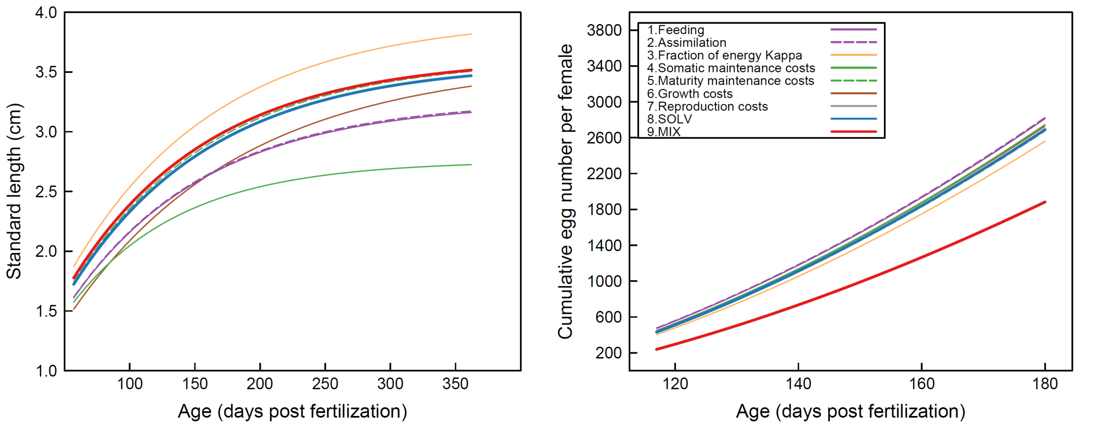
PMOA of PCBs and PBDEs
κ
MIX
Females
SOLV
SOLV
κ
MIX

Slide 16
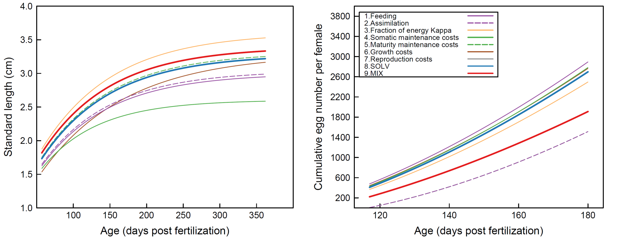
κ
Males
MIX
SOLV
SOLV
κ
MIX

Slide 17
Conclusion
Realistic PCB/PBDE mixtures affect
the share of energy (𝜅 ) between growth and reproduction

Slide 18
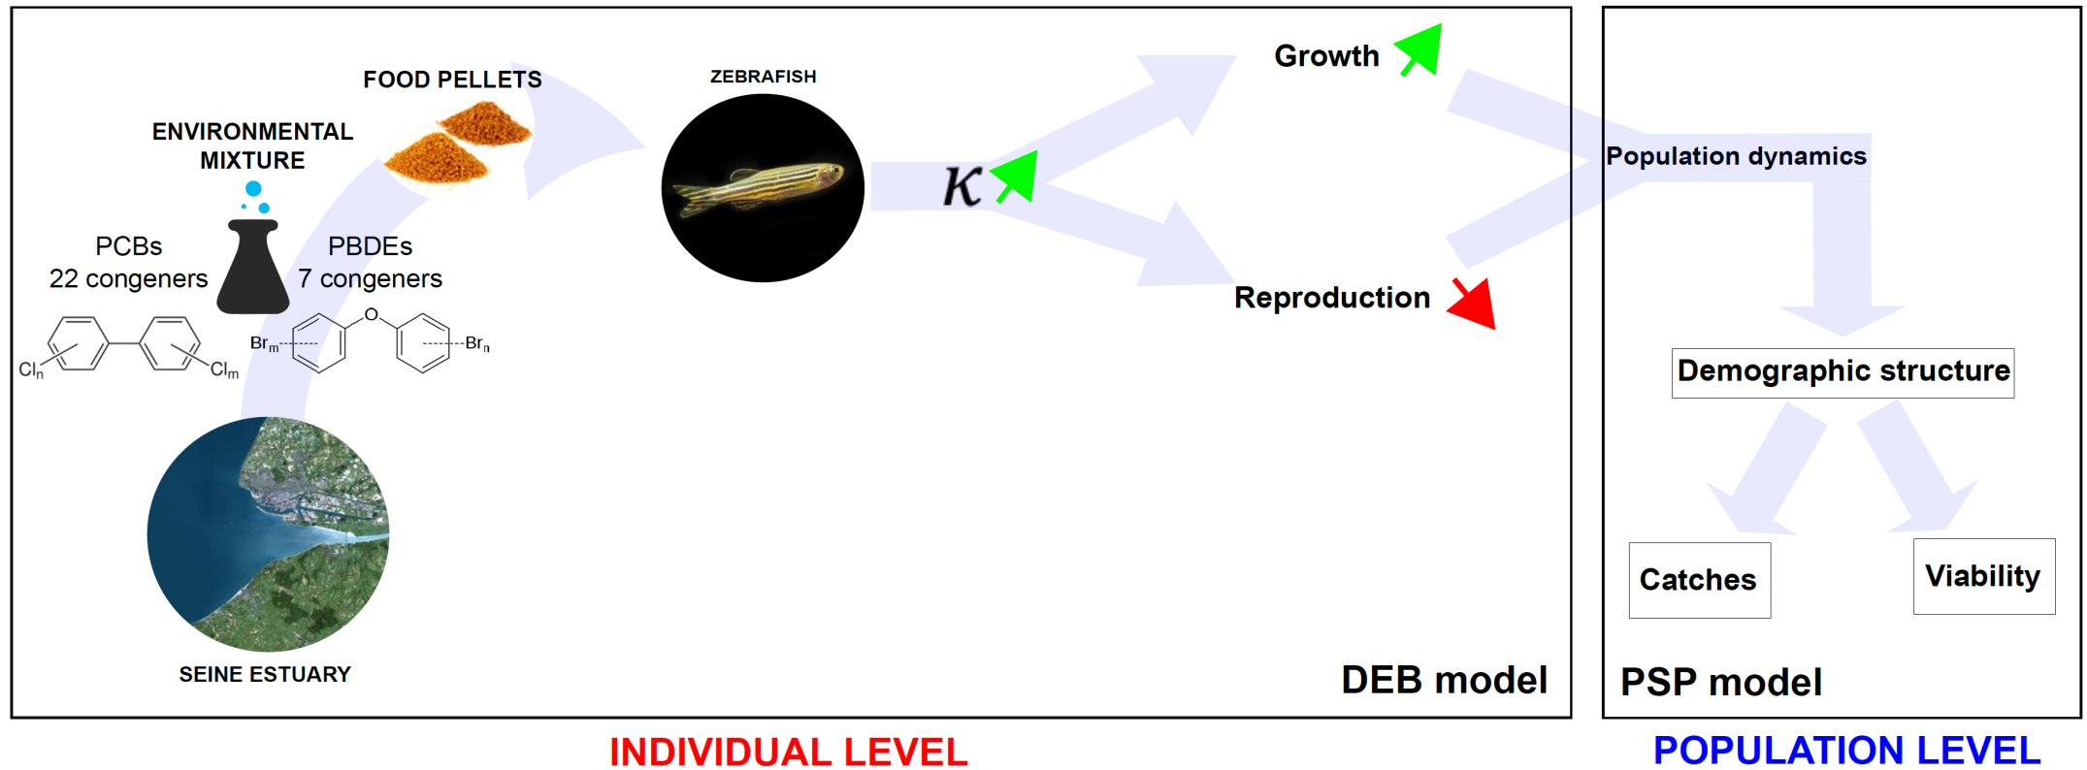
Perspectives
Modeling approach
Experimental and modeling approach
Decrease in
the demographic growth rate
of exploited fish populations

Slide 19
THANK YOU

Slide 20
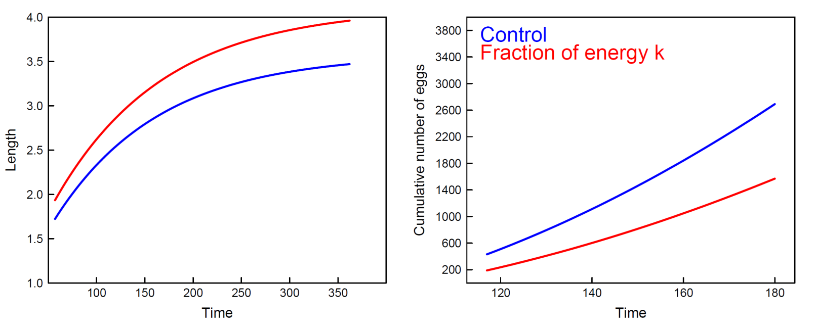
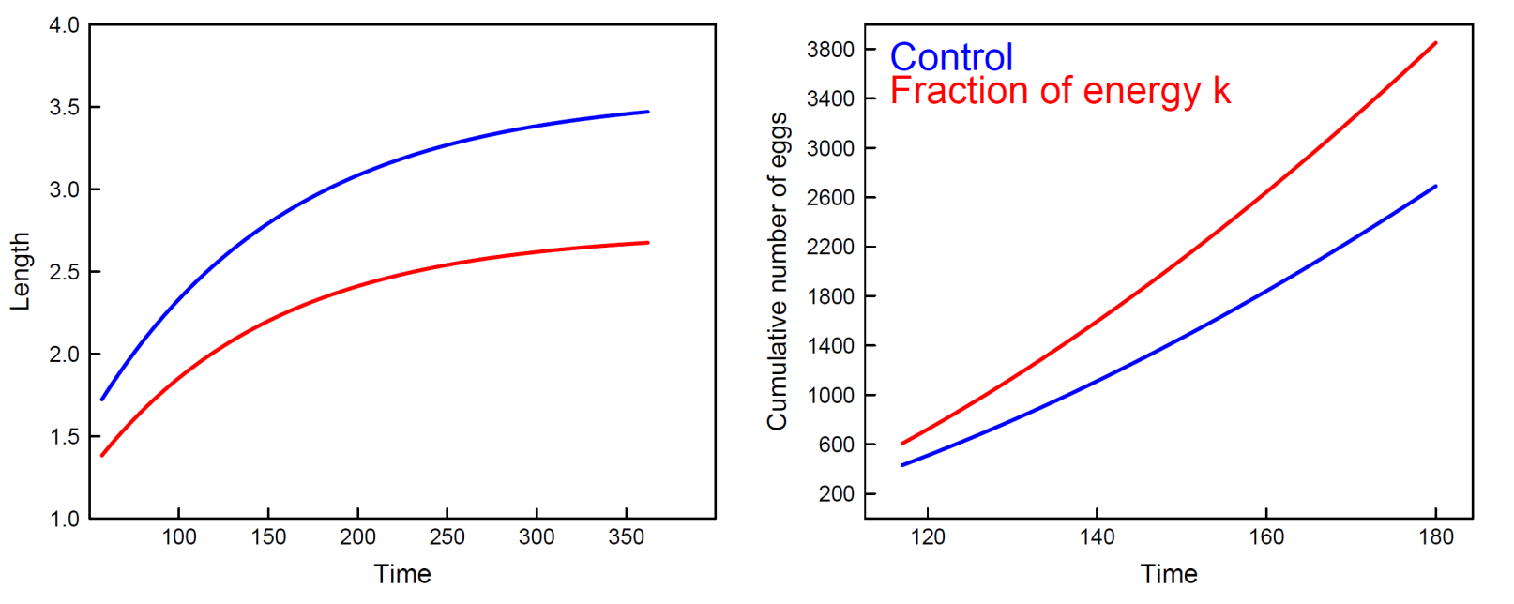
Increase in κ
Decrease in κ

Slide 21
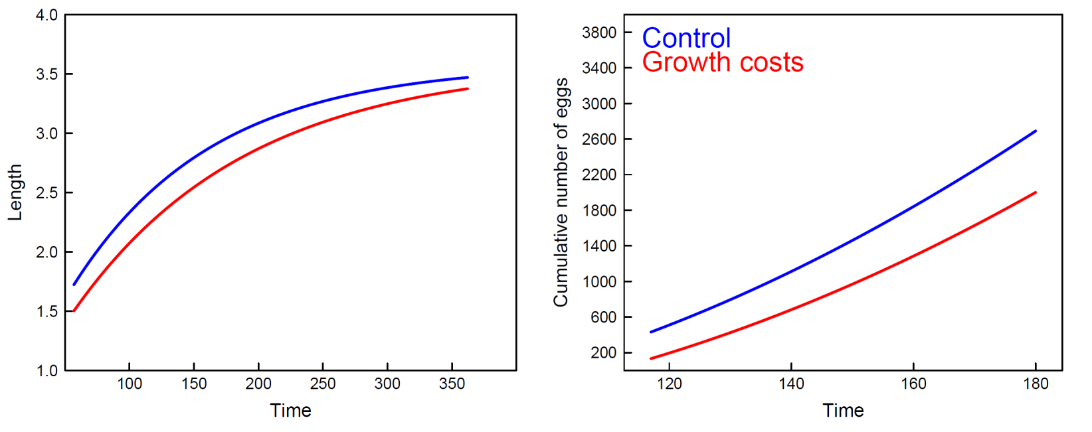
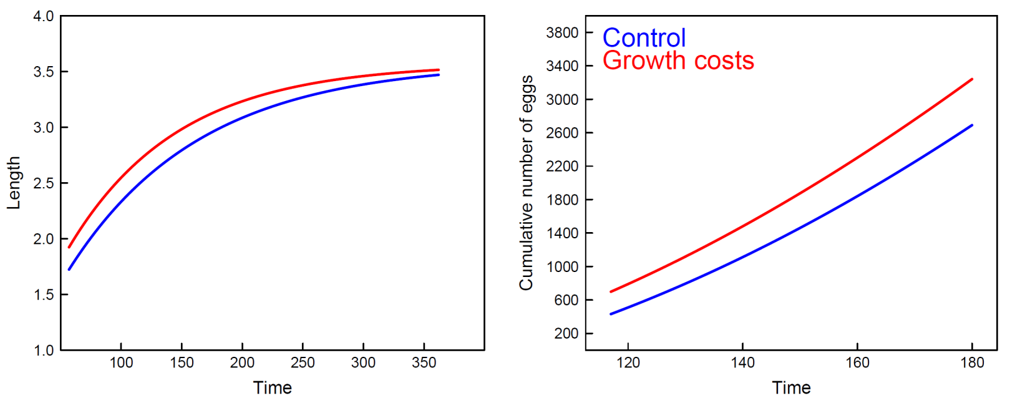
Increase in [E_{G}]
Decrease in [E_{G}]

