Slide 1
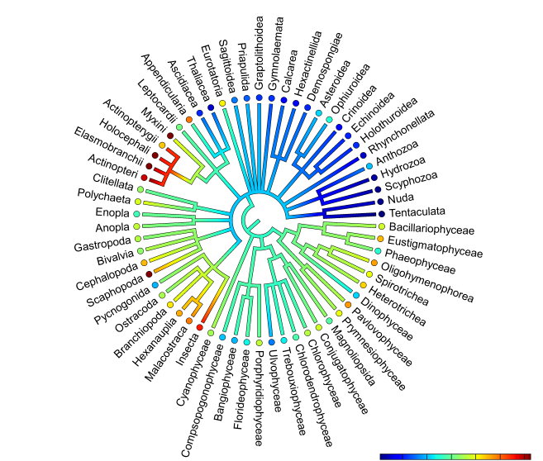
DEB for any species Making the most of existing knowledge
Jorn Bruggeman
Plymouth Marine Laboratory

Slide 2
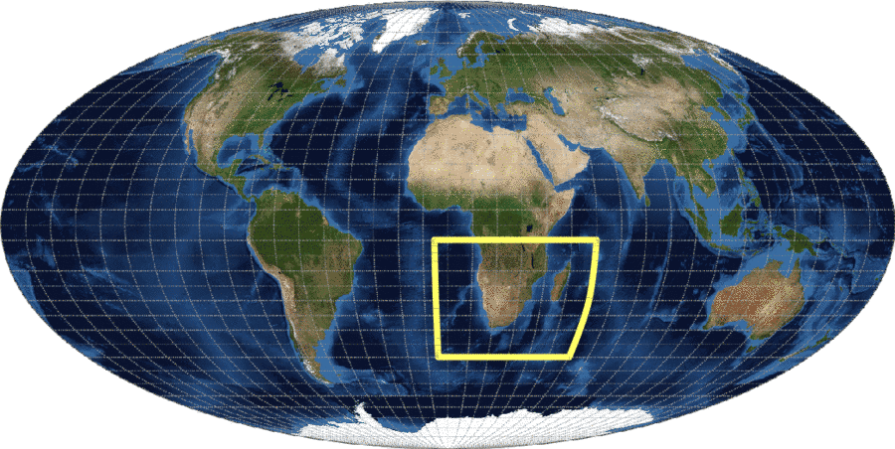
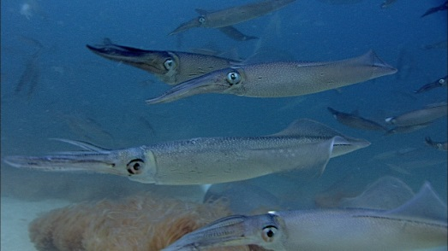
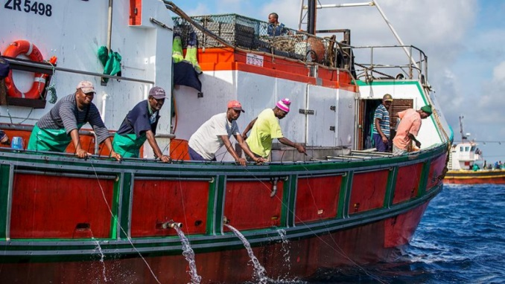
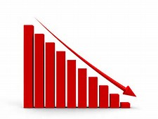
Context: automated pipelines for building models

Slide 3
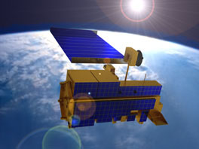
Context: automated pipelines for building models
portable modelling
infrastructure
size structured population or IBM
light-weight, usable by local stakeholders
drivers
online databases
transport/abiotic env.
currents
mixing
temperature
lower trophic levels
chlorophyll
primary production
zooplankton
1/12°world ocean
satellite data
HTL parameters
HTL parameters
higher trophic level model
DEB?
?

Slide 4
Relatedness as source of parameter information
How to parameterize new species?
Identify nearest [parameterized] ancestor
Provide known parameters (e.g., $L_{m}$)
Obtain custom DEB parameter estimates

Slide 5
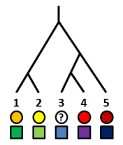
Modelling evolution
Required features:
Joint evolution of multiple parameters (N)
Longer separated in evolution → greater probability to be different
Process-based, e.g., adaptive dynamics?
No idea about past selection pressures!
Alternative: random walk in N dimensions
Evolutionary process summarized by N x N covariance matrix
Methods for estimating covariance
Felsenstein 1985
+ phenotypic error: Ives et al. 2007, Felsenstein 2008
+ missing data: Bruggeman et al. 2009, Goolsby et al. 2016
PhyloPars, http://www.ibi.vu.nl/programs/phylopars/
Rphylopars, https://cran.r-project.org/web/packages/Rphylopars/

Slide 6
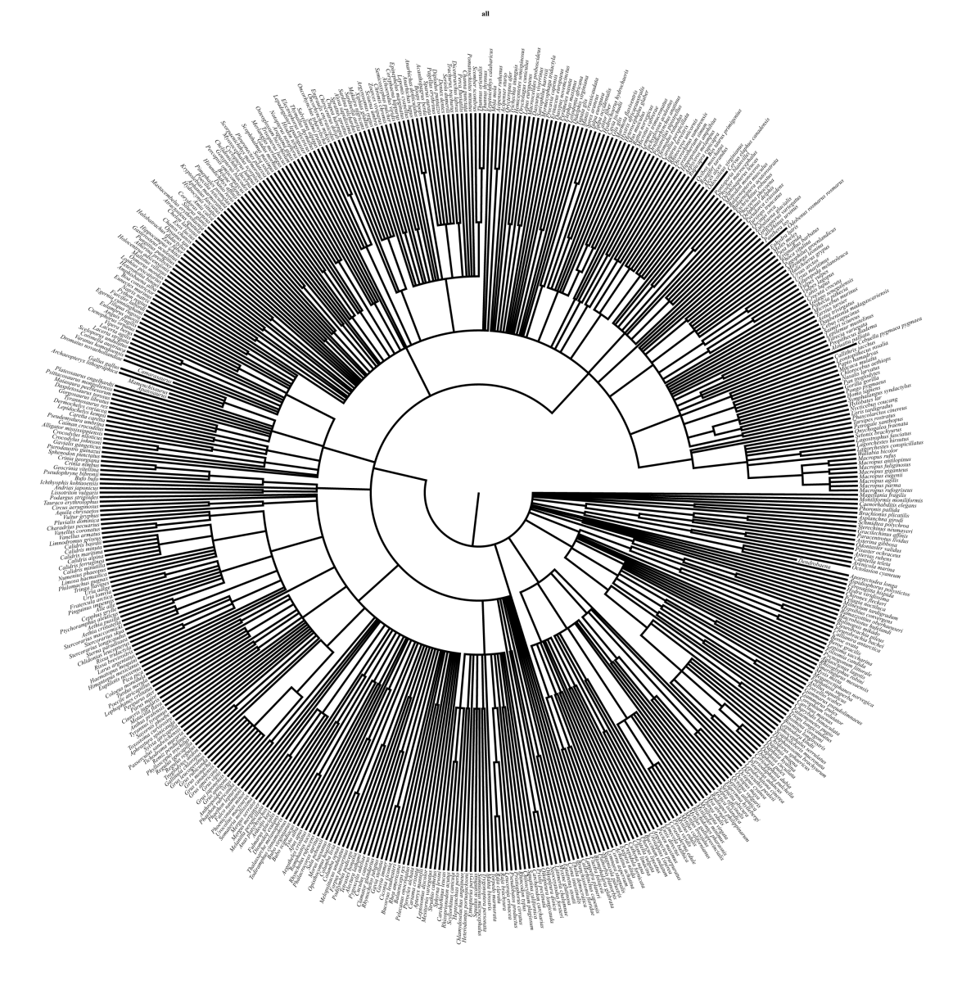
Ingredient 1: a unified phylogeny
Unified phylogeny
Catalogue of Life, http://www.catalogueoflife.org
taxonomy

Slide 7
Ingredient 2: a set of normally distributed traits
Target: primary DEB parameters
But how are these distributed [or: how do they evolve?]
First attempt: log-transform all
Benefit: key implied properties become linear combination of original parameters
$L_{m}={κp_{Am}}/{p_{M}}$ → $\log{L_{m}}=\log{κ+\log{p_{Am}}−\log{p_{M}}}$
$$\dot{υ}$$
$$\left\{{\dot{p}}_{Am}\right\}$$
$$κ$$
☺
😐
☹

Slide 8
So many assumptions. Is this any good?
Cross-validation
leave one parameter out, estimate from remaining data, check error
$${\dot{[p}}_{M}]$$
$$\dot{ν}$$
$$\left\{{\dot{p}}_{Am}\right\}$$

Slide 9
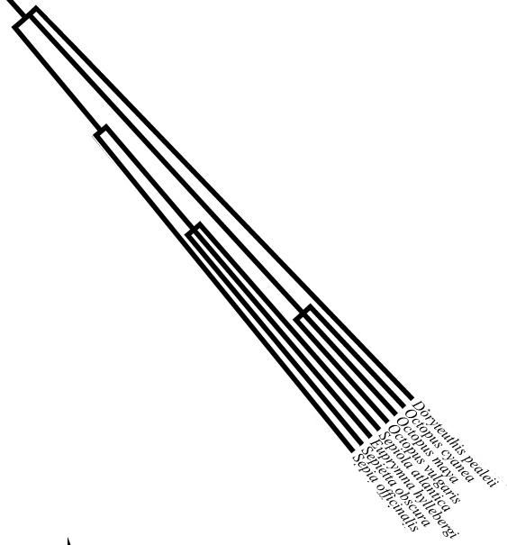
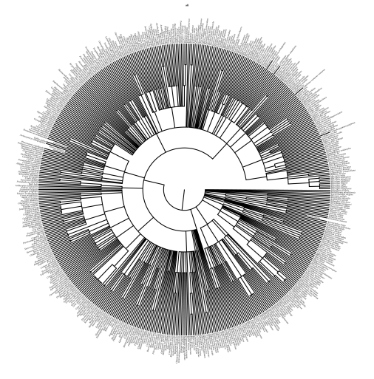
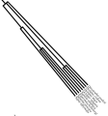
Pipeline
name: Loligo reynaudii
$L_{m}$: 1000 cm³
family: Loliginidae
DEB species explorer
1. Find taxonomic classification
name: Loligo reynaudii
2. Insert in tree, add known parameters
id: a2c0cb293c3054a…
classification:
kingdom | Animalia
phylum | Mollusca
class | Cephalopoda
order | Myopsida
family | Loliginidae
genus | Loligo
3. Compute covariances with all add-my-pet data
4. Infer primary parameters
5. Compute cost of egg, growth curve, reproduction rate

Slide 10
Live demo
http://localhost/traitexplorer/deb.shtml

Slide 11
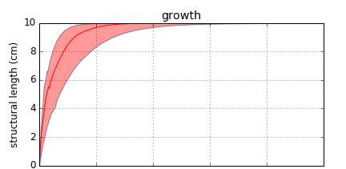
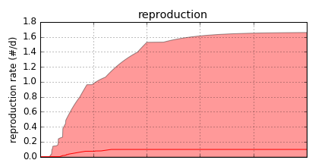
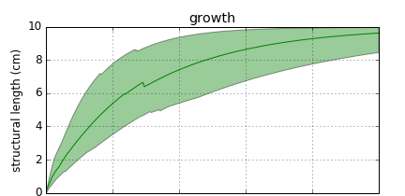
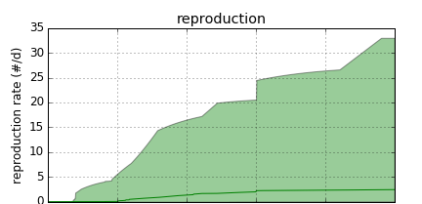
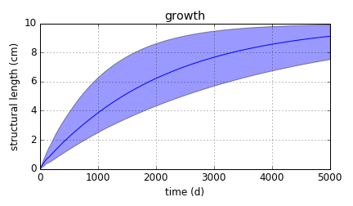
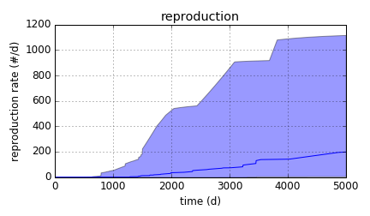
Example results for V_{m} = 1000 cm³
Aves
Amphibia
Actinopterygii

Slide 12
What about typified models?
Initial focus on most common models
std: standard model
stx: foetal development, baby stage
abj: acceleration between birth and metamorphosis
“unified model” with maturity thresholds
birth $E_{H}^{b}$
weaning$E_{H}^{x}$(default:$E_{H}^{b}$)
metamorphosis $E_{H}^{j}$(default:$E_{H}^{x}$)
puberty${ E}_{H}^{p}$

Slide 13
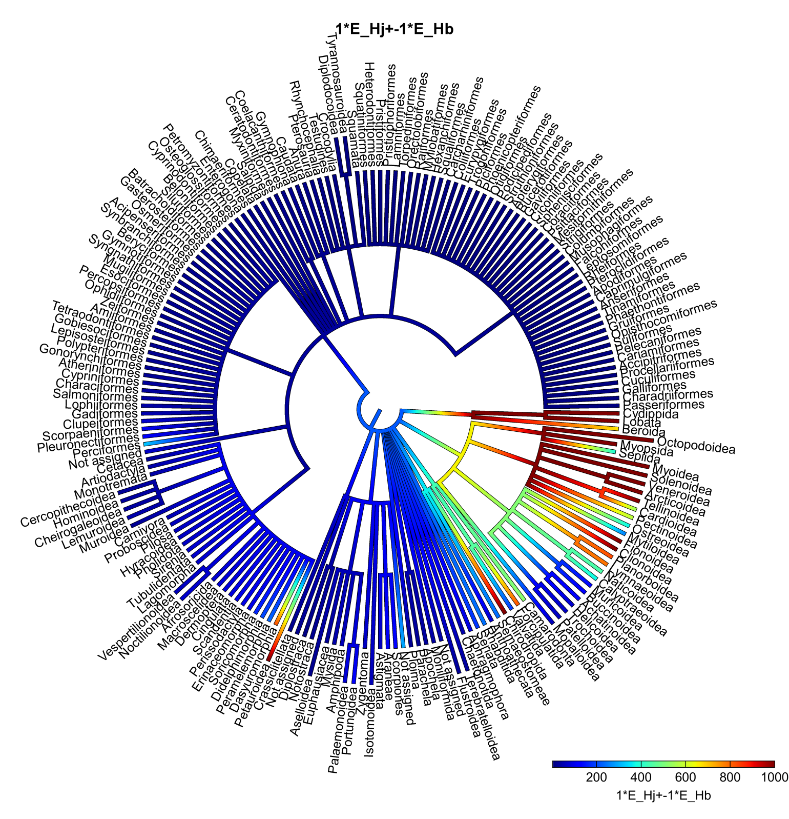
$E_{H}^{j}$/$E_{H}^{b}$

Slide 14
Way forward
Next steps
public availability
expand plotting capabilities to handle non-std models
Envisaged usage: complement real data
use inferences as initial estimates or Bayesian prior
Challenge: main/improve integrity of Add-my-Pet
expectation-minimization approach?
DEB parameter estimates from species-specific data
evolutionary estimates of DEB parameters

