Slide 1
The altricial-precocial spectrum of avian development according to DEB theory
DEB2017 Symposium
5th International Symposium on Dynamic Energy Budget Theory Tromsø, 31.05 - 02.06.2017
Carlos M. G. L. TEIXEIRA¹, Tânia SOUSA¹, Tiago DOMINGOS¹
¹Instituto Superior Técnico,
carlos.teixeira@tecnico.ulisboa.pt
This work is supported through project Maretec 2015-2017 (ISR/IN+/MARETEC) (EEA/50009)

Slide 2
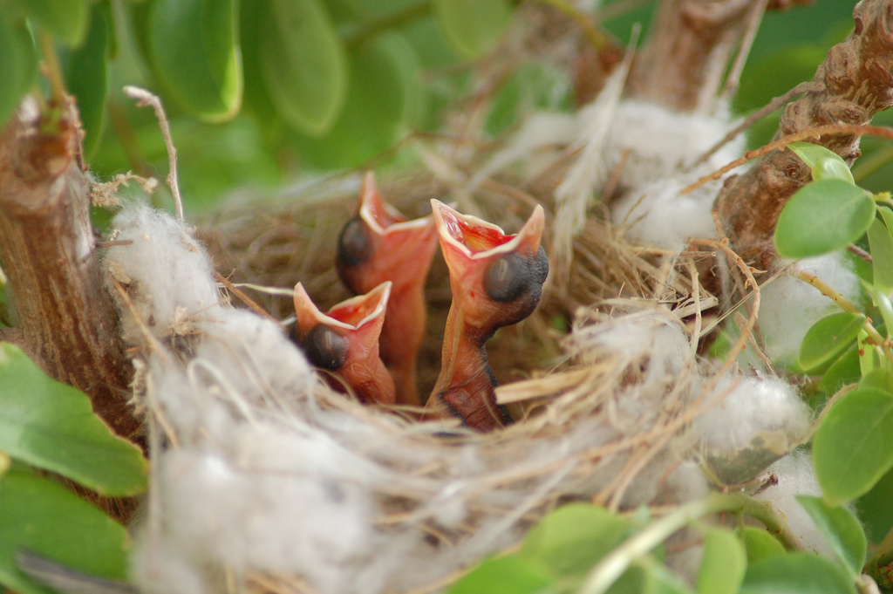
The altricial-precocial spectrum
“...represents a continuum o functional capabilities of neonates, ranging from the complete independence and adultlike capabilities of megapode chicks to the total dependence of passerines, psittaciforms, and other fully altricial taxa...”
altricial precocial
2/19

Slide 3
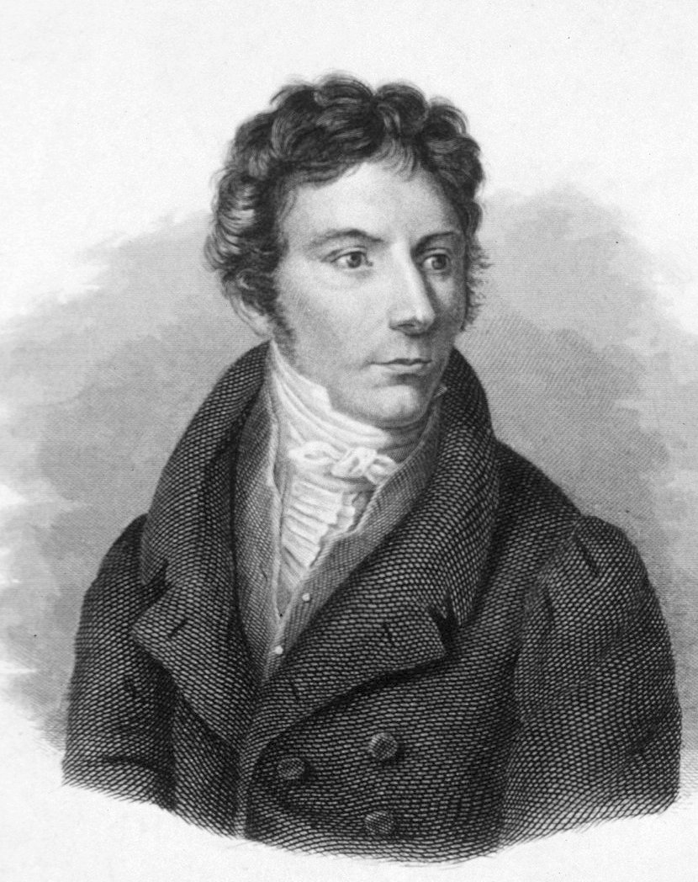
The altricial-precocial spectrum
Lorenz Oken (1837)
“nidifugous” (from the Latin nidus for "nest" and fugere meaning "to flee“
and
“nidicululous” (stays at the nest after hacting from the egg)
C. J. Sundeval (1872)
“altrices” and “precoces”
3/19

Slide 4
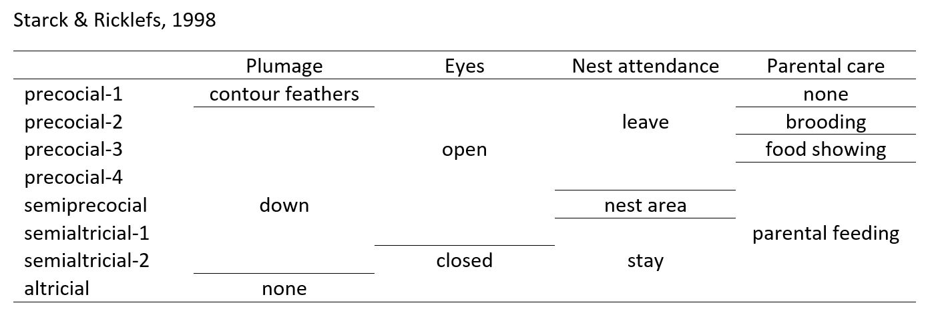
The altricial-precocial spectrum
- Slightly different criteria through the years (e.g., Nice (1962) and Skutch (1976)) but this is quite clear:
- Heterogeneous set of characteristics including criteria such as behavior (nest attendance; feeding), parent-chick interaction and anatomy (eyes opened or closer; presence of down);
4/19

Slide 5
The altricial-precocial spectrum
a sa2 sa1 sp p4 p3 p2 p1
5/19

Slide 6
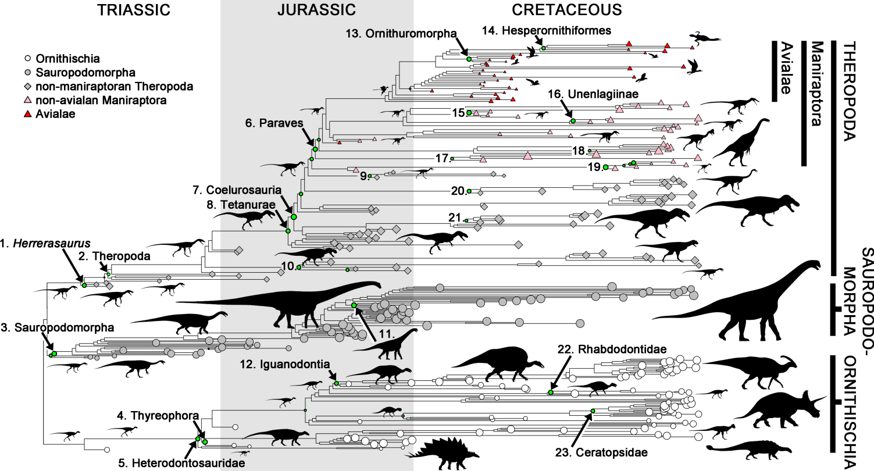
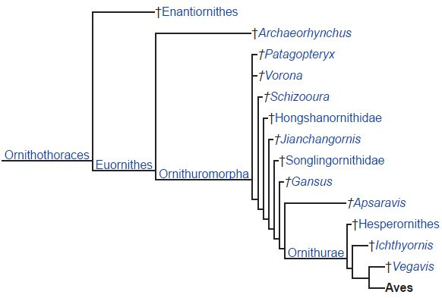
The altricial-precocial spectrum
Dinosaur phylogeny showing nodes with exceptional rates of body size evolution.
- At leat two big evolutionary
radiations: before and after
The K-T event;
Benson RBJ, Campione NE, Carrano MT, Mannion PD, Sullivan C, et al. (2014) Rates of Dinosaur Body Mass Evolution Indicate 170 Million Years of Sustained Ecological Innovation on the Avian Stem Lineage. PLOS Biology 12(5): e1001853. https://doi.org/10.1371/journal.pbio.1001853
http://journals.plos.org/plosbiology/article?id=10.1371/journal.pbio.1001853
6/19

Slide 7
The altricial-precocial spectrum
A phylogeny of doubts:
Cracraft (1888) (based on skeletal characters):
Precocial development at the base of all birds and several, independent origins of altriciality OR vice-versa;
Sibley & Ahlquist (1990) (based on DNA-DNA hybridization):
Altriciality is a derived character of the Neoaves and Precocity arosed secondarily and independently in several taxa;
Recent, molecular, but no specific insight on development patterns:
Hackett et al. (2008)
Jarvis et al. (2014)
7/19

Slide 8
The altricial-precocial spectrum
Development pattern and post natal growth rates:
Environmental (external) selective pressures:
- Predation upon hatchlings (David Lack, 1968; Remes & Martin, 2002)
- Food availability (Case, 1978)
- Ecological factors in general (Lindstrom, 1999)
Latitude (Ricklefs, 1976)
Sibling competition (Royle et al, 1999)
Physiological (internal) selective pressures:
Adult body size and precocity (the rate at which mature functions develop) (Ricklefs, 1973)
early embryonic development and heterochrony (Blom & Lilja, 2005; Karlsson & Lilja, 2008)
Size of alimentary tract ((Konarzewski, Kozłowski, & Ziółko, 1989)
relative maturation of bones (Chinsamy & Elzanowski, 2001; Karlsson & Lilja, 2008)
Balance between somatic growth (rate of cell proliferation) and the acquisition of functional maturity!
8/19

Slide 9
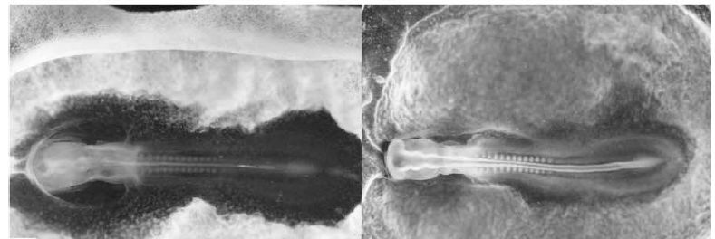
The altricial-precocial spectrum
Could the development spectrum be distributed along one or two, clear and continuous dimension(s) of physiological variation?
- Dry-matter content of a tissue as index of functional maturity (inversely correlated with growth rates) (but this is structural!)
Different degrees of myotome formation (quail vs fieldfare)
“birds with high postnatal growth rates (e.g. altricial species) are characterized by a rapid early development of ‘‘supply’’ organs, such as digestive organs”
vs
“birds with low postnatal growth rates (e.g. precocial
species) exhibit a slower early development of these organs and a more rapid early development of other ‘‘demand’’ organs, such as brain, muscles, skeleton and feathers” (Blom & Lilja, 2005)
9/19

Slide 10
The altricial-precocial spectrum
Precocial
Advantage: Locomotion
Altricial
Advantage: Digestive system
Dry mass-specific maturity
at birth (hatching)
(μ^{b}_{H} = E^{b}_{H} / M^{b}_{V}) (J mol⁻¹)
Puberty/birth altriciality index
(s^{pb}_{H} = E^{p}_{H} / E^{b}_{H}) (-)
Fledging/birth altriciality index
(s^{xb}_{H} = E^{x}_{H} / E^{b}_{H}) (-)
Puberty/birth dry mass-specific maturity densities ratio (μ^{p}_{H} / μ^{b}_{H} ) (-)
Fledging/birth dry mass-specific maturity densities ratio (μ^{x}_{H} / μ^{b}_{H} ) (-)
10/19

Slide 11
The altricial-precocial spectrum
N = 40
altricial N = 11 altricial N = 11
semialtricial-2 N = 10 semialtricial N = 13
semialtricial-1 N = 3
semiprecocial N = 4 semiprecocial N = 4
precocial-4 N = 4 precocial N = 12
precocial-3 N = 3
precocial-2 N = 4
precocial-1 N = 1
11/19

Slide 12
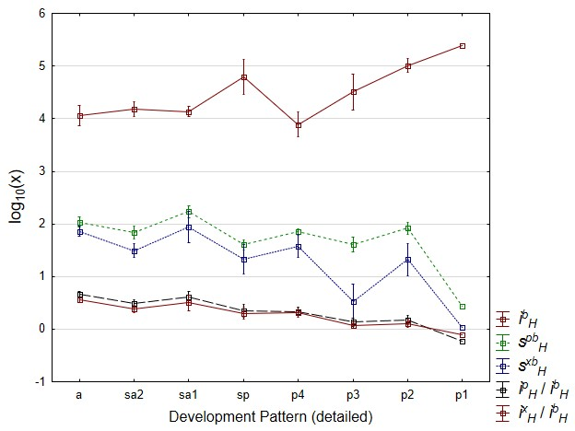
The altricial-precocial spectrum
μ^{b}_{H}
s^{pb}_{H}
s^{xb}_{H}
μ^{p}_{H} / μ^{b}_{H}
μ^{x}_{H} / μ^{b}
12/19

Slide 13
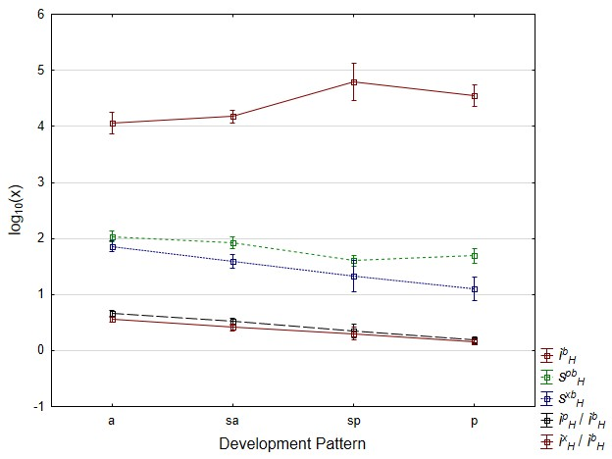
The altricial-precocial spectrum
y = 0,2084x + 3,8727 R² = 0,624
y = -0,1345x + 2,1527 R² = 0,7528
*
y = -0,2543x + 2,1075 R² = 0,9988
**
*
**
**
y = -0,16x + 0,826 R² = 0,9986
**
**
μ^{b}_{H}
s^{pb}_{H}
s^{xb}_{H}
μ^{p}_{H} / μ^{b}_{H}
μ^{x}_{H} / μ^{b}
y = -0,1312x + 0,683 R² = 0,9958
* p < 0.05
** p < 0.001
13/19

Slide 14
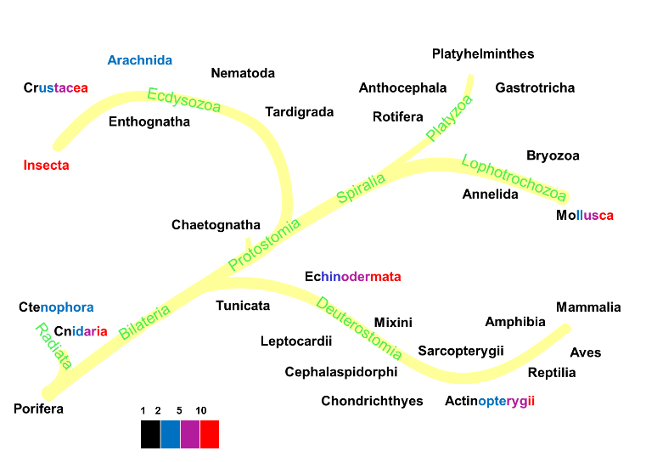
The altricial-precocial spectrum
N = 40 N = 134
altricial N = 11 altricial N = 11-46
semialtricial-2 N = 10 semialtricial N = 13-19
semialtricial-1 N = 3
semiprecocial N = 4 semiprecocial N = 4-19
precocial-4 N = 4 precocial N = 12-50
precocial-3 N = 3
precocial-2 N = 4
precocial-1 N = 1
14/19

Slide 15
The altricial-precocial spectrum
s^{pb}_{H}
s^{xb}_{H}
15/19

Slide 16
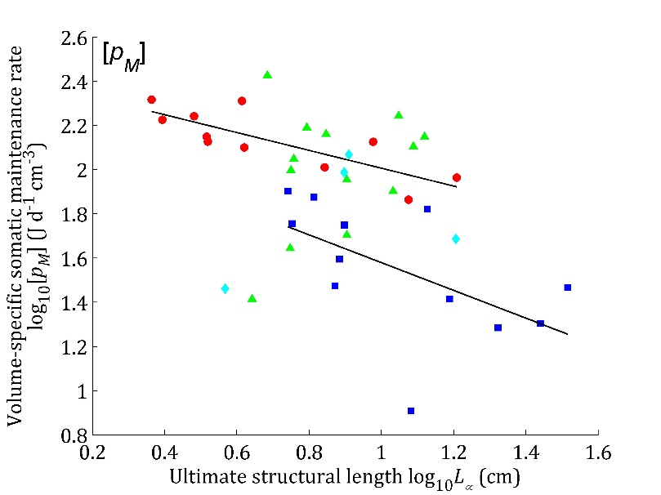
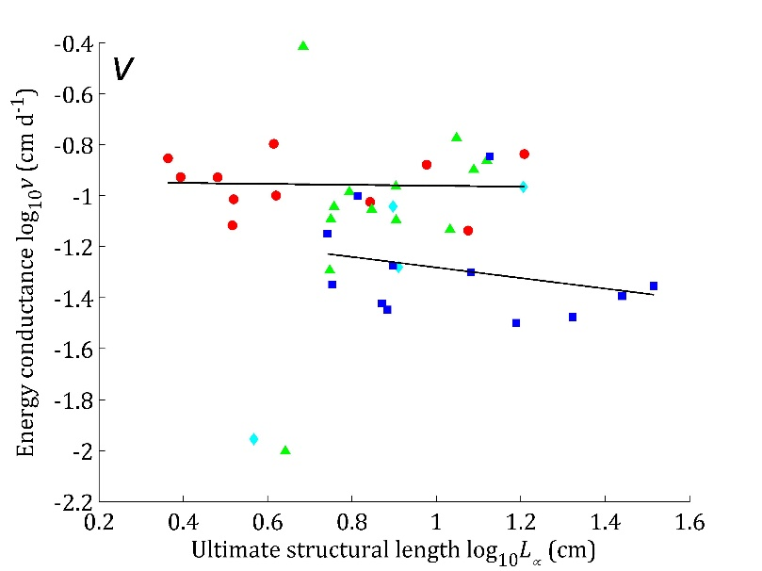
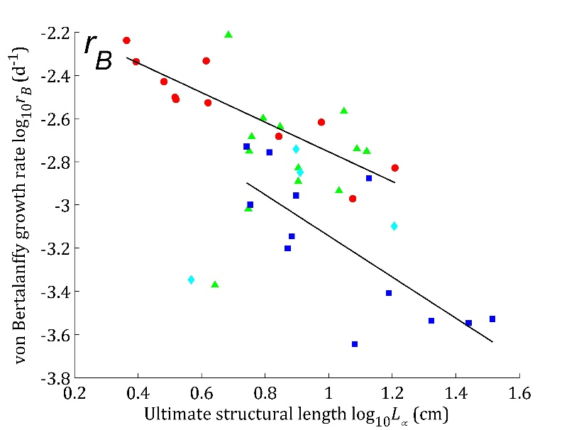
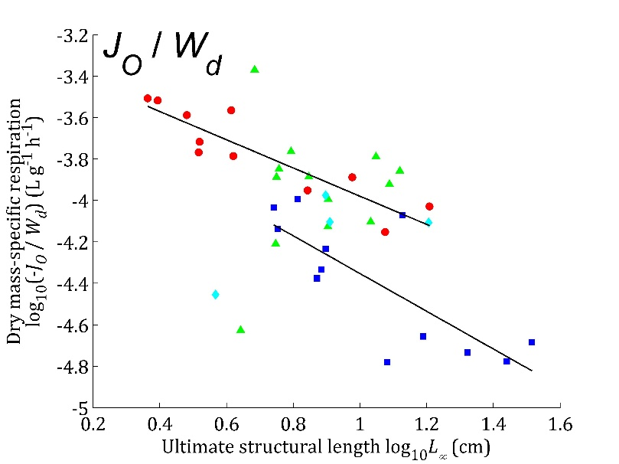
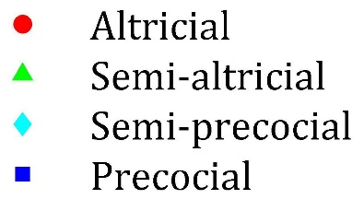
The altricial-precocial spectrum
F(1,22)=16.97, p < 0.001
F(1,22)=12.7, p < 0.05
y = -0.4034x + 2.4099 R² = 0.6658
y = -0.018x - 0.9428 R² = 0.0021
y = -0.207x - 1.0747 R² = 0.0769
y = -0.6278x + 2.2071 R² = 0.3241
F(1,22)=16.33, p < 0.001
F(1,22)=18.49, p < 0.001
y = -0.6855x - 2.0684 R² = 0.8043
y = -0.6813x - 3.2983 R² = 0.8178
y = -0.9525x - 2.191 R² = 0.5954
y = -0.911x - 3.4418 R² = 0.6228
16/19

Slide 17
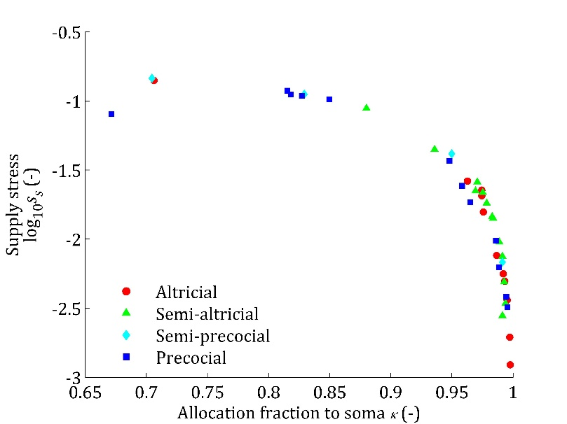
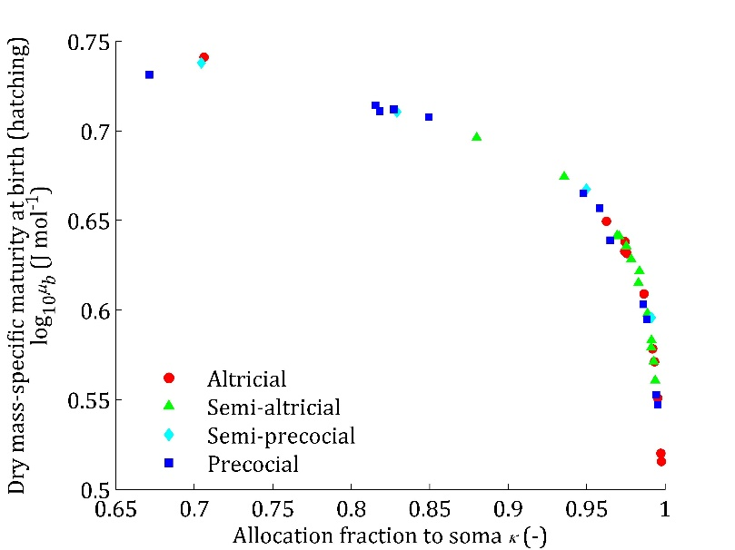
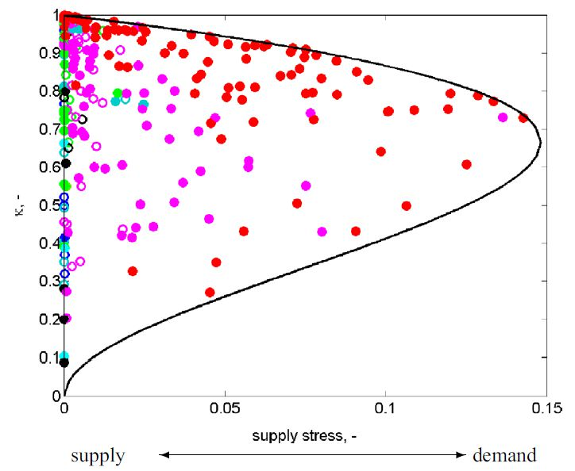
The altricial-precocial spectrum
- birds are generally closer to the demand end of the spectrum (food intake controlled by metabolic needs)
- but most altricial species are further away from that demand end (lower supply stress)
- if evolution in the Neognathae proceeded from early precociality towards altriciality with precociality then reemerging in many orders, advantages regarding parental care or flight abilities must be key
Lika et al., 2014
17/19

Slide 18
Conclusions
DEB theory provides quantitative estimations that allocate the species to the altricial-precocial spectrum in a continuous fashion;
DEB theory offers a perspective on internal, metabolic constraints that shape the altricial-precocial spectrum in birds, particularly through the balance between maturation and structural growth, with the κ rule taking central stage;
Partial support to Ricklef’s and others’ views on the influence of internal, physiological and metabolic constraints, on development and growth rates (but many environmental selective pressures may have acted and still be acting upon avian metabolic constraints);
Support for evolution towards precociality but future research on the advantages of avian altriciality in a rapidly-changing world
18/19

Slide 19
Thank you!
carlos.teixeira@tecnico.ulisboa.pt

