Slide 1
Relating sub-organismal processes that occur at the molecular and cellular level to dynamic energy budgets
Cheryl A. Murphy*and Roger M. Nisbet* *
* Michigan State University, USA
**University of California, Santa Barbara, USA
Thanks for support from:
US National Science Foundation and US Environmental Protection Agency (cooperative agreement to University of California Center for Environmental Implications of Nanotechnology)
US Environmental Protection Agency (STAR grants to RMN and CAM)
National Institute for Mathematical and Biological Synthesis (NIMBioS), Knoxville, Tennessee, USA

Slide 2
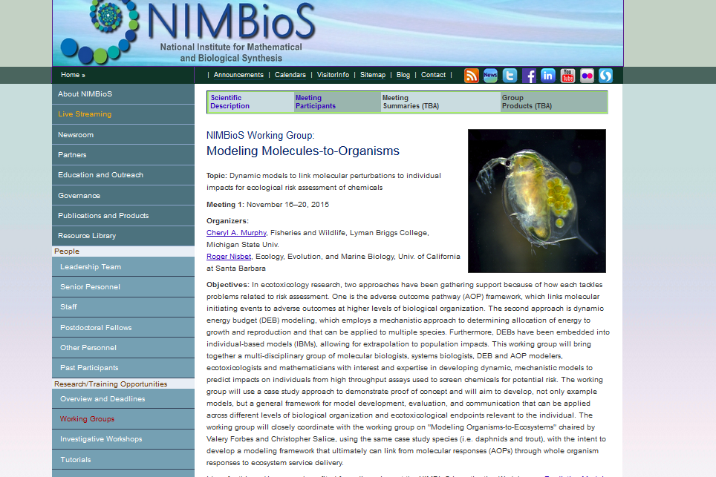

Slide 3
Molecules to Organisms Working Group Participants
Karen Watanabe
Arizona State University
Irv Schultz
National Oceanographic and Atmospheric Agency
Terry Mathews
Oak Ridge National Lab
Diane Nacci
US EPA
Natalia Garcia-Reyero
US Army Corps of Engineers
Philipp Antczak
Univ of Liverpool
Cheryl Murphy
Michigan State Univ
Roger Nisbet
Univ of California, SB
Erik Muller
Univ of California, SB
Dina Lika
Univ of Crete, Greece
Andre Gergs
gaiac,
Germany
Angie Peace
Texas Tech Univ
Chris Remien
Univ of Idaho
Organizers
Physiological
modelers
DEB modelers
Toxicant dynamics
Biological response
Systems Biology
genomics
mathematicians
Notes:
Different people with different backgrounds are involved

Slide 4
Ecological risk assessment (ERA)
ERA involves predicting effects of exposure on populations, communities and ecosystems.
BUT
Toxicity evaluations increasingly use Alternative Testing Strategies (ATS) that rely on in vitro assays
DISCONNECT BETWEEN DATA AND PROTECTION TARGETS
Our approach uses process-based, dynamic models of exposure and response to exposure to predict “step-by-step” up and down levels of organization.

Slide 5
Why predictive toxicology across levels of organization is hard
Feedbacks
Physiology: e.g. regulatory processes within and among cells and organs
Physico-chemical environment: e.g. excretion products may impact toxicity
Ecological interactions: e.g. resource limitation, mutualism
Adaptation: e.g. evolutionary rescue
Emergent properties
Found at every link between levels of organization, e.g. tipping points
NEED NON-LINEAR MATHEMATICAL/COMPUTATIONAL MODELS

Slide 6
Existing models
????
Ecosystem services
Community structure changes
DEB
Matrix, IBM
Population dynamics
TK-TD
Organism responses
Physiological responses
qAOP models
Cellular responses
Macro-Molecular interactions

Slide 7
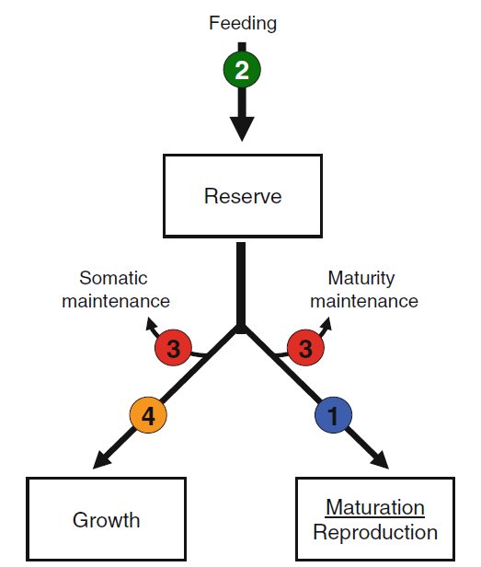
Ecosystem services
WG: Organisms to Ecosystems
Community structure changes
Population dynamics
Organism responses
WG: Molecules to Organisms
Physiological responses
Cellular responses
Macro-Molecular interactions
Find mathematical and computational methods to
scale information collected at different levels of
biological organization

Slide 8
Quantitative schemes to link suborganismal and organismal dynamics
Dynamic Energy Budget (DEB) modeling. A top-down approach that “reverse engineers” a minimal modular representation of energy and material acquisition and utilization by a complete organism.
Quantitative Adverse Outcome Pathway (qAOP). A “bottom-up” approach that describes “the linkage between a direct molecular initiating event and an adverse outcome at a biological level of organization relevant to risk assessment” (Ankley et al. 2010).
Both approaches are “shortcuts” (Jager 2016)
Neither approach is chemical or organism specific, but both have “fuzziness”.

Slide 9
AOP Components
Macro-
Molecular
Interactions
Organ
Responses
Individual
Responses
Population
Responses
Toxicant
Cellular
Responses
Receptor/Ligand Interaction
DNA Binding
Protein Oxidation
Gene Activation
Protein production
Altered Signaling
Protein Depletion
Altered Physiology
Disrupted Homeostasis
Altered Tissue
Development or Function
Lethality
Impaired Development
Impaired Reproduction
Cancer
Behavior
Structure
Recruitment
Extinction
Chemical
Properties
MIE
KE
AO
MIE - molecular initiating event
KE - key events
AO - adverse outcome
MIE → KEs connection commonly rigorous
KE → AO connection fuzzy (often non-quantitative)
Modified from Ankley et al 2010

Slide 10
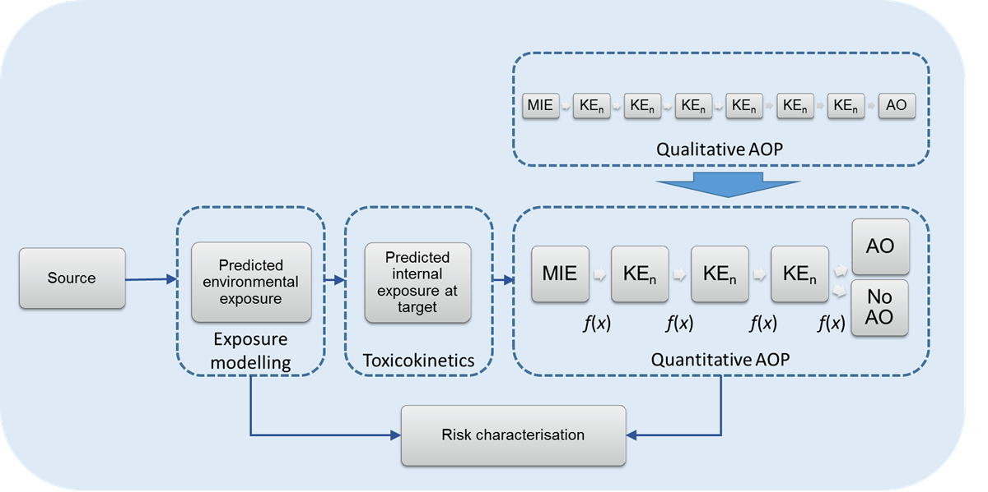
Quantitative AOPS (qAOPs)
2017 Pellston Workshop *
Bayesian Network Models
Regression Models
Ordinary Differential Equation Models
Agent or Individual-based Models
Combination
DEB!
* Perkins et al , “Building and Applying Quantitative Adverse Outcome Pathway Models for Hazard and Risk Assessment ” ET&C in prep

Slide 11
Dynamic Energy Budget Models in Ecotoxicology
Dynamic energy budget (DEB) models describe the assimilation and utilization of energy and elemental matter by living organisms
Toxicants may enter organism directly from environment or via food – represented by toxicokinetic (TK) model.
Toxicants impact one or more energy and material flows (MoA) – represented by toxicodynamic (TD) model.
Link to population dynamics using individual-based population models (DEB-IBM: Martin et al. 2012) or other methods
Link to ecosystem processes in principle but underdeveloped

Slide 12
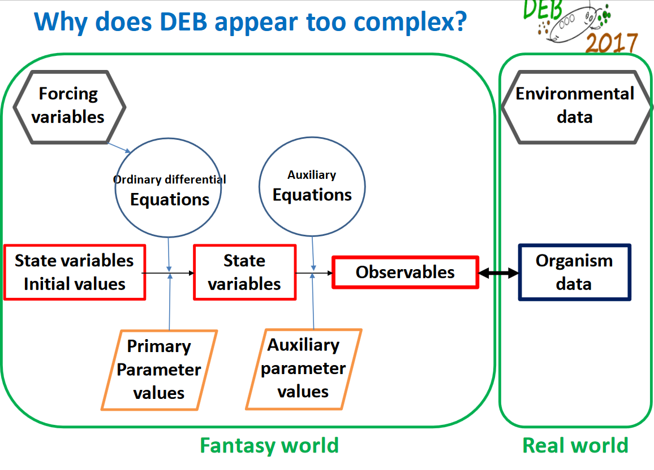

Slide 13
KE (M )
KE (C)
KE (O)
Adverse Outcome
Brain
AOPs describe Key Events (KE) at 3 levels:
Molecular (M)
Cellular (C)
Organ (O)
KE (M )
KE (C)
KE (O)
Adverse Outcome
Liver
KE (M )
KE (C)
KE (O)
Adverse Outcome
Gonad
Key Event Network
“Damage”

Slide 14
Conceptual model linking AOP and DEB approaches
Connect AOP Key Events with Physiological Modes of Action in energy flow diagram
Resource
Feeding/Assimilation
Reserve
Key Event Network
“Damage”
Reserve mobilization
Partitioning
Maturity or Reproduction
Structure
Link to AOP
DEB model
Murphy et al., in press

Slide 15
Mathematical framework
Murphy et al., in press

Slide 16
Case studies linking AOP and DEB approaches
Case study I: Effect of endocrine disruptors in trout
Aims to link molecular processes (signaling and biosynthesis) at organ level to DEB dynamics
Case study II: Effect of coal ash and food on Daphnia
Aims to link transcriptomic information to DEB processes

Slide 17
Case study I: Organ level processes and DEB
Mechanistic ODE model to DEB relationships using “physiological” damage variables
Case study on endocrine disruptors on fish
Ongoing research led by Erik Muller (UCSB)

Slide 18
Quantitative AOPs: Physiological Model*
Relate physiological biomarkers to number of viable oocytes
using ordinary differential equations
Gonadotropin
pituitary
Estradiol
Estrogen receptor
liver
Testosterone
ovary
Vitellogenin
Viable
Oocytes
* Murphy et al, 2005
Notes:
Physiological model, models the internal mechanisms of a fish. Many biomarkers are measured to determine if any of these components are working correctly. Why do we need a physiological model? Well, each EDC can have a different effect. For example, some may act on just the organs (pituitary, ovary, liver), some may act on the messenger, or some may disrupt the production of proteins like vitellogenin which are critical to production of eggs. If we can model these mechanisms, we may be able to predict how an EDC will affect the production of viable oocytes.

Slide 19
Gonadotropin
(driving)
pituitary
Synthesis T (GtH)
SBP
SBP
k₁
k₁
Estradiol
(x2)
Testosterone
(x1)
k₋₁
Synthesis E2 (T)
k₋₁
(x3)
ovary
(x3)
k₁
k₋₁
k₁
Estradiol
k₋₁
(x7)
Estrogen Receptor
k₂
Estrogen Receptor (x6)
liver
k₂
Vitellogenin
(x8)
blood

Slide 20
Laboratory Studies of Hypoxia Exposure
14
14
Gonadotropin
(ng/mL)
12
12
10
Testosterone
(ng/mL)
8
10
6
8
4
6
2
4
0
2
Control
2.7 ppm
1.7 ppm
0
Control
2.7 ppm
1.7 ppm
8
100
Estradiol (ng/mL)
*
80
6
*
*
60
4
*
Relative ERmRNA
2
40
20
0
Control
2.7 ppm
1.7 ppm
0
Control
2.7 ppm
1.7 ppm
200
20
Fecundity
(1000 eggs/fish)
160
*
GSI
15
*
120
10
80
*
40
5
0
Control
2.7 ppm
1.7 ppm
0
Control
2.7 ppm
1.7 ppm
Treatment
Treatment
Thomas et al, 2005

Slide 21
Hypoxia Simulation
Lab~ 62% decrease
fecundity
Lab~ 67 % decrease
ER mRNA
200
6
150
Baseline
Vitellogenin (mg/mL)
4
73%
GtH
Estrogen receptor (pmol/g)
100
61%
50
2
GtH + aromatase
0
0
1
2
3
4
5
6
1
2
3
4
5
6
2000
2000
Lab~ 59% decrease
1500
1500
Total Testosterone (pg/mL)
No change
Total Estradiol (pg/mL)
1000
1000
59%
500
500
0
0
1
2
3
4
5
6
1
2
3
4
5
6
Time (months)
Time (months)
Murphy et al 2009

Slide 22
Case Study II: Correlative connections from molecules to DEB: “-omic” damage variables
Case study on effects of coal ash on Daphnia

Slide 23
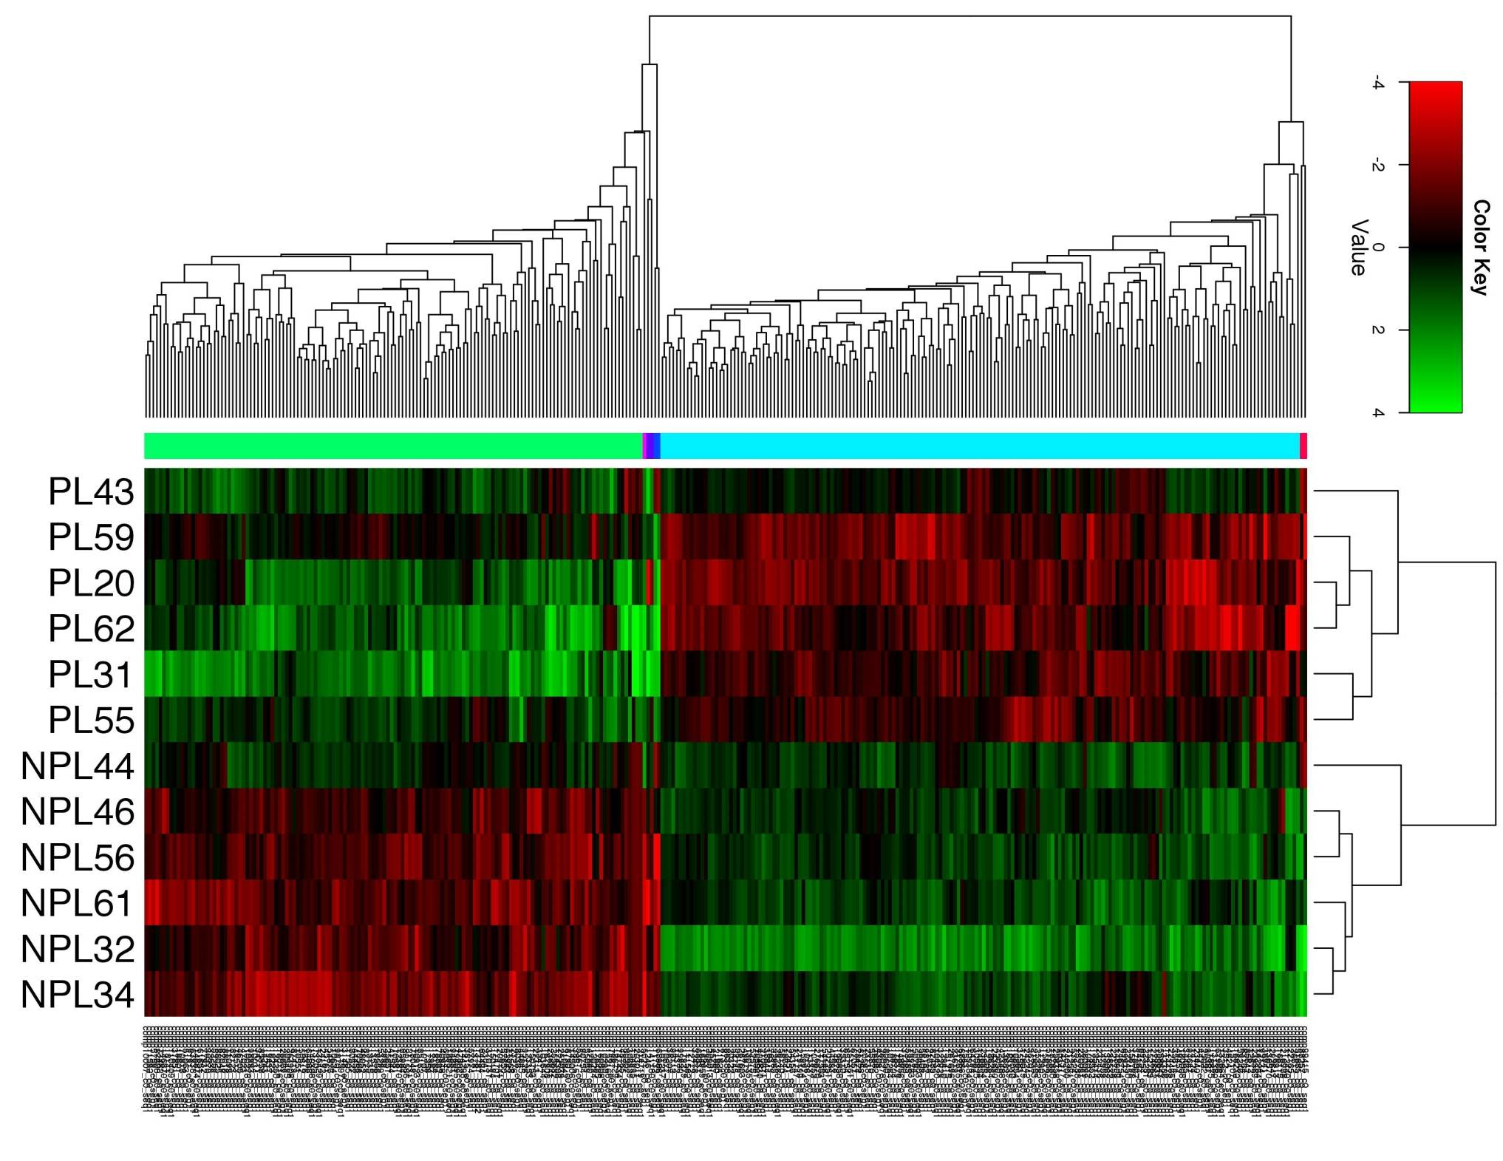
Gene expression data

Slide 24
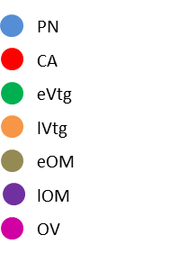
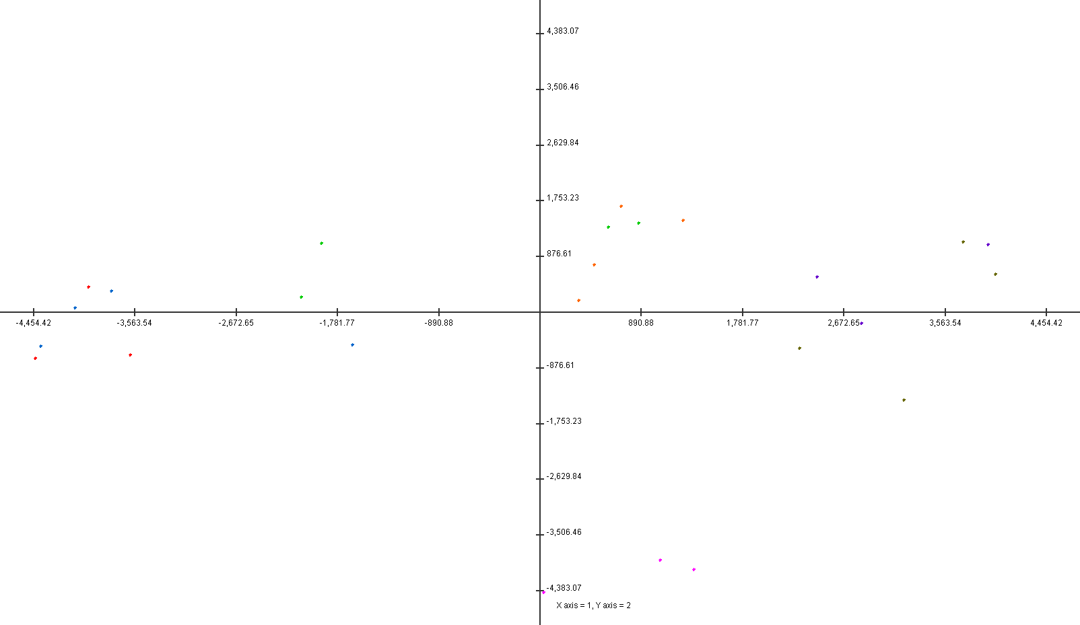
Principal components analysis of gene expression data
Vtg
OM
PN CA
PC1
Vitellogenin (Vtg), estradiol (E2) and Gonadosomatic index (GSI) measurments were taken at the sampling time.
PC2
OV
Martyniuk et al. (2013) PLoS ONE 8(3). doi:10.1371/journal.pone.0059093
Notes:
Adult female of Largemouth Bass (LMB) were collected from St. John’s River in Florida a site known to be relatively free from pollutants.
Ovaries were sampled, fixed and categorized into seven ovarian stages depending on histology.
At the sampling time three different measurements were taken: Vitellogenin (Vtg), estradiol (E2) and Gonadosomatic index (GSI)
Vitellogenin is the egg yolk precursor protein while GSI is an index used to know the maturation stage of a fish
Then, a transcriptomics analysis using Microarray technology was carry out.
The PCA was performed on the whole set of genes coming from both the Time-course and the Multiclass sam approach to look for samples distribution and possible outliers. As you can see there is a clear progress from the first stage of development to the last one.

Slide 25
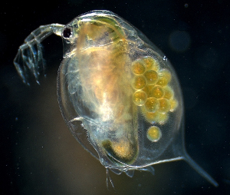
Experiment with Daphnia - led by Teresa Mathews (ORNL)
KE(M) → DEB rates
(molecules → DEB parameters)
Daphnia as model organism
  Designed an experiment to statistically link gene expression to DEB modes of action
  Experiments completed late summer 2016
Daphnia growth and reproduction – Paul Pickhardt and undergrads at Lakeland University, WI
Metals analyses – Teresa Mathews (ORNL)
Gene expression (RNASeq) - Natalia Reyero (ERDC Vicksburg)
Data analyses Phillip Antczak, Liverpool
DEB Modeling – Nisbet group, UCSB; Andre Gergs, gaiac

Slide 26
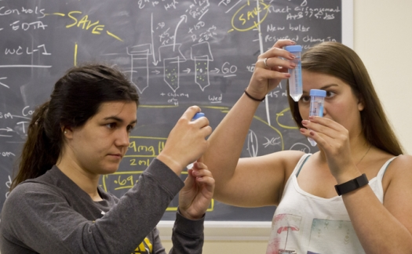
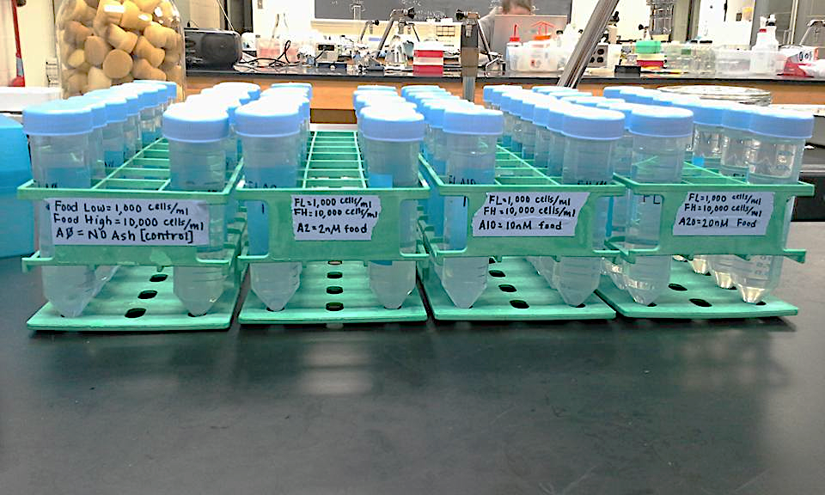
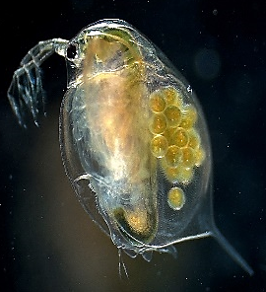
Study Design
Exposed Daphnia for 30 d to different food rations and different ash exposures
Food exposures; Chlamy exposed to varying ash concentrations (low, medium, high)
Total offspring, clutch size, first clutch release, individual brood mother lengths, metal concentration
Four individuals/treatment were sacrificed for gene expression at seven intervals corresponding to different stages in molt cycle
Madison Hull & Brooke Wilder Corrigan

Slide 27
AOP-DEB Regulatory applicability
2017 Pellston workshop*
Guide early toxicity testing before chemicals are on the market
Inform testing strategies
Cross-species extrapolations
Study design for site specific ecological risk assessments
NIMBioS working groups’ ultimate objective:
Use DEB to make tight connections to ecological models currently used in regulation and management (e.g. Aquatox and Instream)
* Coady et al, “Using Adverse Outcome Pathways to Inform Decision Making For Chemical Innovation, Regulation & Stewardship” ET&C in prep

Slide 28
AOP-DEB Regulatory applicability
2017 Pellston workshop*
Guide early toxicity testing before chemicals are on the market
Inform testing strategies
Cross-species extrapolations
Study design for site specific ecological risk assessments
NIMBioS working groups’ objective:
Use DEB to make tight connections to ecological models currently used in regulation and management (e.g. Aquatox and Instream)
* Coady et al, “Using Adverse Outcome Pathways to Inform Decision Making For Chemical Innovation, Regulation & Stewardship” ET&C in prep

