Slide 1




Damage-related protein turnover explains inter-specific patterns of maintenance rate in the DEB theory.
Olivier Maury, Olivier Aumont, Jean-Christophe Poggiale

Slide 2
Empirical patterns of maintenance
Protein turnover & aerobic metabolism
Intra- and inter-specific scaling of maintenance
Impacts on the DEB theory?
Conclusion
What is somatic maintenance
Somatic maintenance = energy used to maintain the structure in a viable state.
Costs not associated to the production of biomass (growth & reprod.) or to development (maturation):
  removing and replacing damaged proteins (turnover = 70-90% of maintenance costs),
  maintaining chemical & electrical gradients through cellular membranes,
  forming products (scales, hair, nails, etc),
  maintaining muscular tonicity,
  circulating body fluids (blood, lymph, etc), moving,
  etc…
  Somatic maintenance rate can either be proportional
    to structural volume
    to structural surface

Slide 3
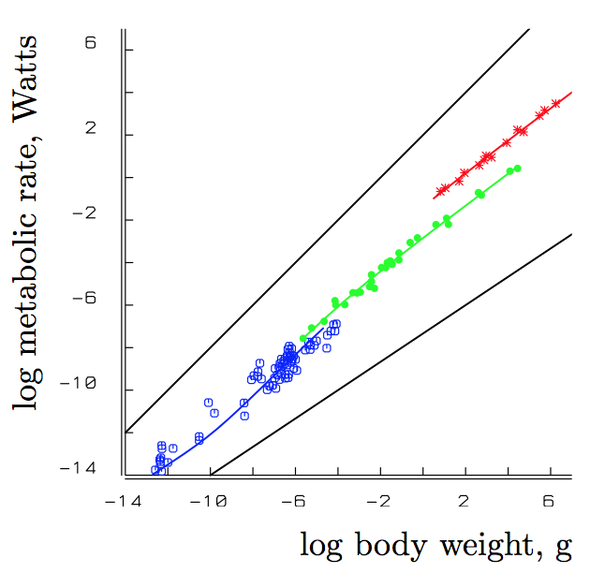
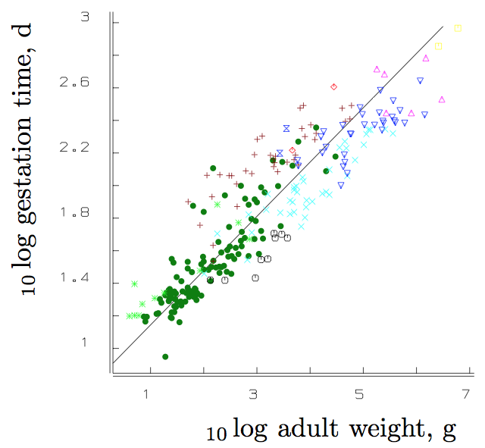
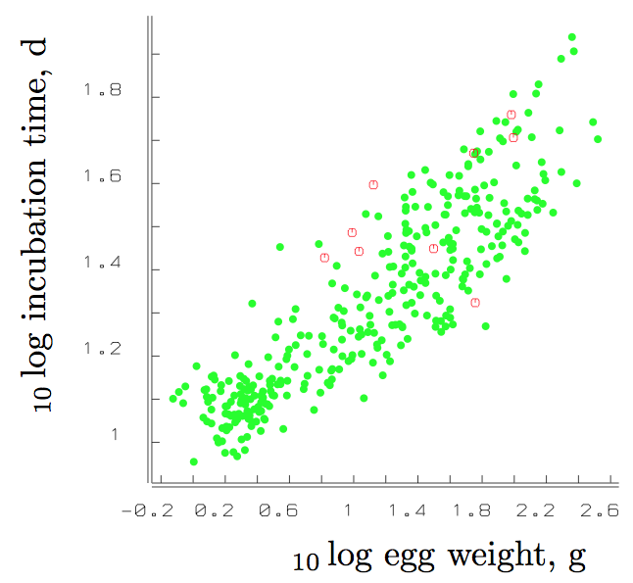
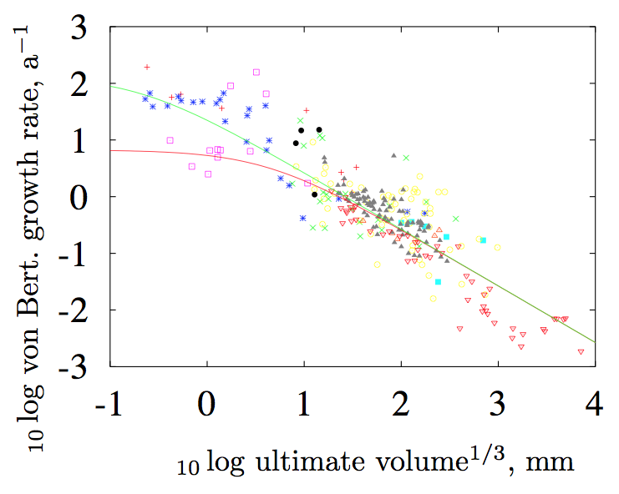
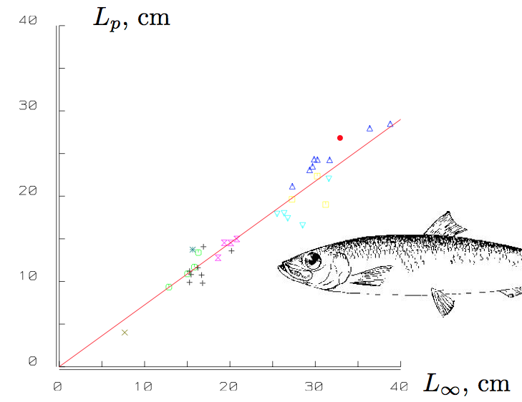
Empirical patterns of maintenance
Protein turnover & aerobic metabolism
Intra- and inter-specific scaling of maintenance
Impacts on the DEB theory?
Conclusion
Interspecific body-size scaling relationships
Somatic maintenance = similar metabolic processes between species → intensive parameter
  Inter-specific body-size scaling relationships (Kooijman, 2010)
Respiration rate
Gestation time
(eutherian mammals)
Incubation time
(birds)
Growth rate
Length at puberty
(fish)

Slide 4
Empirical patterns of maintenance
Protein turnover & aerobic metabolism
Intra- and inter-specific scaling of maintenance
Impacts on the DEB theory?
Conclusion
Trait-based approaches
An infinite number of species can be represented using the same DEB parameters
Maury & Poggiale, 2013

Slide 5
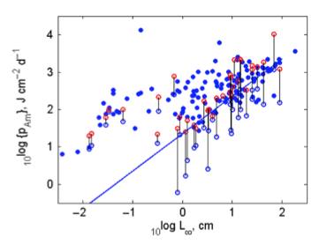
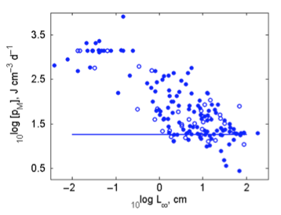
Empirical patterns of maintenance
Protein turnover & aerobic metabolism
Intra- and inter-specific scaling of maintenance
Impacts on the DEB theory?
Conclusion
“Waste to hurry” paper (Kooijman, 2013)
Are inter-specific scaling rules verified in the add-my-pet collection (2013, 165 species)?
Kooijman, 2013
varies over more than 3 orders of magnitude from 3 to 8000 J.d-1.cm-3 at 20°C.
It exhibits both a trend and huge variability around this trend.
varies logically in the inverse proportion

Slide 6
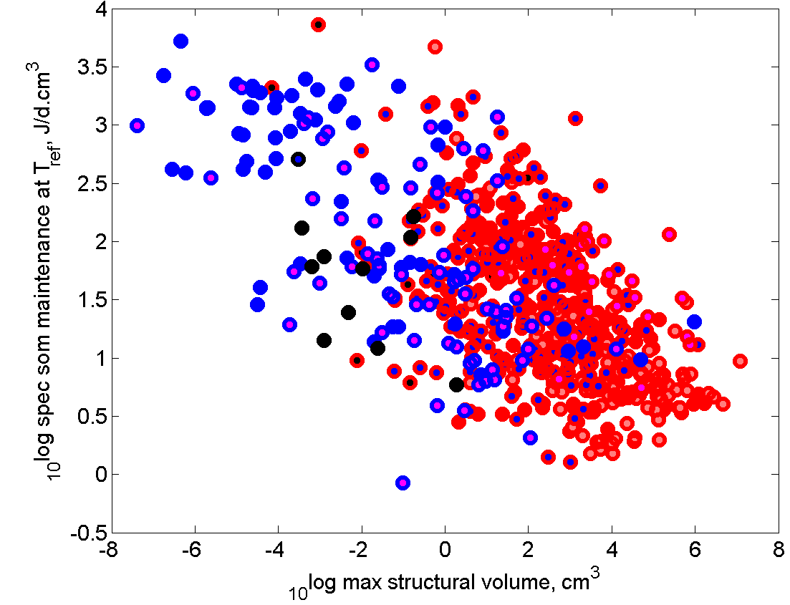
Empirical patterns of maintenance
Protein turnover & aerobic metabolism
Intra- and inter-specific scaling of maintenance
Impacts on the DEB theory?
Conclusion
“Waste to hurry” paper (Kooijman, 2013)
More recent addmypet estimates confirm the trends of somatic maintenance
303 species
685 species
http://www.bio.vu.nl/thb/deb/deblab/add_my_pet/patterns.html
Small species have a high and large species have a low somatic maintenance rate:
Species waste resources for remaining small, growing fast, and speed-up the life-cycle
Respond rapidly to environmental variability = evolutionary argument
Phenomenological, no clear mechanism for explaining the generality of the pattern observed
Can we find a mechanistic process that would explain dispersion & trend of estimated maintenance?

Slide 7
Empirical patterns of maintenance
Protein turnover & aerobic metabolism
Intra- and inter-specific scaling of maintenance
Impacts on the DEB theory?
Conclusion
A simple physiological mechanism to explain the patterns of maintenance
protein turnover rate & cell repair constitute the most important component of maintenance,
Damaged
protein removal
Heating
costs
FOOD
Structural
maintenance
ingestion
κ
V
D
GUT
E
1-κ
E_{H}/E_{R}
Embryo
egestion
Maturity
maintenance
FECES

Slide 8
Empirical patterns of maintenance
Protein turnover & aerobic metabolism
Intra- and inter-specific scaling of maintenance
Impacts on the DEB theory?
Conclusion
Mass balance
Damaged
protein removal
Heating
costs
Structural
maintenance
V
D
E

Slide 9
Empirical patterns of maintenance
Protein turnover & aerobic metabolism
Intra- and inter-specific scaling of maintenance
Impacts on the DEB theory?
Conclusion
Protein turnover is linked to aerobic metabolism
Mass balance equation:
Aerobic organisms oxidize organic molecules to produce ATP → reactive oxygen species (ROS)
ROS oxidize amino acids in proteins → protein damage rate proportional to aerobic metabolism (cf. ageing).
O (cm³.J⁻¹) volume of structural proteins damaged by one joule spent in aerobic metabolism.
Degrading damaged structural proteins has a cost
(J.cm⁻³) cost of removing a fixed volume of damaged structure
With
The fraction of aerobic metabolism allocated to protein turnover.

Slide 10
Empirical patterns of maintenance
Protein turnover & aerobic metabolism
Intra- and inter-specific scaling of maintenance
Impacts on the DEB theory?
Conclusion
The maintenance rate varies with both L and L_{m}
The total volume-specific maintenance rate varies at the intraspecific level with V
The total volume-specific maintenance rate varies at the interspecific level with V_{m}
L_{m}=0.02cm
L_{m}=0.2cm
L_{m}=2cm
L_{m}=20cm
L_{m}=200cm
If you want to waste and hurry: be small, have a small V_{b}, and die long before reaching V_{m}

Slide 11
Empirical patterns of maintenance
Protein turnover & aerobic metabolism
Intra- and inter-specific scaling of maintenance
Impacts on the DEB theory?
Conclusion
Addmypet maintenance estimates distribute in the expected interval
We can plot expected highest (at V_{b}) and lowest (at V_{m}) maintenance curves
L_{b} fixed arbitrarily at 4.10⁻³ L_{m}
V_{b}
V_{m}
Addmypet estimate fall somewhere in between min and max values
They would correspond to an average value for the range of sizes used for estimation

Slide 12
Empirical patterns of maintenance
Protein turnover & aerobic metabolism
Intra- and inter-specific scaling of maintenance
Impacts on the DEB theory?
Conclusion
Influence of the scaling of the maximum reserve energy density [E_{m}]

Slide 13
Empirical patterns of maintenance
Protein turnover & aerobic metabolism
Intra- and inter-specific scaling of maintenance
Impacts on the DEB theory?
Conclusion
Does it change the DEB theory?
Growth at constant food keeps Von Bertalanffy
ρ = 0
ρ = 0.1
ρ = 0.2
ρ = 0.3
ρ = 0.4
ρ = 0.5
ρ = 0.6
ρ = 0.7
Reproductive flux keeps the same as well
ρ = 0
ρ = 0.1
ρ = 0.2
ρ = 0.3
ρ = 0.7

Slide 14
Empirical patterns of maintenance
Protein turnover & aerobic metabolism
Intra- and inter-specific scaling of maintenance
Impacts on the DEB theory?
Conclusion
Conclusion
Empirical patterns of maintenance in addmypet invalidate DEB interspecific scaling rules.
We propose a simple mechanism to explain empirical inter-specific scaling of maintenance.
  Making protein turnover explicit in maintenance.
  Linking protein damage rate to aerobic metabolism.
  It would restore inter-specific scaling rules in the DEB theory.
  It would explain a (large?) part of the inter-specific variability of estimated maintenance.
  It provides a simple mechanism to the “waste to hurry” evolutionary hypotheses.
  Inter-specific patterns in addmypet suggest modifications of the standard DEB equations at the individual level → strengthening the consistency of the theory.
  Adding one extra mechanistic parameter is more parsimonious than re-estimating it for every species.
  Parameter estimation for selected species should be conducted with modified DEB equations to test our proposition.

