Slide 1



Dynamics of lipid storage in marine copepods and its consequences for effects of oil pollution
Tjalling Jager & Bjørn Henrik Hansen
DEB symposium, May/June 2017

Slide 2
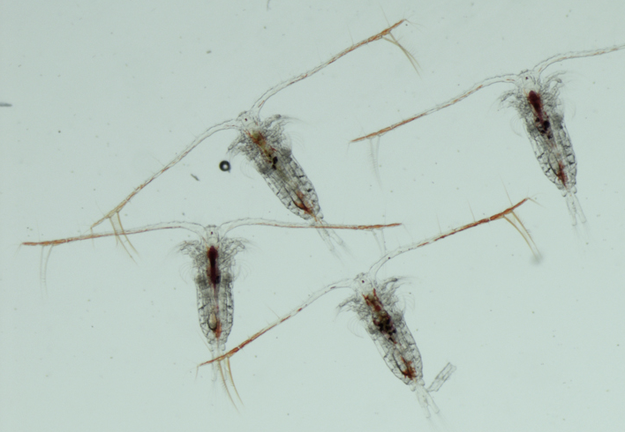
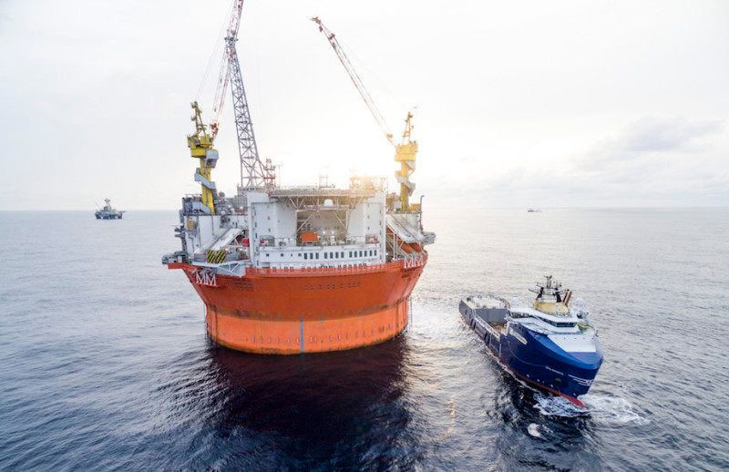
Context
EnergyBar project (RCN-funded)
Effects of produced water on copepods
Tools for ERA offshore petroleum activities
Calanus finmarchicus

Slide 3
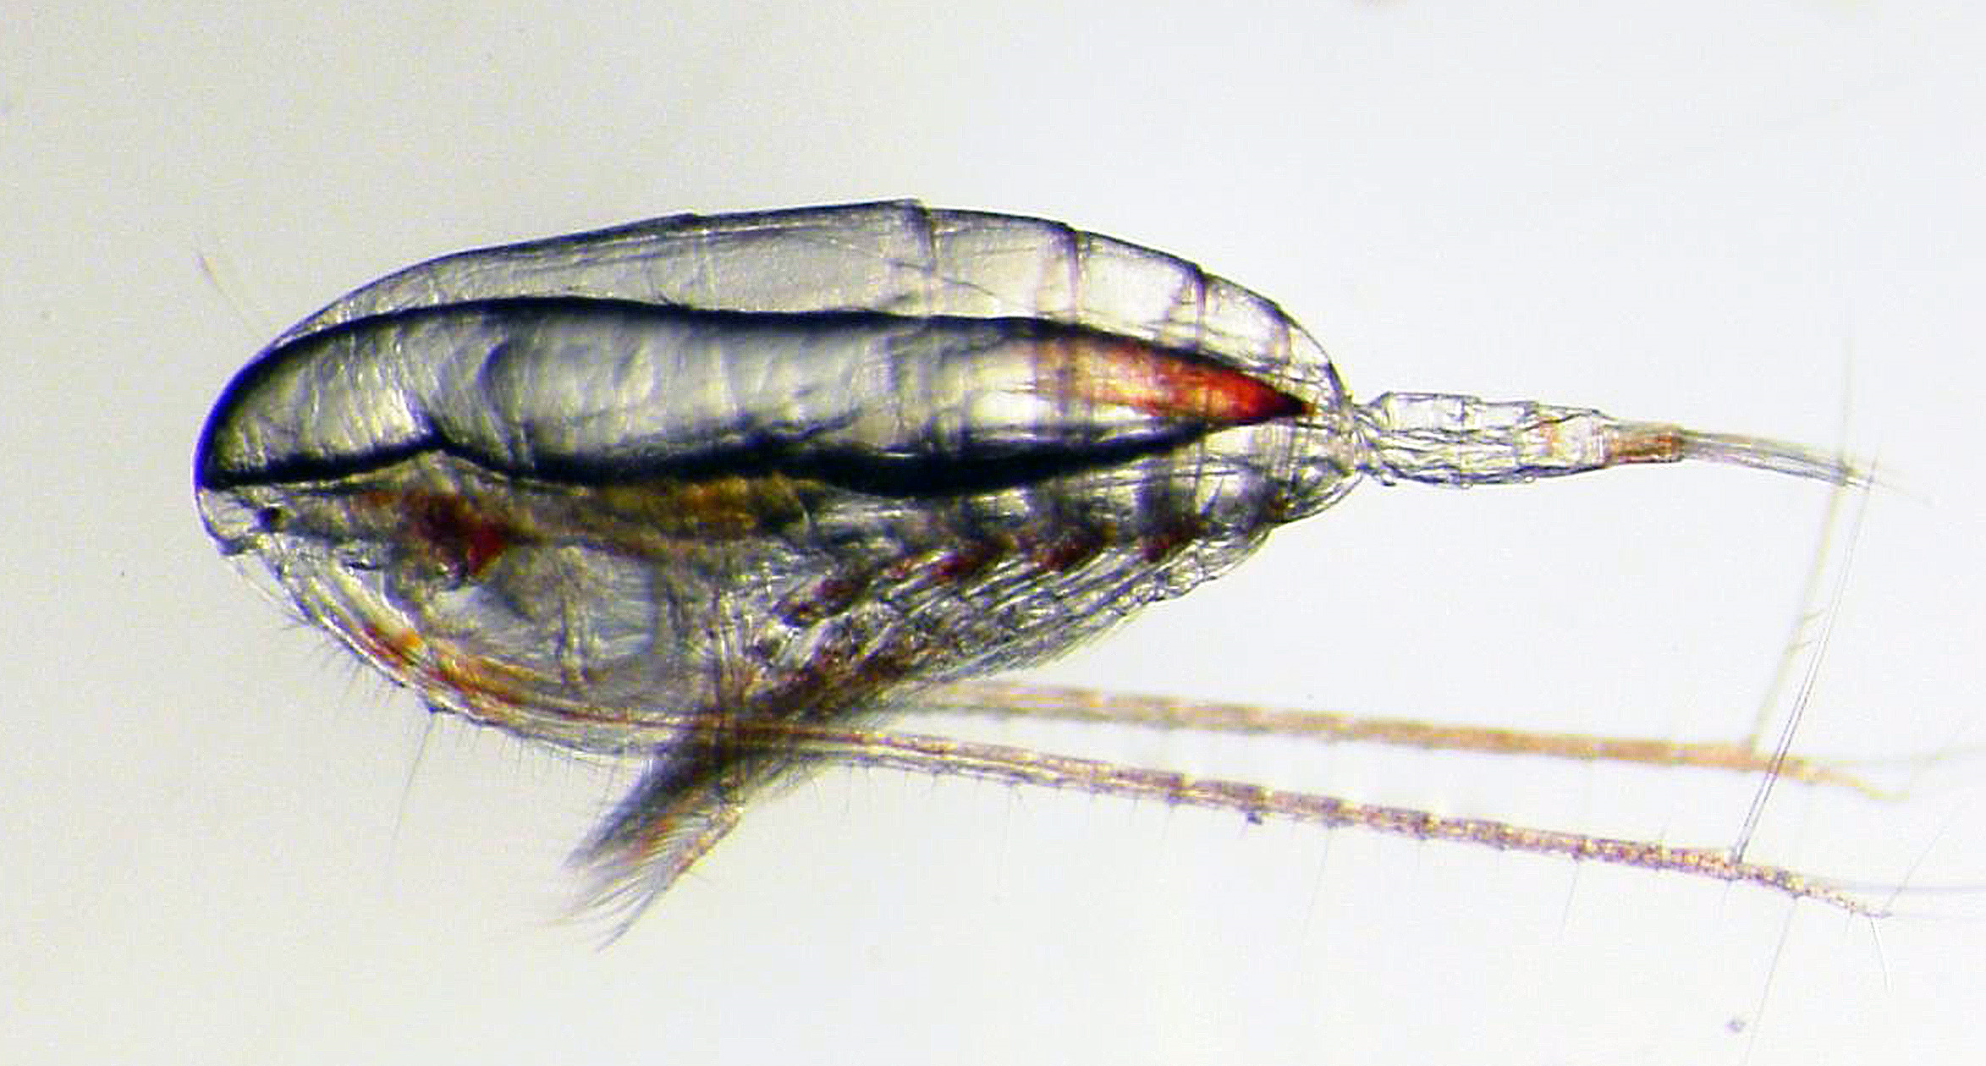
Context
Focus on lipid storage
Capture its dynamics in a DEB context?
Effects on accumulation/toxicity of chemicals?

Slide 4
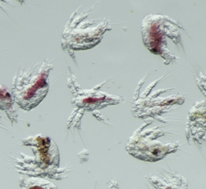
Calanus life cycle
acceleration
birth
metamorphosis
adulthood
egg N1 N2 N3 N4 N5 N6 C1 C2 C3 C4 C5 C6
non-feeding embryo/nauplius
feeding nauplius
copepodite
adult
Acceleration of growth after metamorphosis
Abrupt stop of growth after final moult

Slide 5
Calanus life cycle
acceleration
birth
metamorphosis
puberty
adulthood
egg N1 N2 N3 N4 N5 N6 C1 C2 C3 C4 C5 C6
non-feeding embryo/nauplius
feeding nauplius
copepodite
adult
lipid build-up
Lipids clearly visible from C3 onwards:
  increases over C3-C5
  decrease in adults
treat as ‘reproduction buffer’

Slide 6
Calanus life cycle
birth
acceleration/puberty
adulthood
egg N1 N2 N3 N4 N5 N6 C1 C2 C3 C4 C5 C6
non-feeding embryo/nauplius
feeding nauplius
copepodite
adult
lipid build-up
Model design:
  use one switch for acceleration and puberty
  depart from reserveless model (‘DEBkiss’)
  treat lipid storage as reproduction buffer
  different scheme for adults (no kappa rule)
  stop growth at size limit
Jager et al (2017), Mar Biol

Slide 7
Model fit (data Campbell et al, 2001)
structure
structure+storage
temperatures
food levels
Jager et al (2017), Mar Biol

Slide 8
We’re not there yet …
Open issues:
  maintenance estimated from respiration
  effect temperature/food on final size descriptive
  high maturity maintenance to capture food limitation
  energetics of gonad maturation requires attention
  rules for allocation to eggs unclear

Slide 9
We’re not there yet …
Open issues:
  maintenance estimated from respiration
  effect temperature/food on final size descriptive
  high maturity maintenance to capture food limitation
  energetics of gonad maturation requires attention
  rules for allocation to eggs unclear

Slide 10
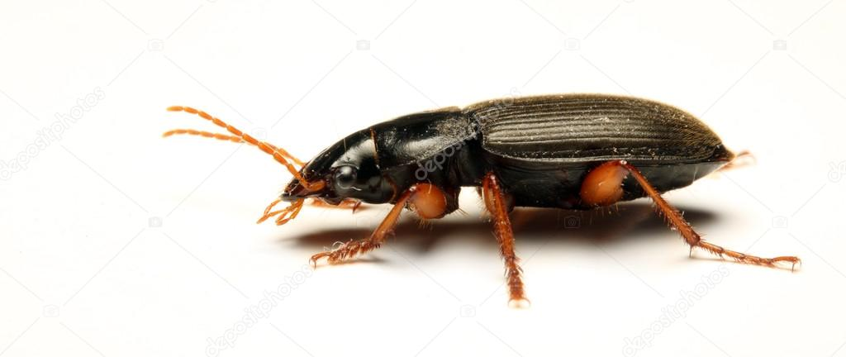
We’re not there yet …
Open issues:
  maintenance estimated from respiration
  effect temperature/food on final size descriptive
  high maturity maintenance to capture food limitation
  energetics of gonad maturation requires attention
  rules for allocation to eggs unclear

Slide 11
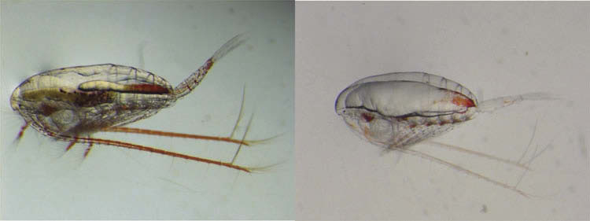
Lipids and toxicants
Hydrophobic chemicals high affinity for wax esters
Effect lipid on uptake/elimination and toxicity?
  focus on survival (GUTS-SD or DEBtox-survival)
lipid poor
lipid rich

Slide 12
Lipids and toxicants
Can lipids explain differences between experiments?
1
lipid rich
0.8
0.6
fraction surviving
0.4
lipid poor
0.2
CD
MD
0
2
3
10
10
external concentration (THC, µg/L)
Hansen et al (2016), JTEH

Slide 13
Lipids and toxicants
Can lipids explain differences between experiments?
‘Survival of the fattest’ (Lassiter & Hallam, 1990):
  two compartments to represent individual
  assume fast internal redistribution
Hansen et al (2016), JTEH

Slide 14
Lipids and toxicants
Can lipids explain differences between experiments?
‘Survival of the fattest’ (Lassiter & Hallam, 1990):
  two compartments to represent individual
  assume fast internal redistribution
  fatter individuals take longer to reach steady state
increasing lipid content
however, in this case …
insufficient difference in lipid content
no shift in lipid content survivors over treatments
Hansen et al (2016), JTEH

Slide 15
Case: dimethylnaphthalene
Survival and body residues over time
  do not assume that lipids are fast
  mortality linked to concentration in ‘structure’
  submitted: Jager et al …

Slide 16
Case: dimethylnaphthalene
Survival and body residues over time
  do not assume that lipids are fast
  mortality linked to concentration in ‘structure’
  lipids are very slow …
0 µM
1.03 µM
1
)
1.97 µM
g
4.83 µM
k
3000
/
l
10.3 µM
y
0.8
o
t
m
29.3 µM
i
l
µ
i
2500
b
(
1.2 µM
a
l
b
a
o
0.6
t
2000
r
o
p
t
,
l
.
a
c
1500
v
0.4
n
i
o
v
c
r
l
u
a
1000
s
n
0.2
r
e
t
500
n
i
0
0
2
4
6
0
2
4
6
8
time (days)
time (days)
  submitted: Jager et al …

Slide 17
Case: dimethylnaphthalene
Simulate effect of different lipid content
total body
structure
internal concentration
internal concentration
time
time
  submitted: Jager et al …

Slide 18
Case: dimethylnaphthalene
Simulate effect of different lipid content
Limited effect on toxicity
toxicity
structure
15
10
LC50 (µM)
internal concentration
5
0
0
2
4
6
8
10
time
time (days)
  submitted: Jager et al …

Slide 19
Difference toxicity life stages
No effect lipid content … but several stages differ …
  Jager et al (2016) ETC

Slide 20
Conclusions
Lipids play important role in life cycle and toxicity
  storage dynamics like ‘repro buffer’
  lipids affect toxicokinetics, limited effect on toxicity
  differences in sensitivity not explained by lipids …
  maternal transfer and secondary poisoning?

Slide 21
Conclusions
Lipids play important role in life cycle and toxicity
  lipid storage functions like ‘repro buffer’
  lipids affect toxicokinetics, limited effect on toxicity
  differences in sensitivity not explained by lipids …
  maternal transfer and secondary poisoning?
Mechanistic models increase understanding
  first version of DEBkiss Calanus model
  GUTS-SD works well for survival data

Slide 22
Conclusions
Lipids play important role in life cycle and toxicity
  lipid storage functions like ‘repro buffer’
  lipids affect toxicokinetics, limited effect on toxicity
  differences in sensitivity not explained by lipids …
  maternal transfer and secondary poisoning?
Mechanistic models increase understanding
  first version of DEBkiss Calanus model
  GUTS-SD works well for survival data
Predictive tools for the field situation?

Slide 23


Funding
EnergyBar 225314/E40
Project output: www.debtox.nl/projects/project_energybar.html
More information
on DEBtox/GUTS: www.debtox.info
summercourse dynamic modelling of toxic effects, August 2018 (DK)

