Slide 1
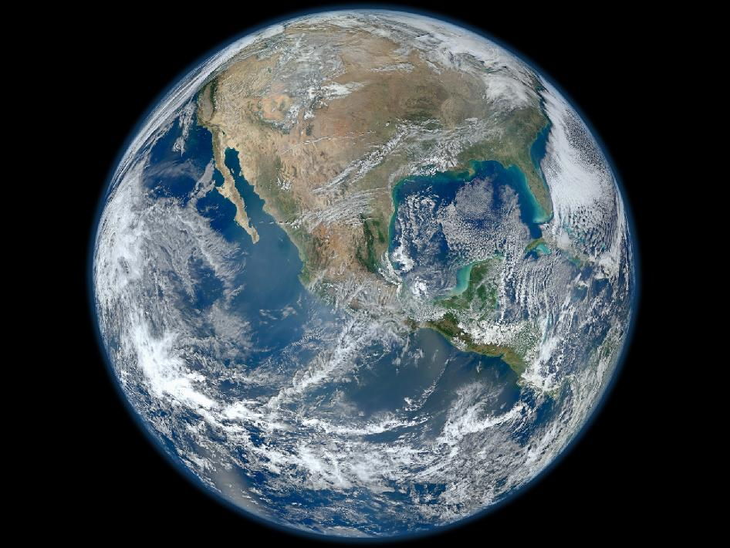

General Ecosystems Models:
Virtual laboratories for the exploring the living world
Mike Harfoot, Derek Tittensor, Tim Newbold, Drew Purves
Notes:
Good afternoon
Thank you to Starrlight and all the organisers for the opportunity to talk about my research developing General Ecosystem Models
I am very excited and slightly apprehensive about giving this talk – because our modelling approach misses out a whole lot of the ecology and biology that you all are focussed upon.
I became aware of DEB theory after meeting with Tiago and Tania during their time in Cambridge. And I do think that DEB could improve the ecological realism of the bioenergetics in the model. However, we have not, to date, implemented any of the developments we spoke about at the time.
Despite this, I hope to show that General Ecosystem Modelling approaches might be valuable for unifying DEB with other field of ecology and more optimistically, for putting ecological modelling on a similar footing to more physical sciences such as climate modelling.

Slide 2
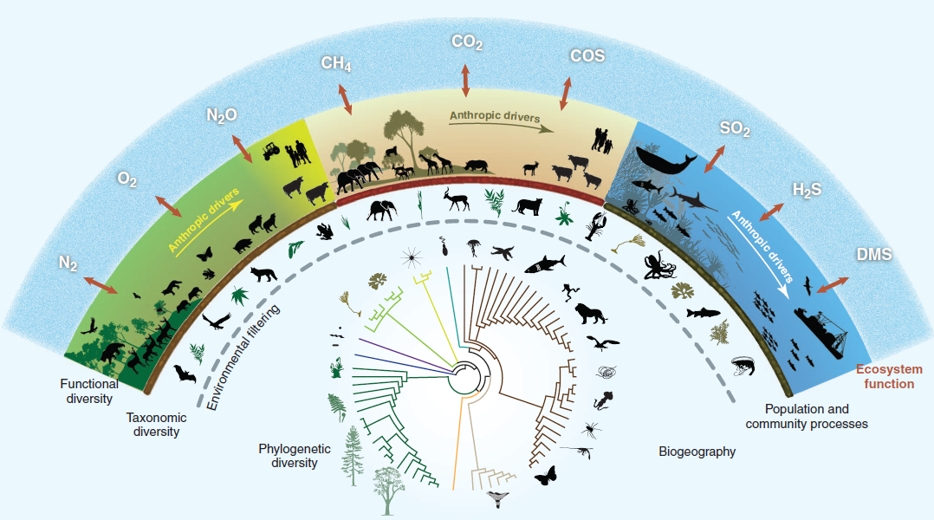
Biodiversity: Complex and fundamental for a habitable planet
Naeem et al. (2012), Science
Notes:
Biodiversity is complex, it is also fundamental for a habitable planet.
Perhaps because of this complexity most ecological/conservation modelling is statistical in approach

Slide 3

Need tools to help understand the impacts of our actions now and into the future
Notes:
Habitat conversion, exploitation, climate change, pollution, invasive species are all acting simultaneously to affect biodiversity in unprecedented ways.
We are in a situation where effective targeting of resources is critical, and we need tools to help us do so as effectively as possible, as well as to understand and convey the situation and the problems.

Slide 4
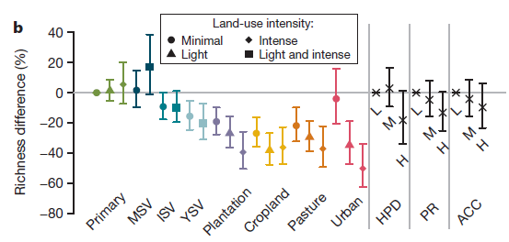
Much of conservation and ecological science relies on pattern-based models
Newbold et al. (2015), Nature, 520, 45–50
Notes:
Perhaps because of the complexity of ecology and biodiversity, most conservation and ecological science relies on pattern-based models.
1. Predicts –Same with SDMs -
Problems:
correlative approaches are often unable to identify causal relationships (MSV increase.. Don’t know without collecting further data what is causing this).
transferability across geographic space, time, and environmental space.
Global change is multidimensional.
Ecosystem shifts.

Slide 5
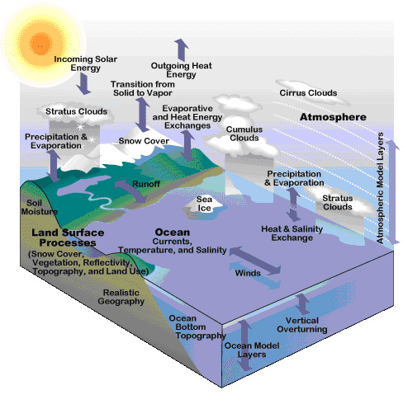
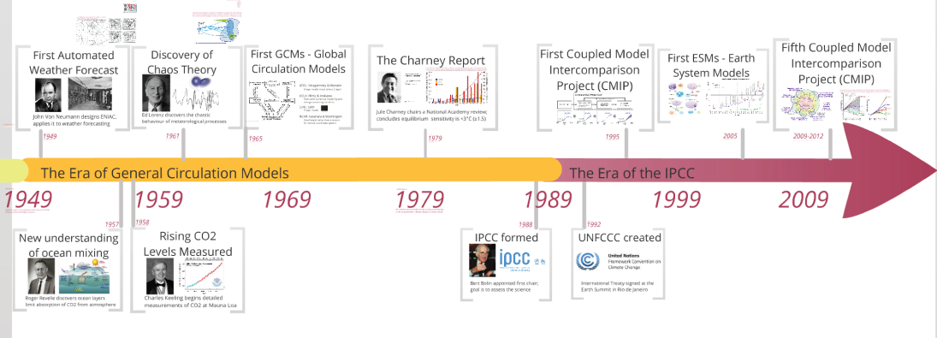
The climate system is also complex
…but mechanistic models have been developing for over 60 years
Phillips (1956) The general circulation of the atmosphere: A numerical experiment

Slide 6
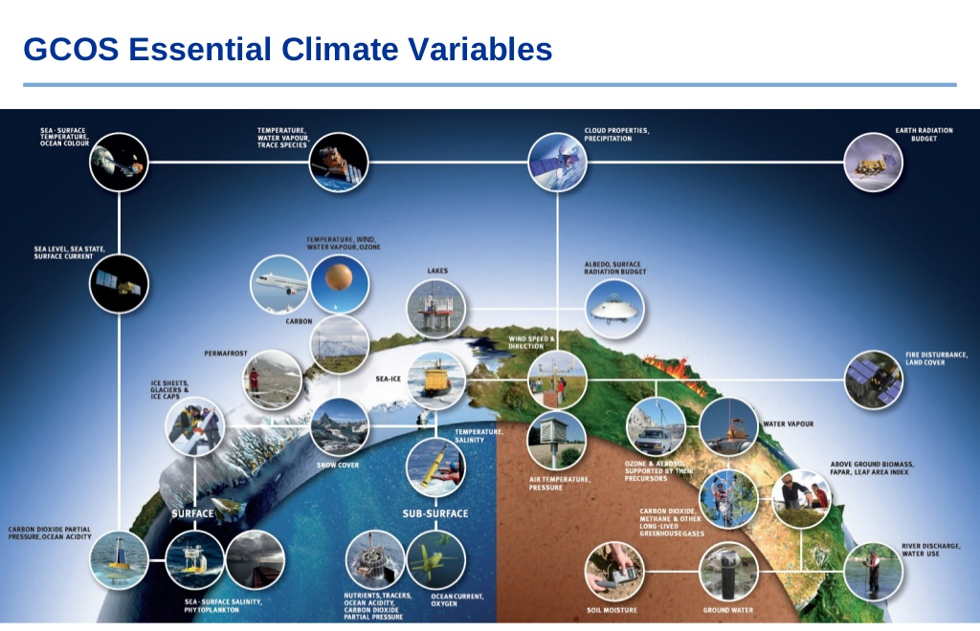
Required data has also developed – as data needs have been identified

Slide 7

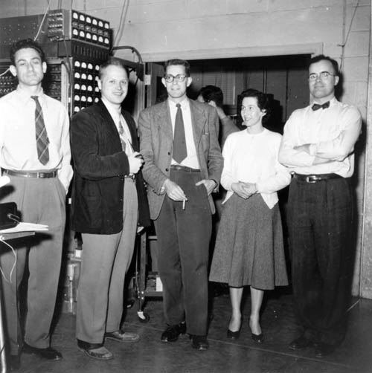
It’s early days for GEMs
Bert Bolin, 1952:
"There is very little hope, for the possibility of deducing a theory for the general circulation of the atmosphere from the complete hydrodynamic and thermodynamic equations."
Norman Phillips, Princeton, 1955:
First General Circulation Model
Computer had 5 kb of memory
Earth was a cylinder, not a sphere
No distinction between land and ocean
Notes:
Earlier this year we argued in a comment piece for Nature that the time is right to attempt to mechanistically model all life on earth.. Drawing the analogy between the IPCC, which has GCMs, mechanistic models of the earth system that allow us to gain some understanding of the future state of the climate system. The nascent IPBES does not have GEMs – though we are trying to build them!
Like the pioneers of general circulation model many were sceptical – but look where the Earth System modelling community is now.

Slide 8
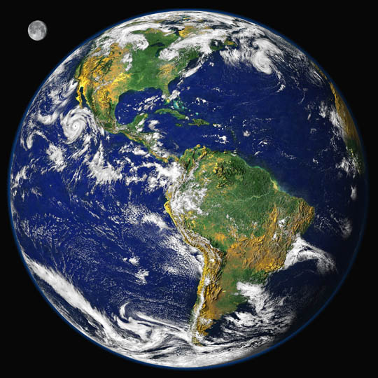
Modelling Philosophy
The Madingley model
Global & spatially explicit
Balanced consideration of all trophic levels
Transparent
Open
Reproducible
Emergent properties
Not the only way
Terrestrial
Marine
Purves et al (2013) Nature
Notes:
Not THE way but A way

Slide 9
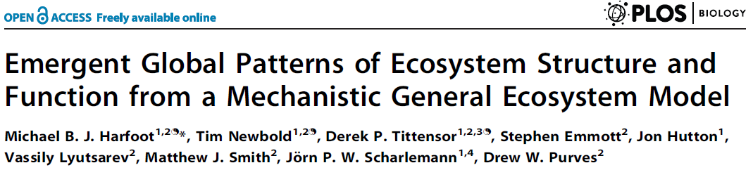
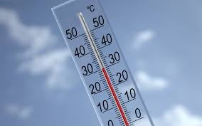
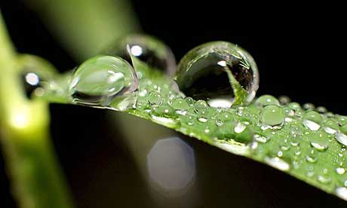
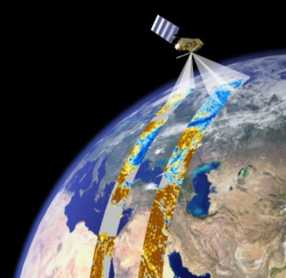

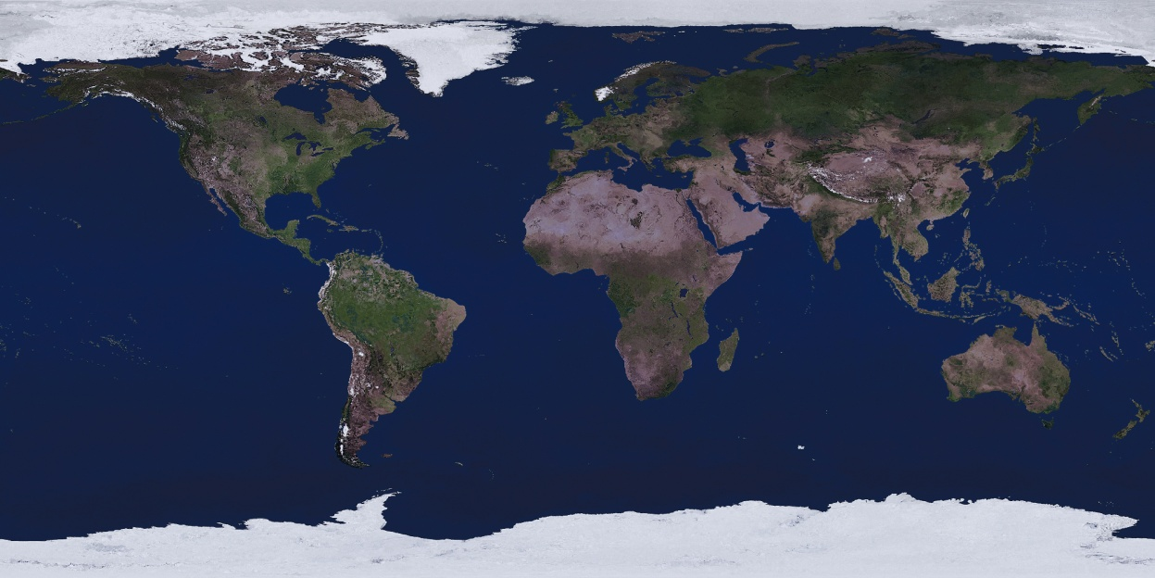
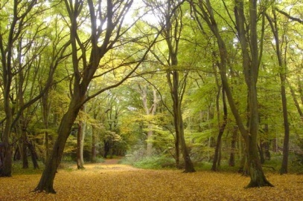
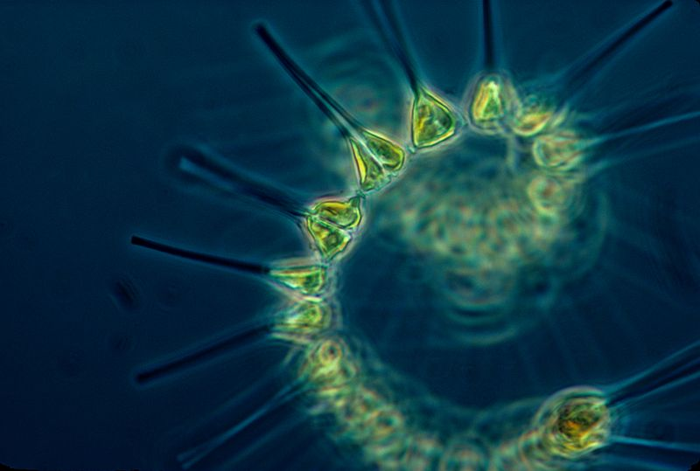
Madingley General Ecosystem Model
Realistic geography, ocean circulation, environmental conditions (air & ocean temperature, precipitation)
Terrestrial: data constrained carbon model (Smith et al., 2013 Biogeosciences)
Marine: remotely sensed phytoplankton concentration
+

Slide 10

Madingley Model: Animals – trait & cohort-based approach
Herbivore / omnivore / carnivore
Ectotherm / Endotherm
Active disperser / passive disperser
Iteroparous / semelparous
Juvenile body mass
Adult body mass
Current body mass
Herbivore / omnivore / carnivore
Ecotherm / Endotherm
Active disperser / passive disperser
Iteroparous / semelparous
Adult body mass
Juvenile body mass
Current body mass
Abundance
Notes:
Want to model individuals but 2 issues
Agents

Slide 11
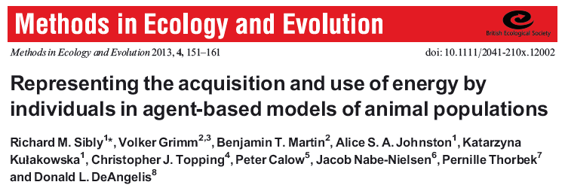
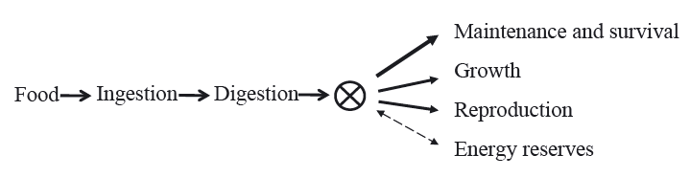
Madingley Model: Ecological processes
Harfoot, Newbold, Tittensor et al. (2014) PLoS Biology
Notes:
Constraining at the level of these processes

Slide 12
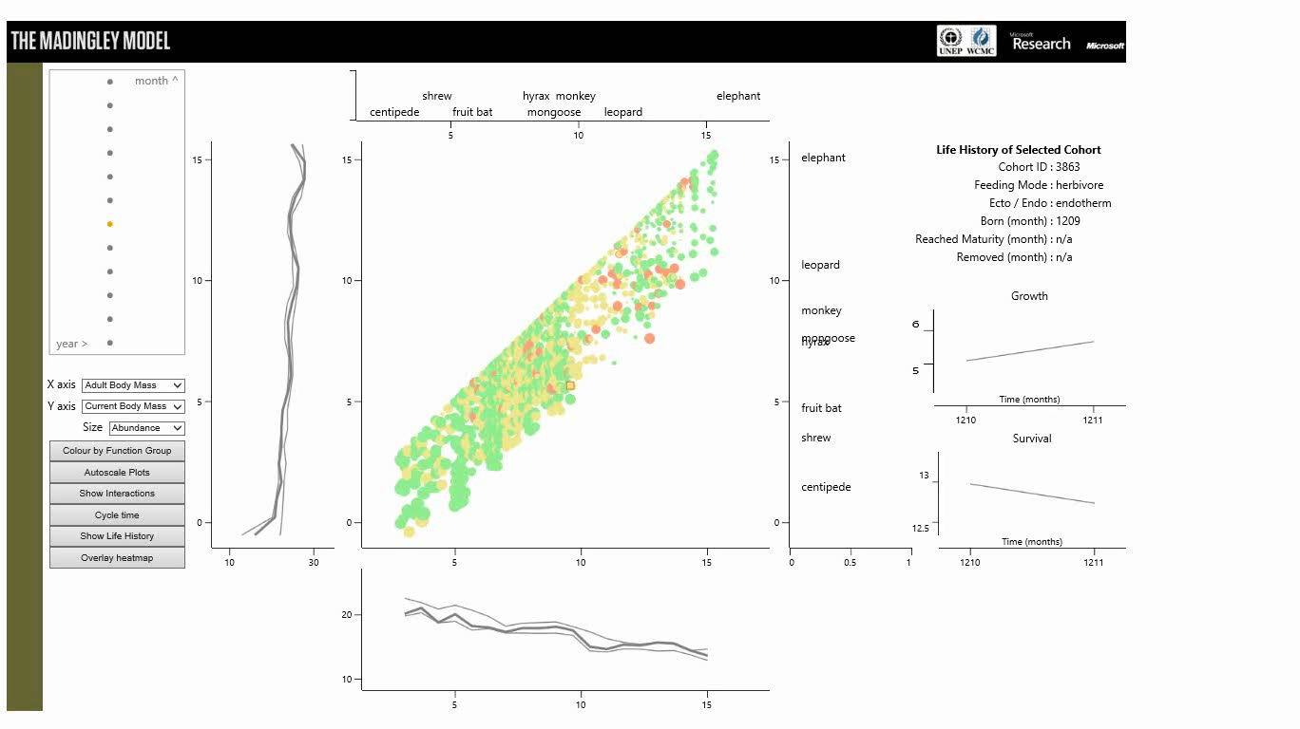
Madingley Model: Emergent structure local

Slide 13
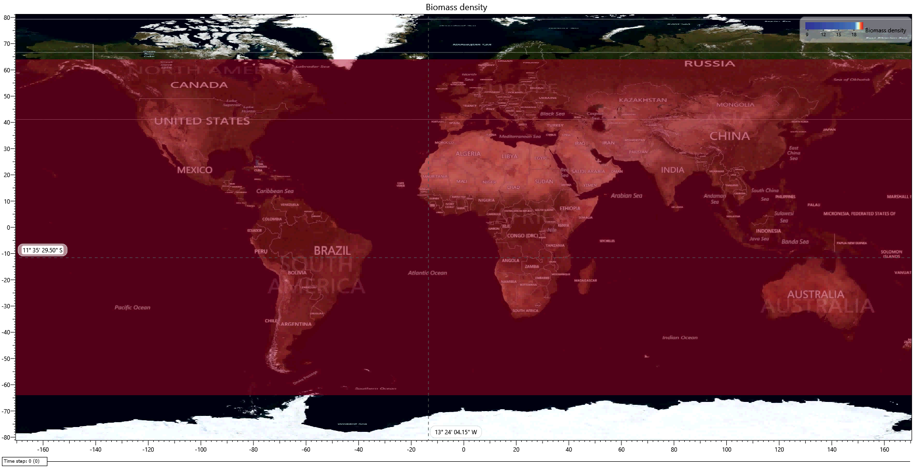
Madingley Model: Emergent patterns

Slide 14
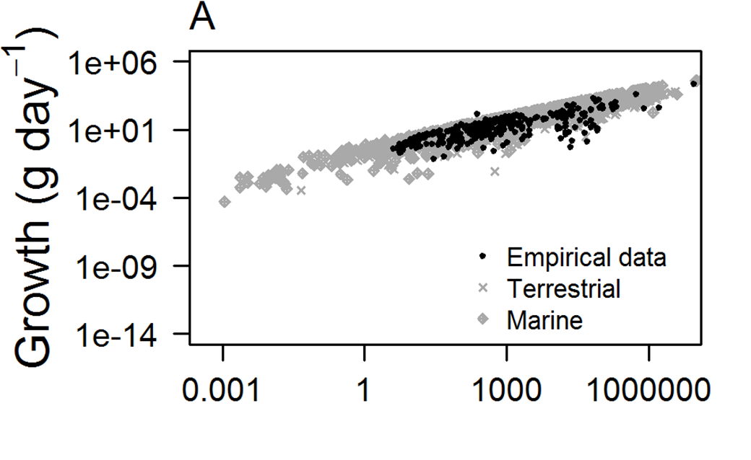
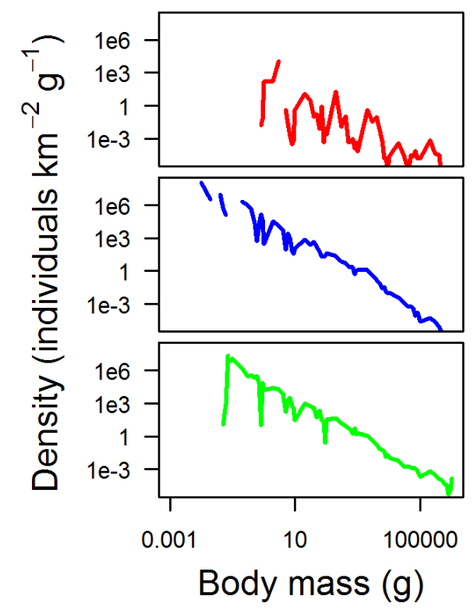
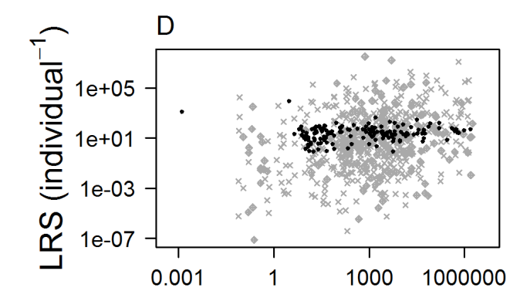
What emerges is broadly realistic - locally
Body mass (g)
Harfoot , Newbold, Tittensor et al. (2014)

Slide 15
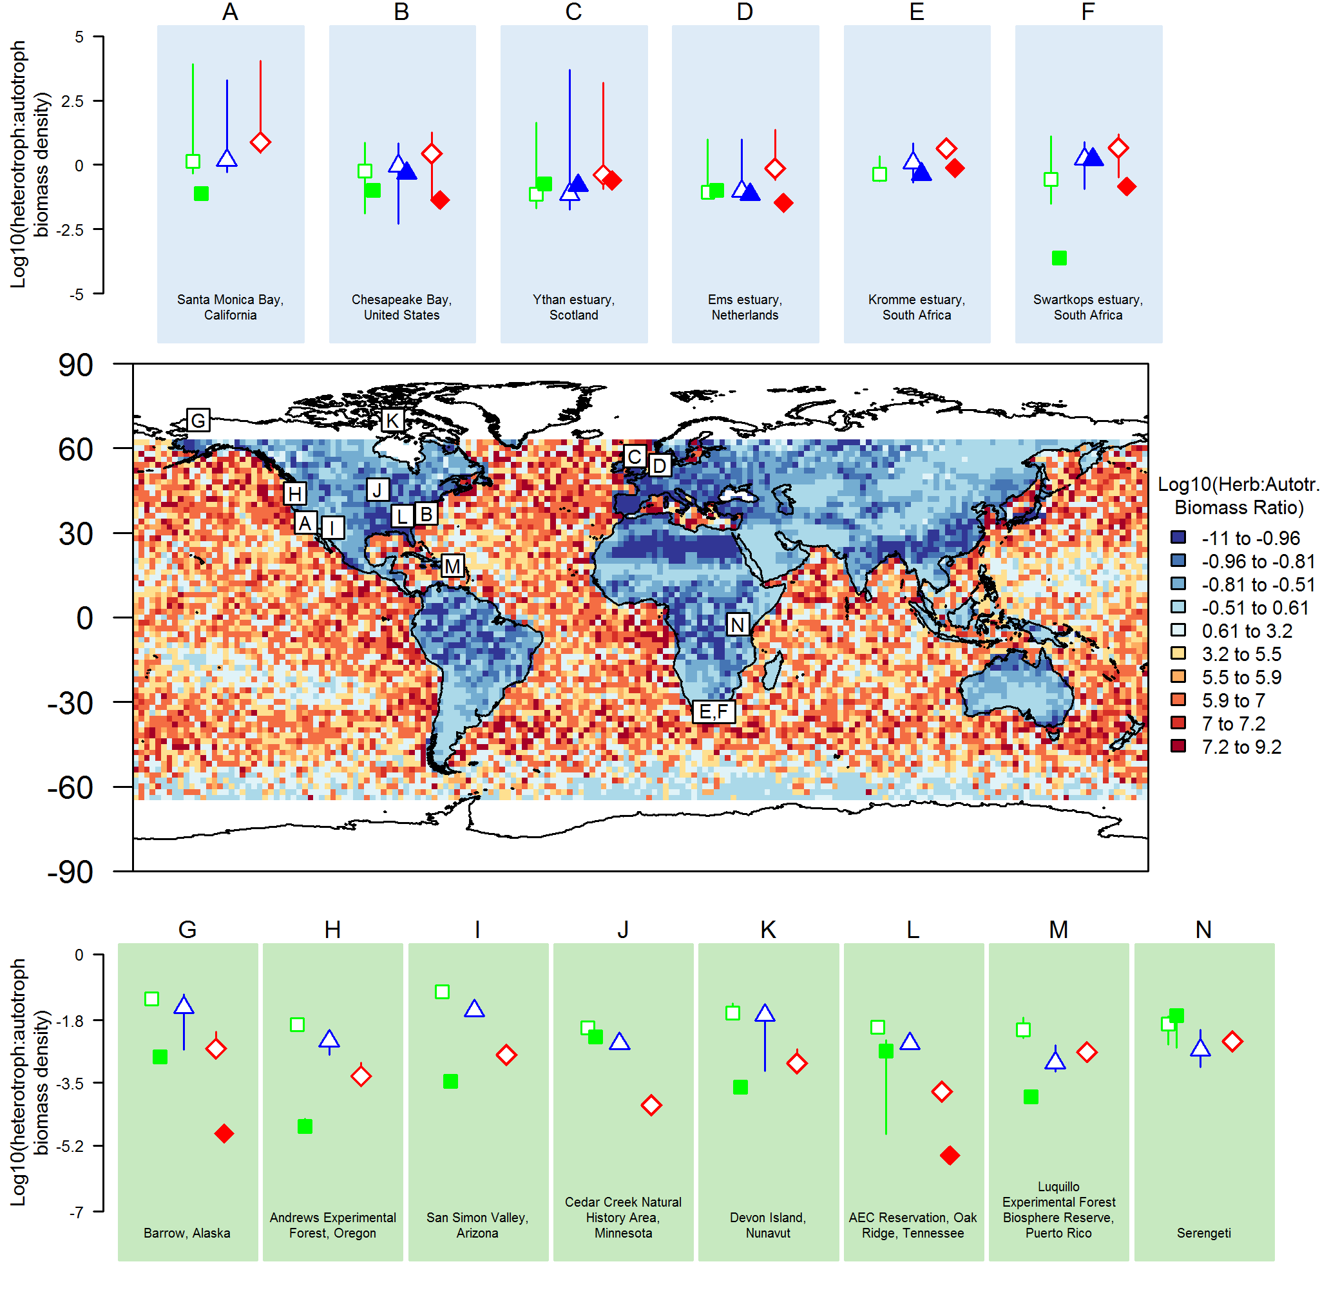
What emerges: ecosystems
Harfoot et al. (2014)
Legend:
Herbivores
Omnivores
Carnivores
Open symbols = Modelled
Closed symbols = Empirical
Notes:
Clearly there is lots of ecology missing
Anthropogenic influence on data

Slide 16
Mechanistic macroecology

Slide 17
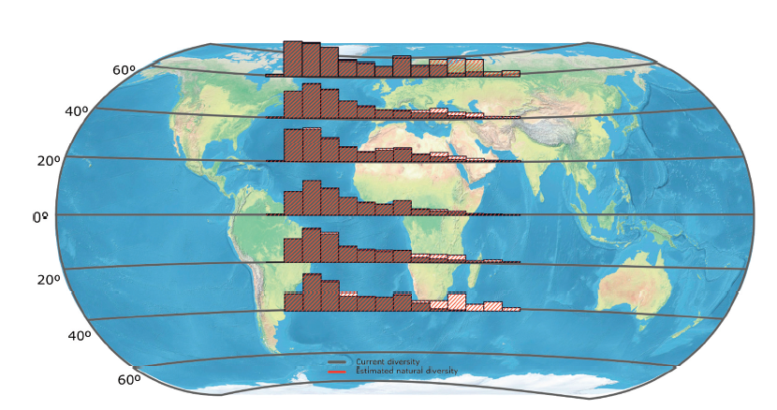
Bergmann’s Rule
Faurby & Araujo (2016) Ecography
Chance
Migration ability
Thermoregulation (incl. developmental temperatures)
Resource availability
Starvation resistance

Slide 18
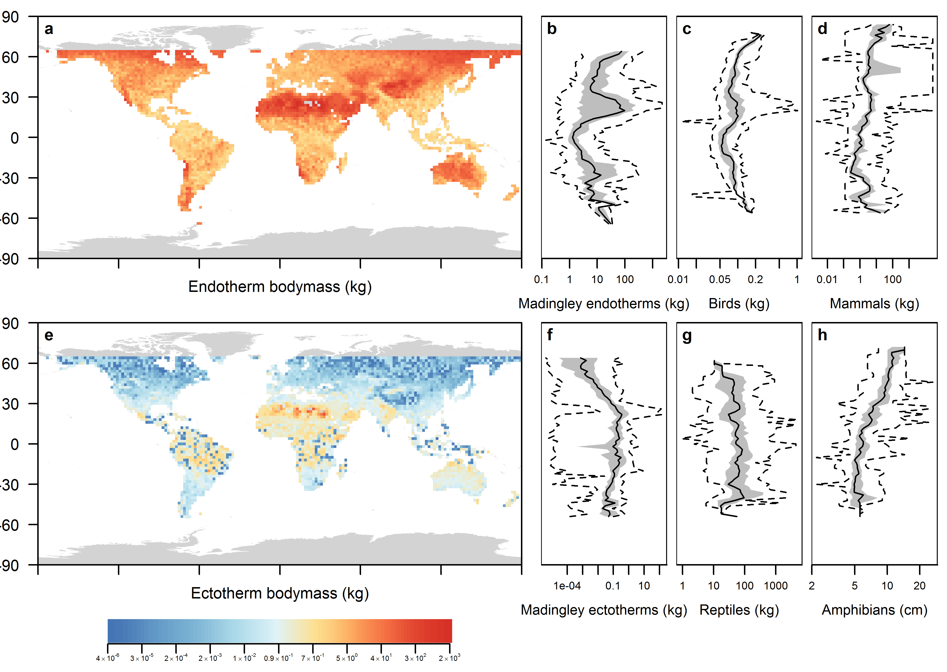
Emergent body size patterns – comparison to ‘empirical’
Harfoot et al., in prep
Notes:
Bergmann (1847): thermoregulation in endotherms
Interspecific patterns as well as within groups of closely related species.
Observed widely in mammals and birds
Equivocal evidence in ectotherms: anurans, arthropods, reptiles.
Still some uncertainty about the mechanisms giving rise to Bergmann’s rule:
Chance
Migration ability
Thermoregulation (incl. developmental temperatures)
Resource availability
Starvation resistance

Slide 19
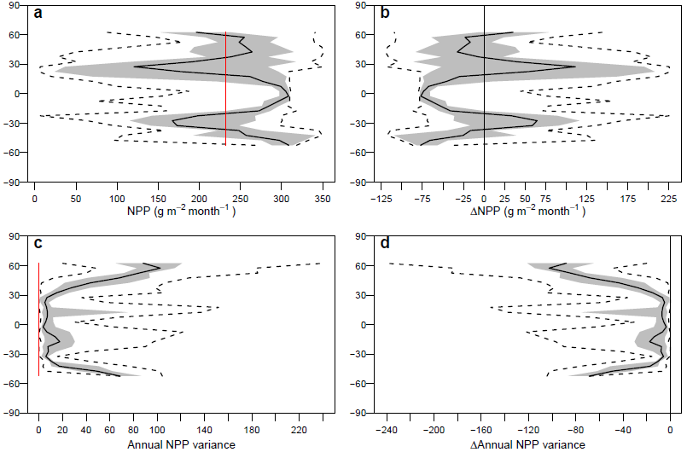
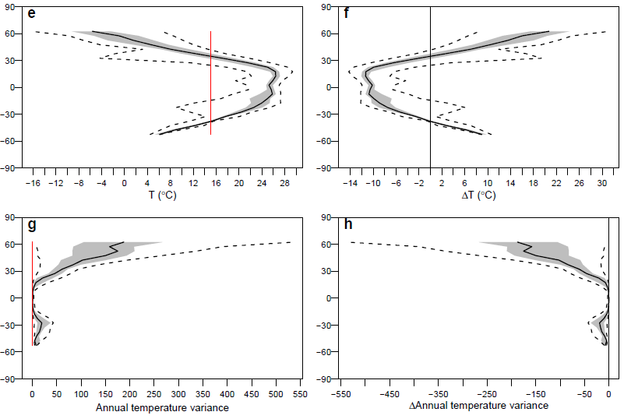
Environmental manipulations
Annual mean productivity
Seasonality of productivity
Annual mean Temp.
Temperature seasonality
Harfoot et al., in prep

Slide 20
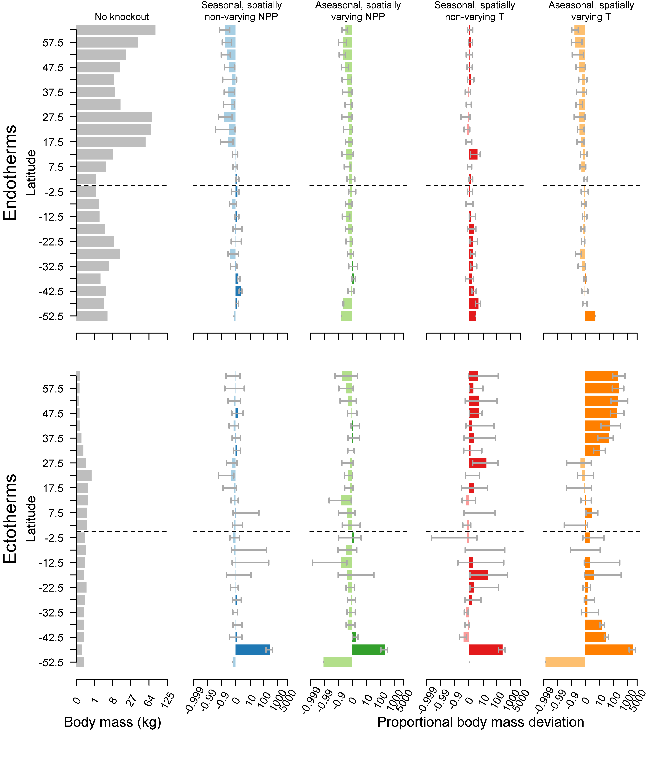
Body size effects
Endotherms
Total productivity (NH)
Seasonalilty of NPP
Seasonality of T
Notes:
Starvation mortality is a key loss for smaller organisms in high latitudes
Smaller organisms eat more, reproduce more and have lower mortality rates

Slide 21
Body size effects
Endotherms
Total productivity (NH)
Seasonalilty of NPP
Seasonality of T
Ectotherms:
Seasonality of T

Slide 22
Responses to global change
Notes:
Move on to demonstrating how such models might be valuable for exploring ecosystem responses to global change

Slide 23
Does the model produce realistic responses?
Newbold et al. (2015), Nature, 520, 45–50

Slide 24
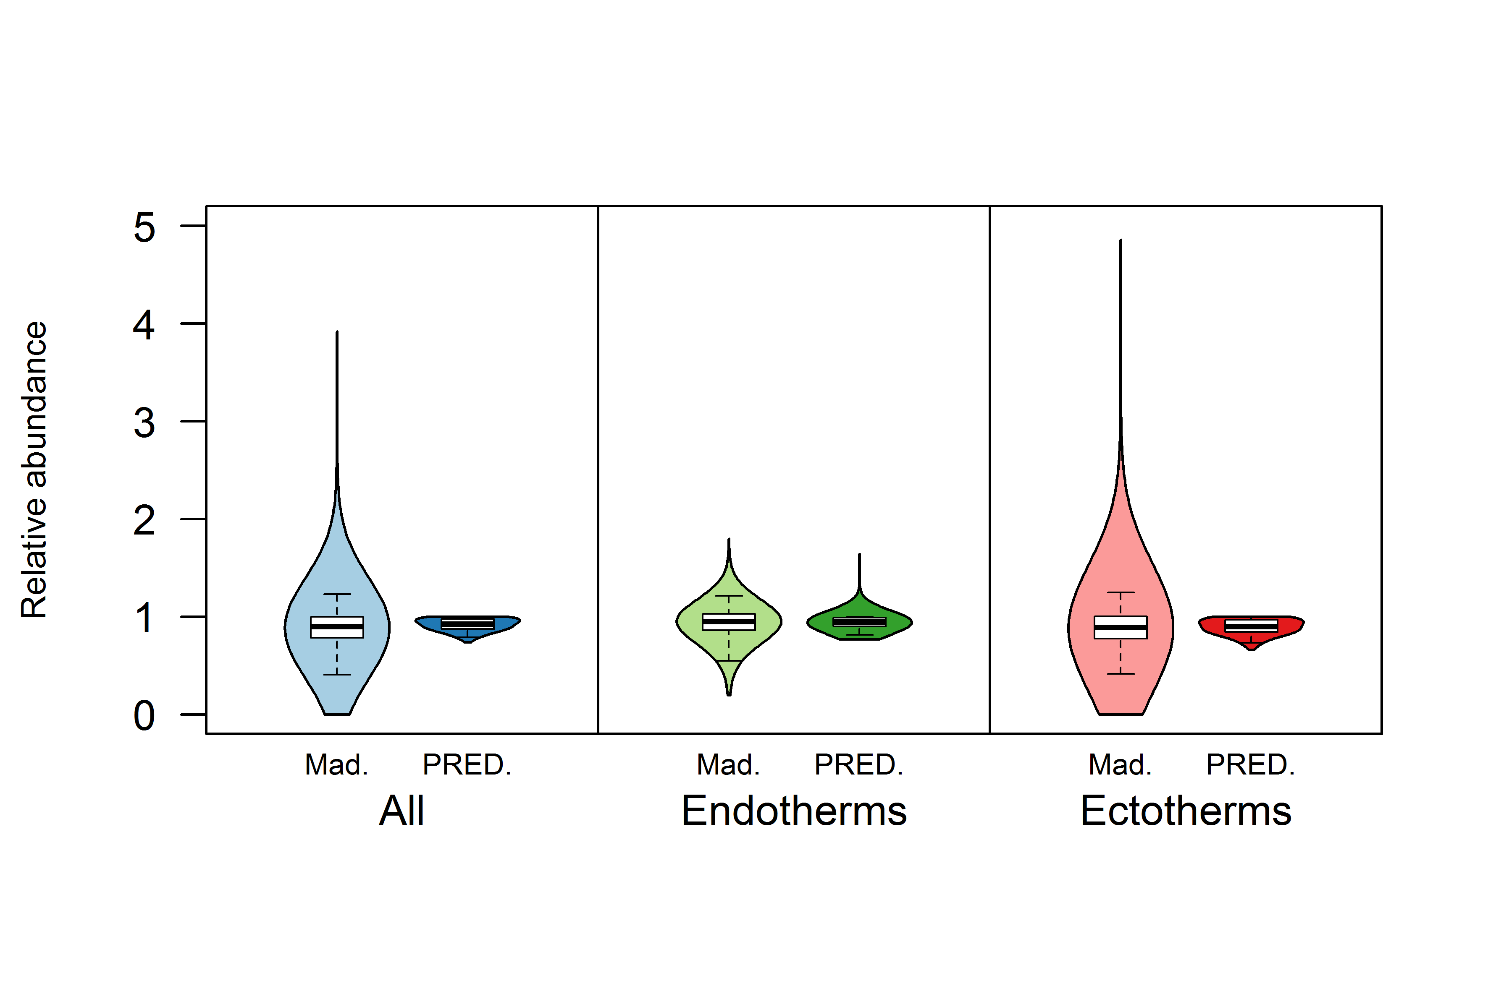
Broad agreement between two very different approaches
Harfoot et al., in prep
Notes:
. Madingley projected a median abundance decline of 10% in the whole animal community across all grid cells compared to a 7.2% decline for PREDICTS. For endotherms Madingley estimated the median change as a 4.9% decline compared to 5.2% for PREDICTS, whilst Madingley estimated a median decline in ectotherms of 10.5% and PREDICTS estimated a 9.7% decline

Slide 25
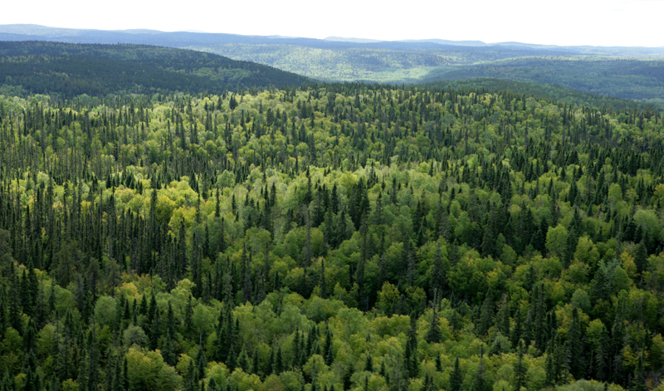
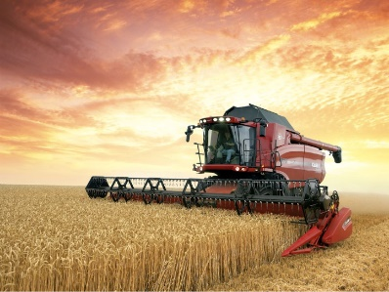
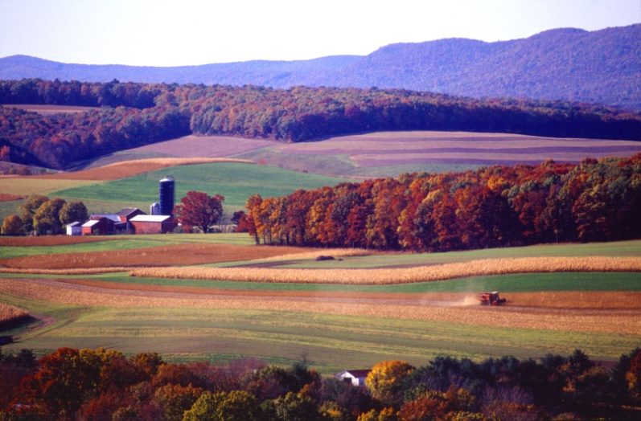
Ecosystem responses
1000 yrs
Spin-up
100 yrs
Impact
1%/year
10%
20%
.
.
.
Newbold, Harfoot, Tittensor et al. (in prep)

Slide 26
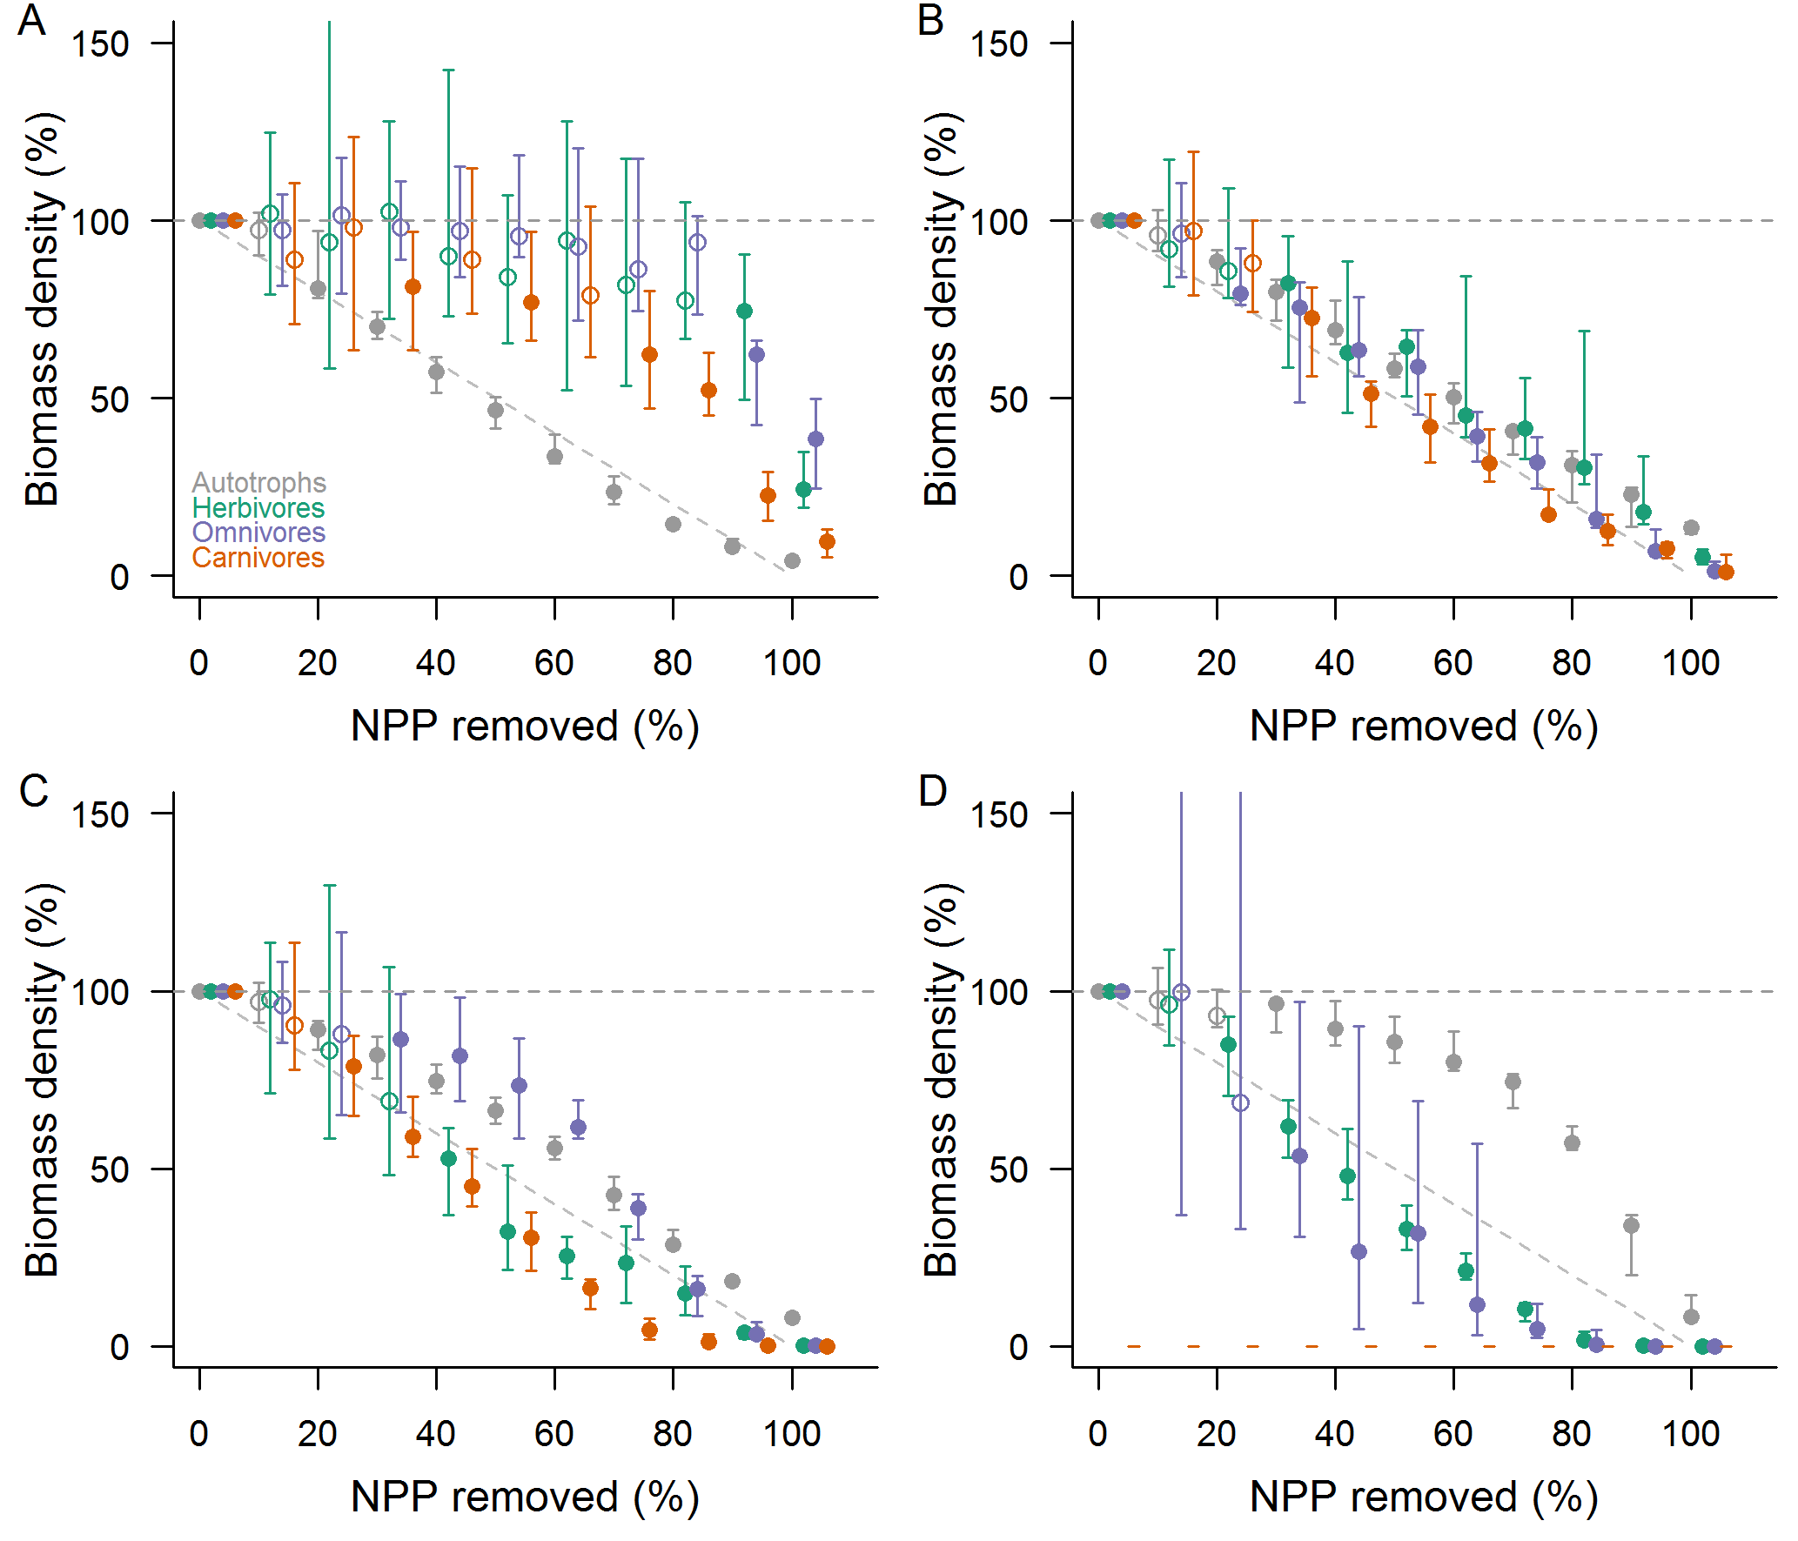
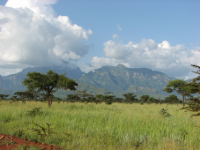
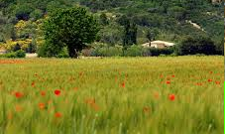

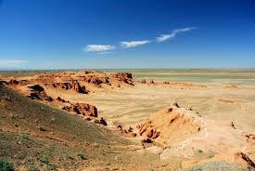
Different ecosystems have qualitatively different responses
Uganda
France
Libyan
desert
Gobi desert
Newbold, Harfoot, Tittensor et al. (in prep)

Slide 27
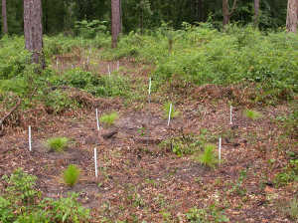
Do recovering ecosystems return to the pre-impact state?
Impact phase
95%
Recovery phase

Slide 28
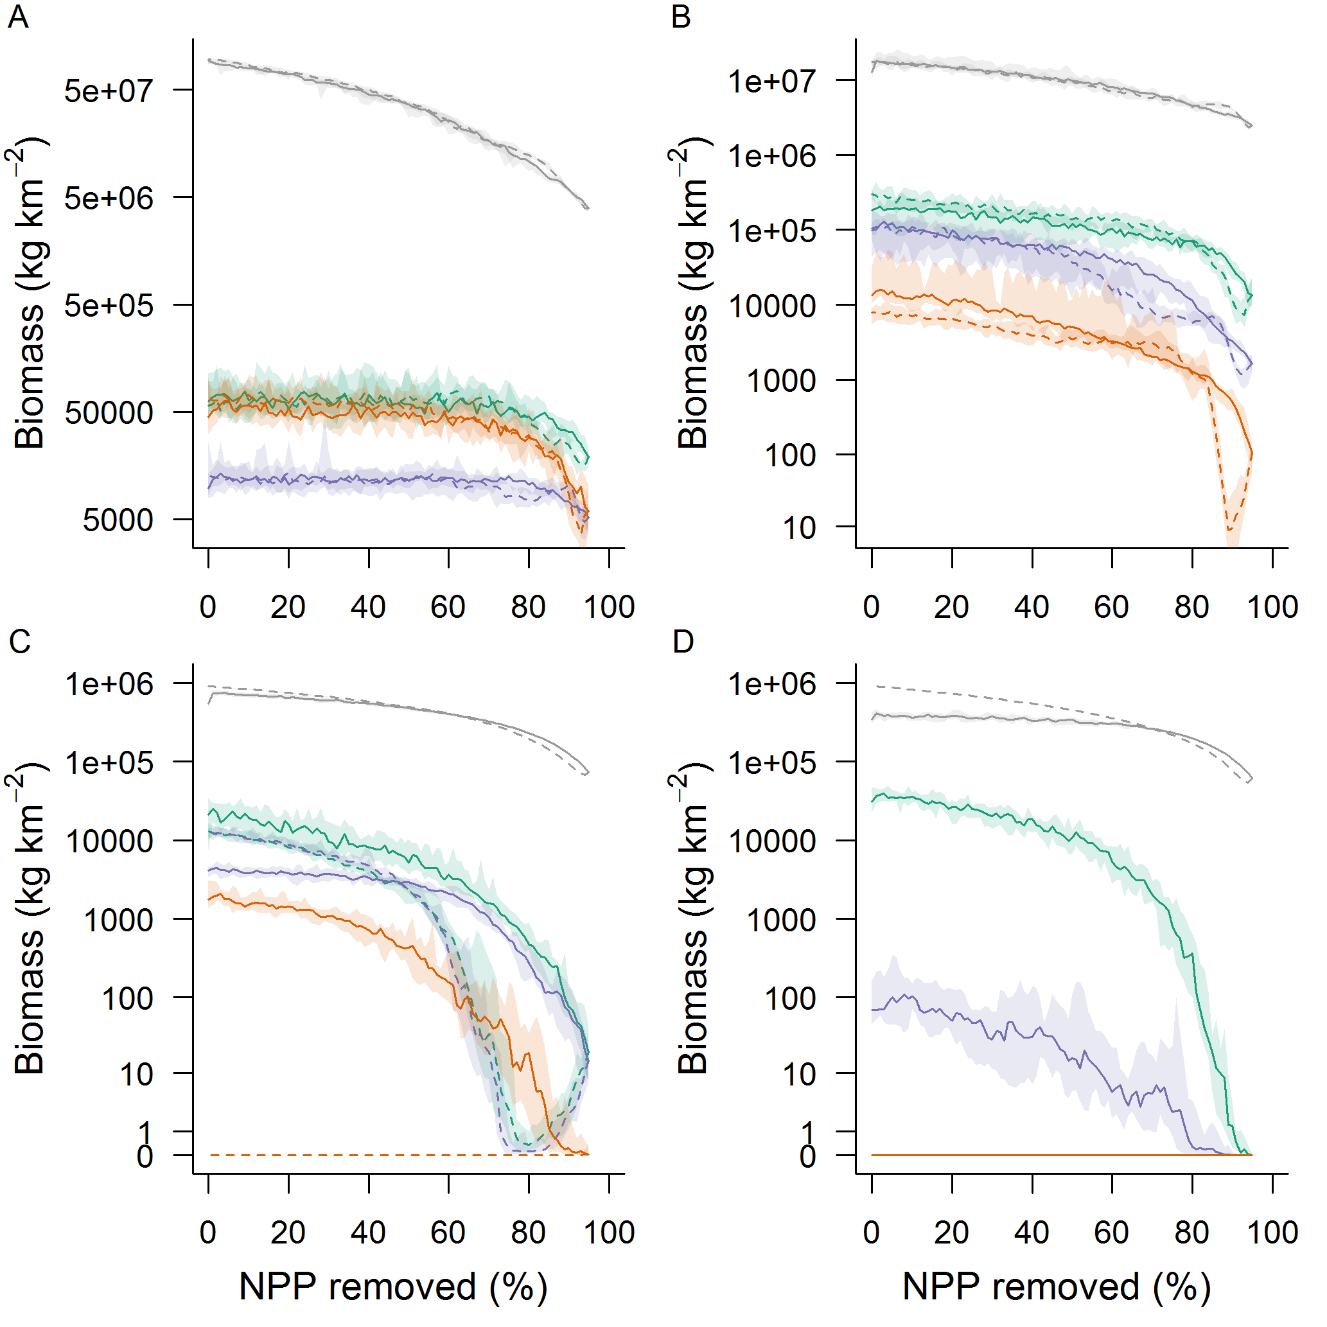
Do recovering ecosystems return to the pre-impact state?
France
Uganda
Libyan
desert
Gobi desert

Slide 29
Challenges

Slide 30


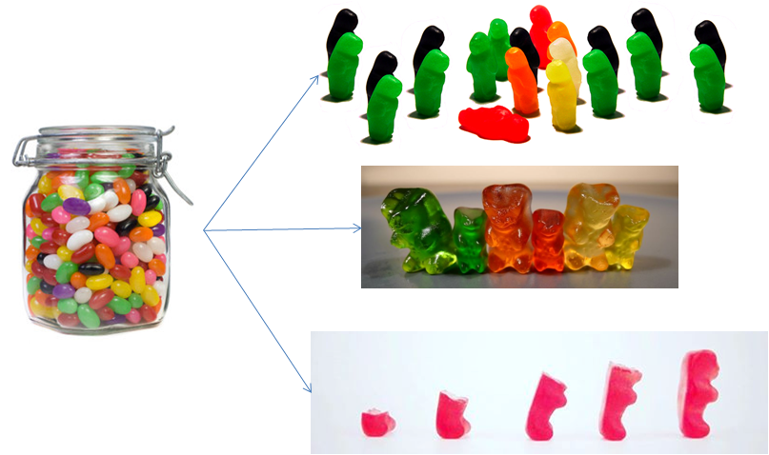
Data
Ecological understanding
Predictability
Capacity
Notes:
Complexity

Slide 31

Organismal Intelligence
Perception of near-term, local environment vs learnt strategies
Responses to change: starvation, disturbance etc – plants and animals

Slide 32
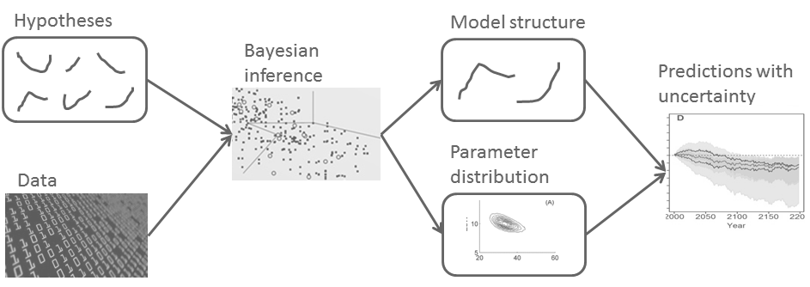
Evaluating ecological uncertainty, complexity and understanding
Hypotheses

Slide 33

Thank you!
www.madingleymodel.org
mike.harfoot@unep-wcmc.org
@harfootmike

Slide 35
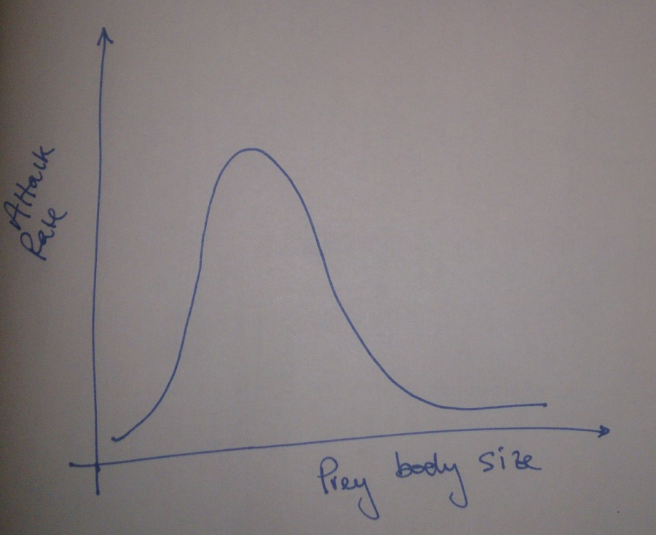
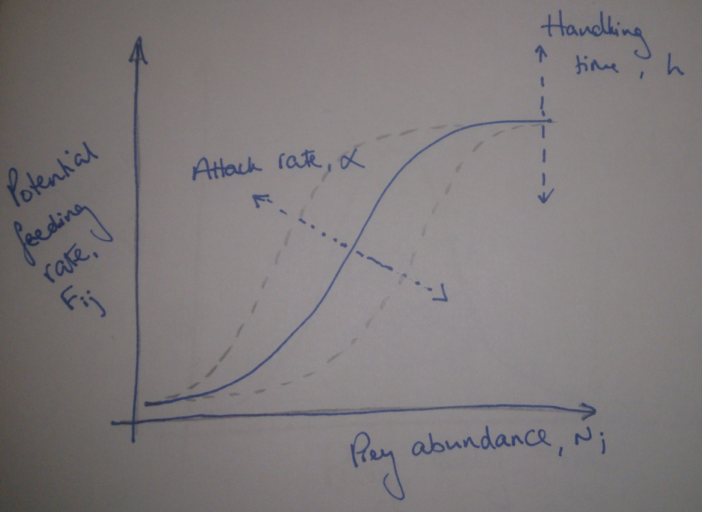

Handling time
Type III:
Predator
Brose et al., (2006), Ecology, 87, 2411-2417
Jeschke (2002), Ecological monographs, 72, 95-112
Prey avoidance, predator switching search image…

Slide 36
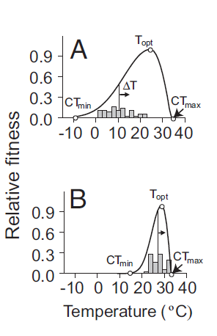
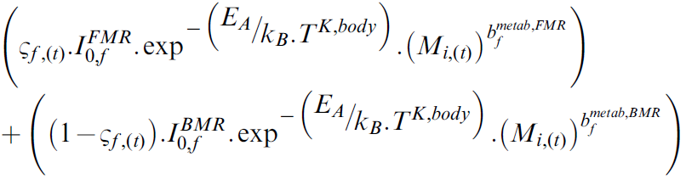

= 310K for endotherms, ambient T for ectotherms
Deutsch et al., (2008) PNAS, 105, 6668-6672

Slide 37
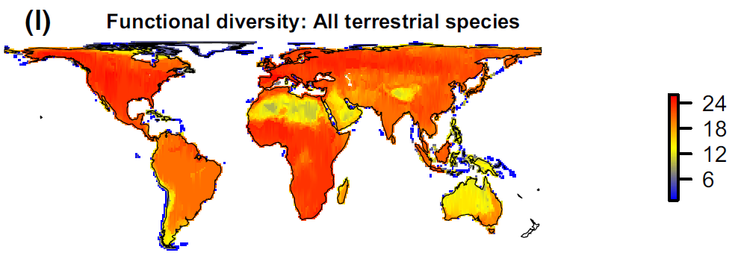
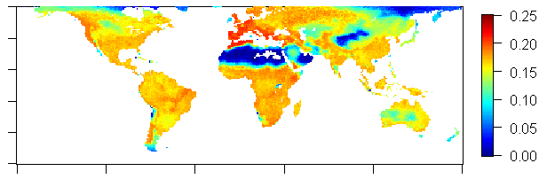
What emerges is broadly realistic – globally
Faurby & Svenning (2015) Div. Distr.
Madingley modelled

Slide 38
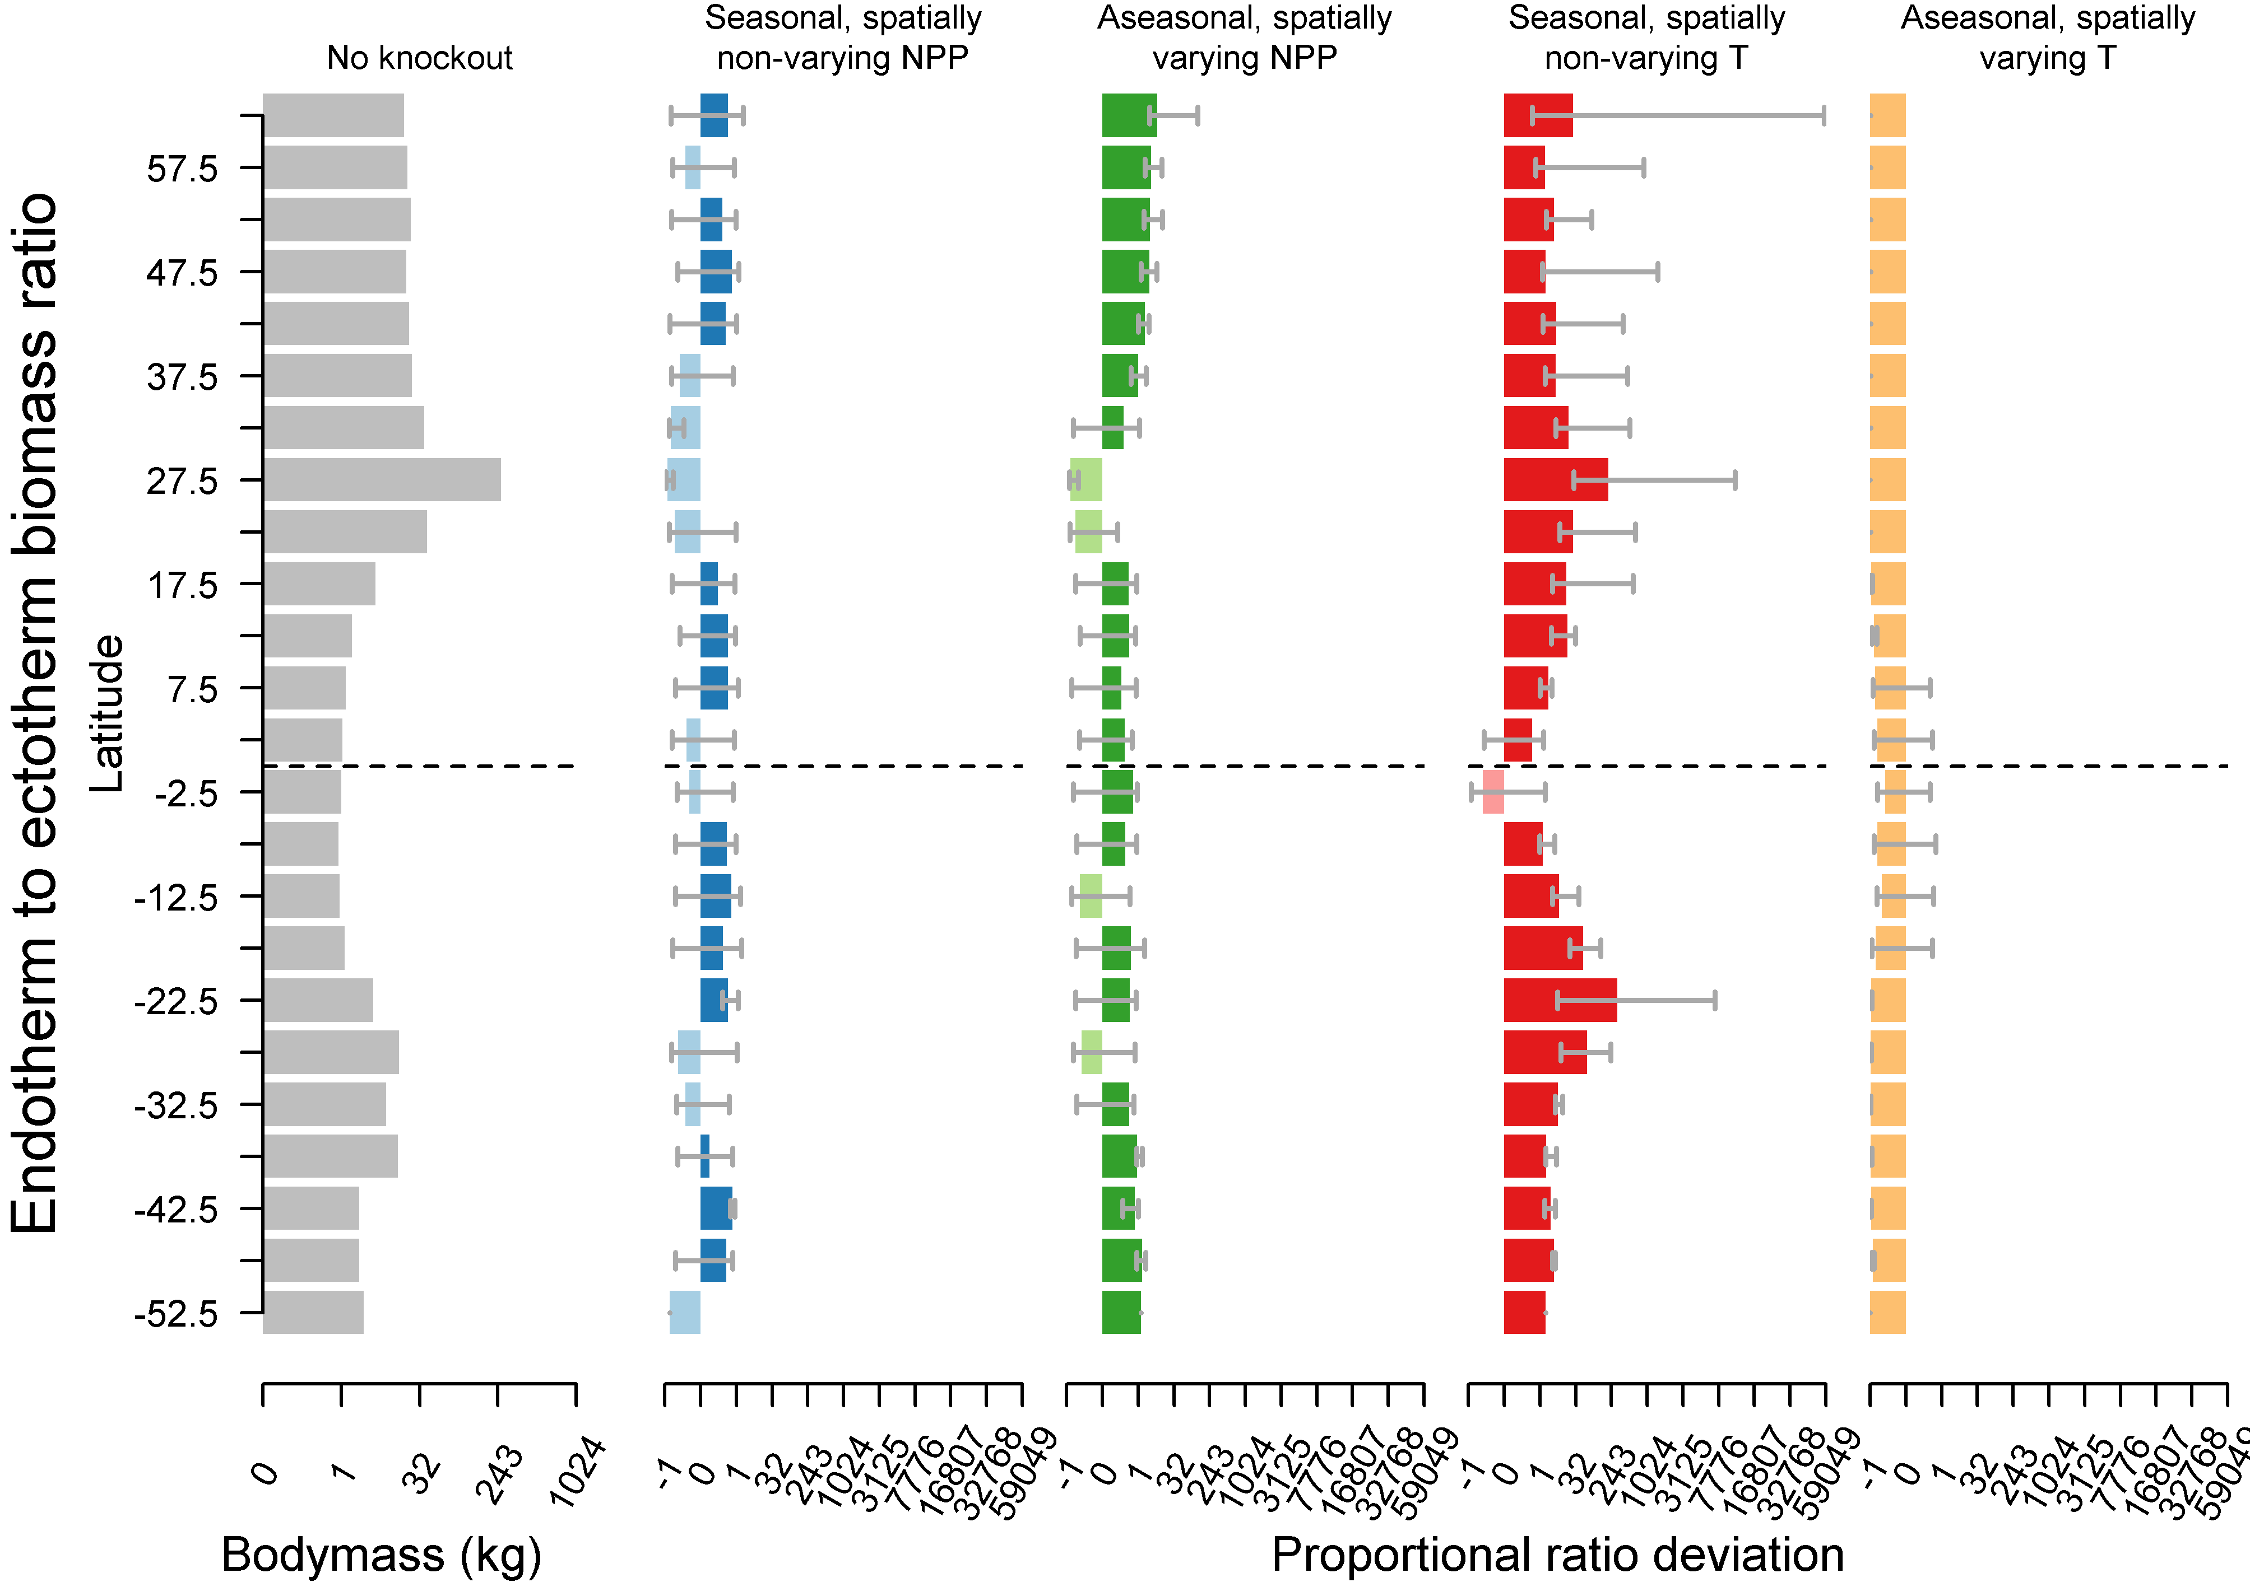

Slide 39
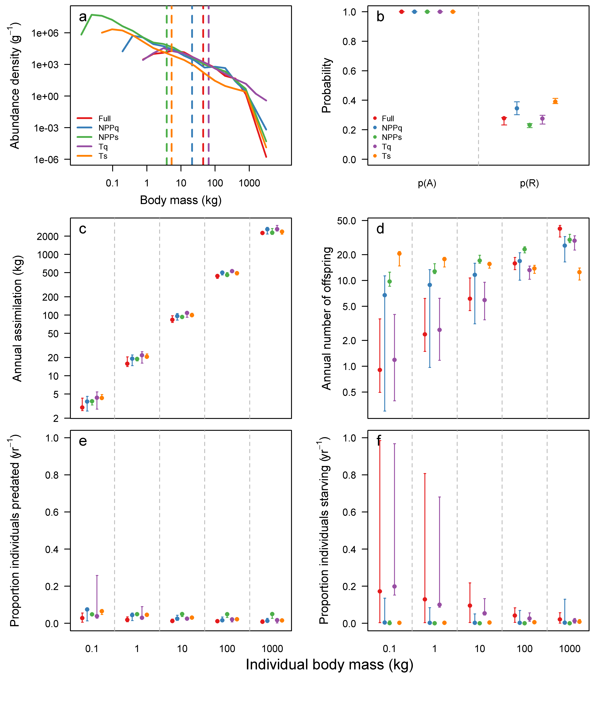
Why?

Slide 40
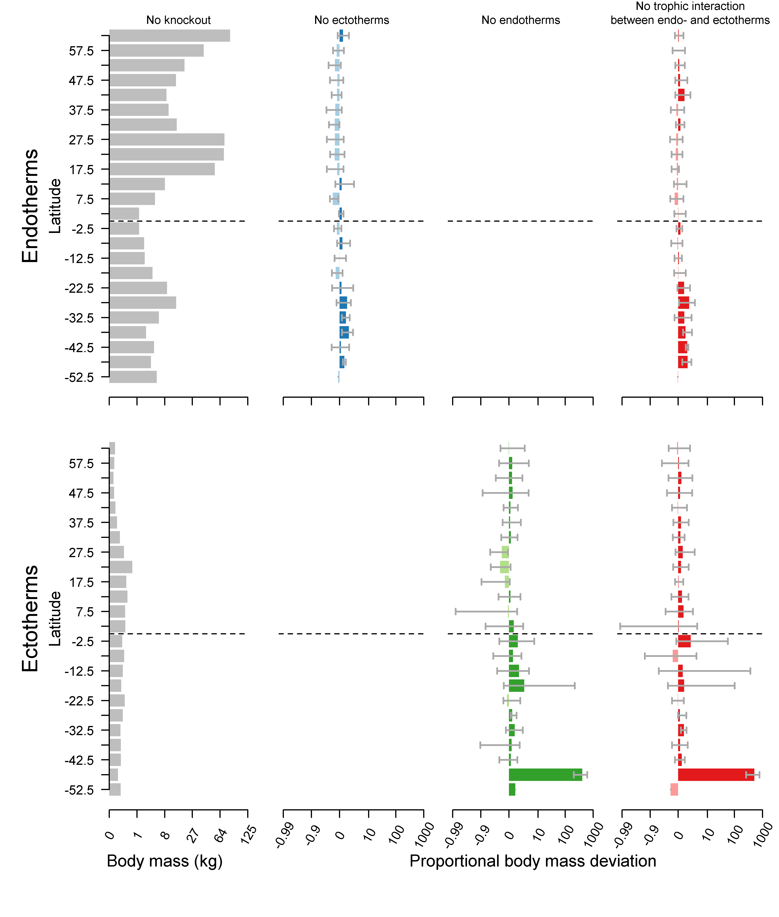
Interaction between endo- and ecto-therms
Might:
Ectotherms provide some bottom-up control over endotherm body size
Endotherms exert top-down control over ectotherms

Slide 41
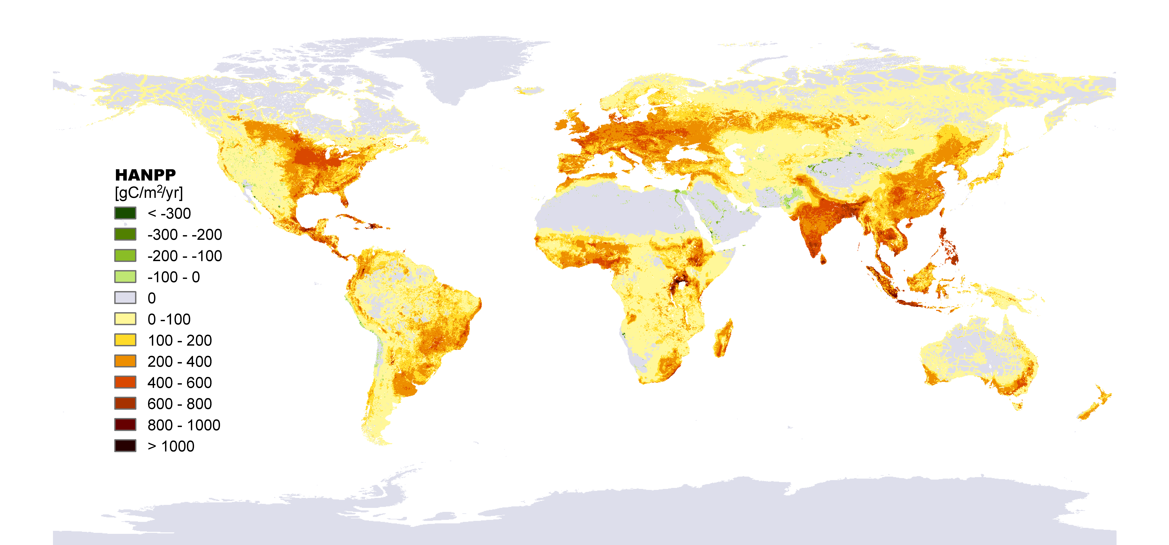


Slide 42



Resolving the biodiversity planetary boundary
Steffen et al. (2015) Science

Slide 43



Rationale
Mechanistic
Understanding of
Ecology and ecosystems

