Slide 1

Environmental sustainability challenges in the Arctic – developing solutions with the help of DEB
JoLynn Carroll
Assistant Director
Keynote 1

Slide 2
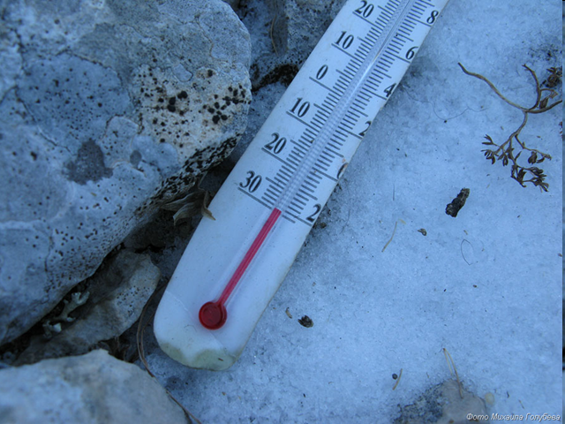
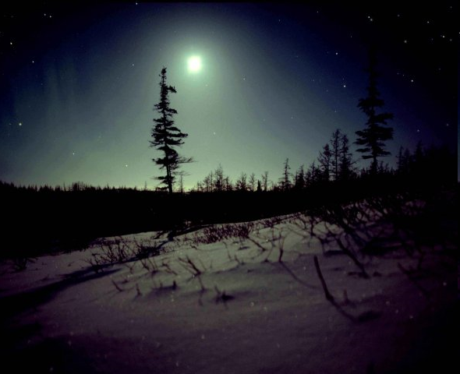
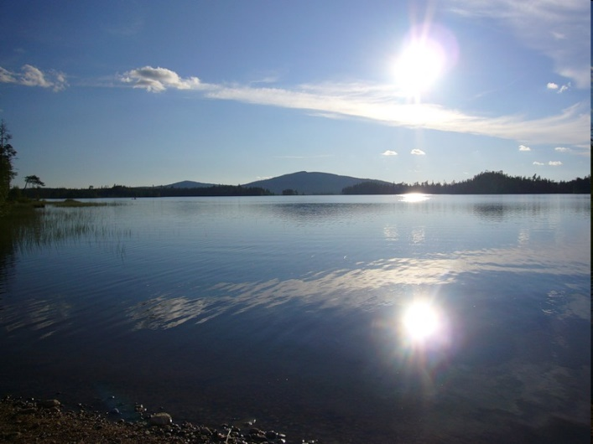
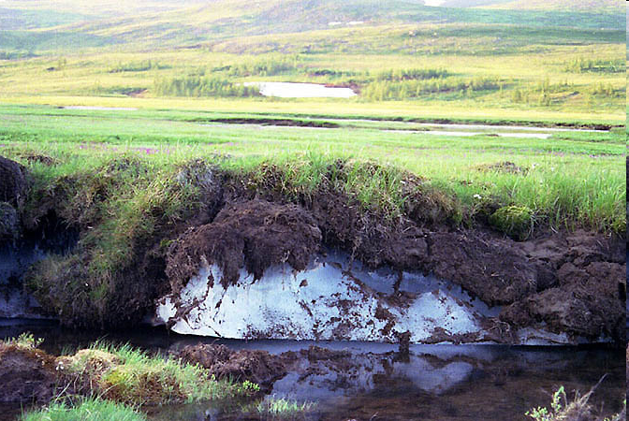
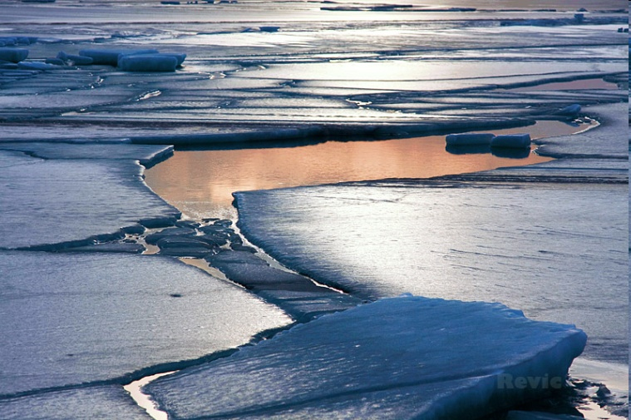
The Arctic – physical environment
Low temperatures
Light\dark regime
Permafrost
Sea ice

Slide 3

The Arctic – biological environment
Seasonal aggregation of animals
Long-lived and slow-growing animals
High lipid values (fat content)
Large seasonal variations
Low metabolism
Migration

Slide 4
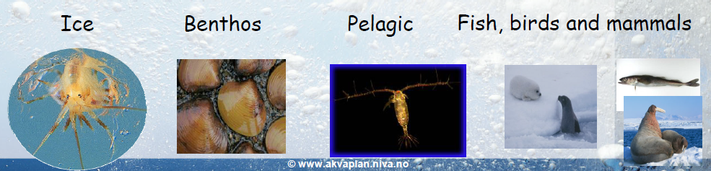
Robust or vulnerable?
Adapted to survive in extreme environmental conditions
Can withstand large seasonal variations in food availability
Robust
Special physiological adaptations
High lipids levels with large seasonal variations
Increased sensitivity to contaminant exposures
Vulnerable
Notes:
Are arctic ecosystems robust or vulnerable

Slide 5
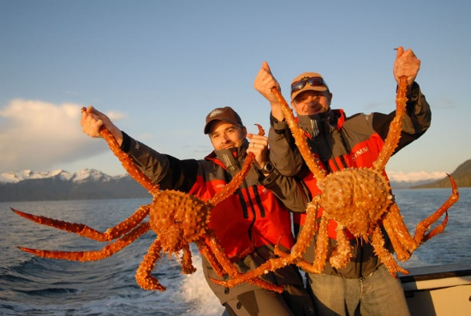
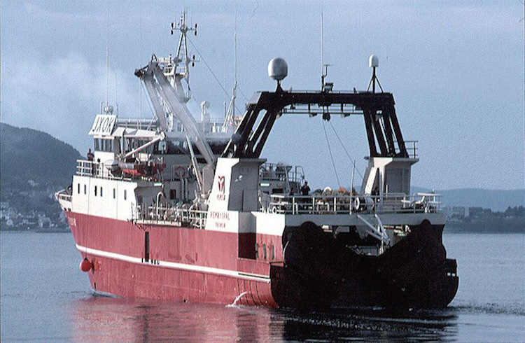
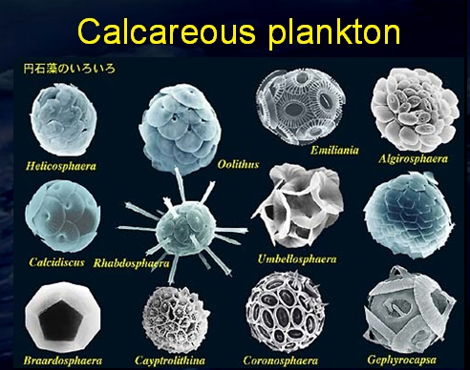

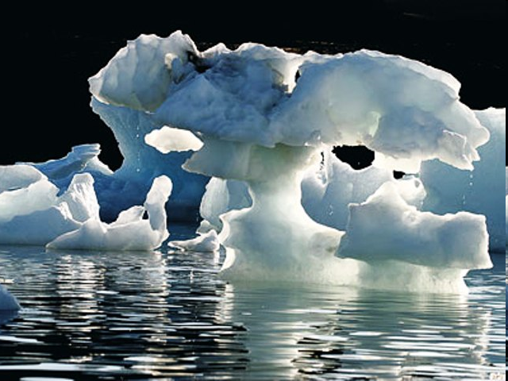
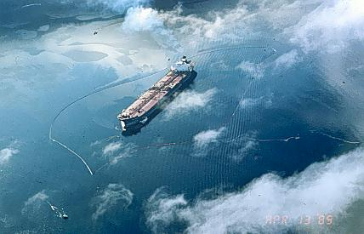
The Arctic at risk
Introduced species
Radioactivity
Combustion Sources
Acidification
Legacy POPs
Climate change
Petroleum
Notes:
Despite remoteness
Climate change comes first in Arctic
Changes are more rapid
Cross-border challenges Barents Sea - russia

Slide 6
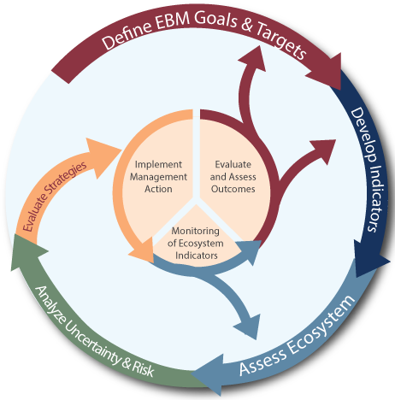
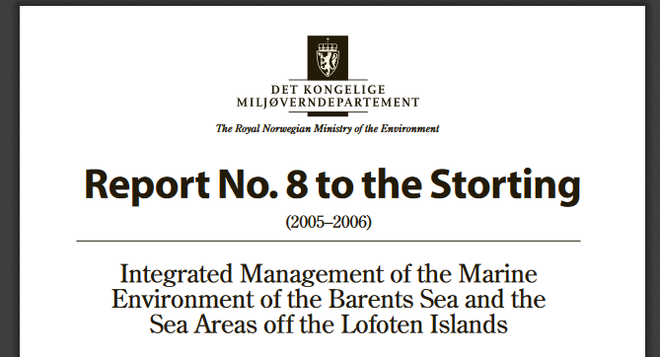

Ecosystem-based management
Balance
Collaboration
Adaptive
Protect ecosystem health & provide ecosystem services
Notes:
EBM needs research to evolve
EBM-the gold standard and Norway EU adopted Marine Strategy directive June 2008 - The Directive enshrines in a legislative framework the ecosystem approach to the management of human activities having an impact on the marine environment, integrating the concepts of environmental protection and sustainable use.
balance and integrate the needs of multiple human user groups while maintaining the health of the underlying system that supports those needs
collaborative decision-making involving a diverse set of organizations and individuals .
monitoring and evaluation are tied to changes in future management directions.
Adaptive – needs to continuously evolve to stay in step with research developments

Slide 7
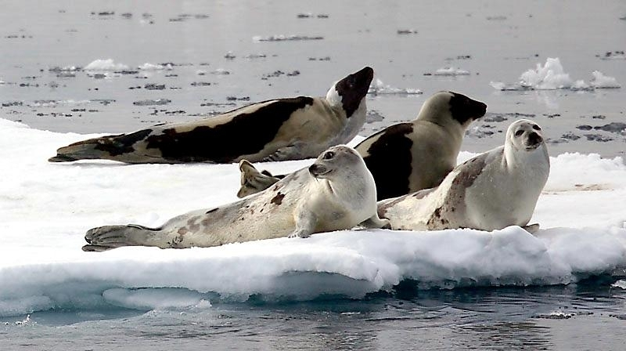
The DEB Ecosystem
End-users
Developers
Managers
Regulators
Politicians
Practitioners
Notes:
By now you are wondering if this has anything to do with DEB.
It has everything to do with DEB!
Mechanistic effects models based on Deb are an essential part of the modeling for decision-making
Arctic is potentially vulnerable ecosystem
Many pressures from human activities
Continuous acquisition of knowledge is required for EBM
Need models to address questions that cannot be addressed otherwise
is critical for developing EBM in to a useful strategy for managing the environment

Slide 8

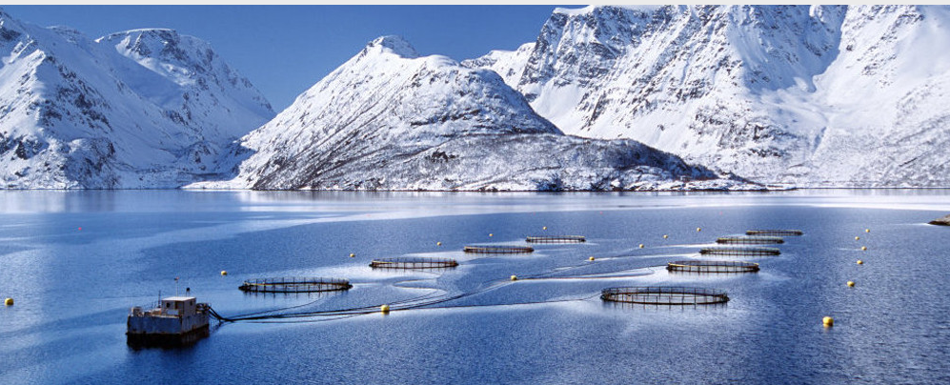
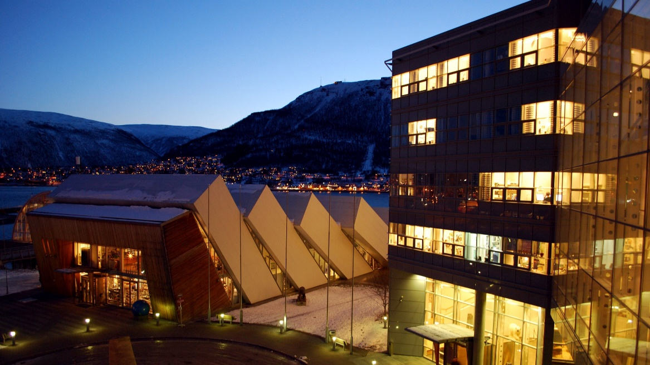
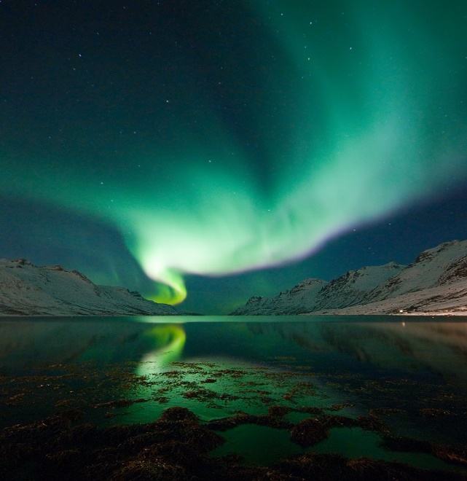
Research and consultancy, main office and laboratories in Tromsø
110 employees, 20 nationalities
8 prof II and 20 PhD students
Branch offices and representatives in Russia, Iceland, France, Spain
Part of Norwegian Institute for Water Research
FRAM - High North Research Centre for Climate and the Environment
Notes:
Northern Norwegian Knowledge Hub
– consortium of 22 institutes/orgs
ARCTOS

Slide 9
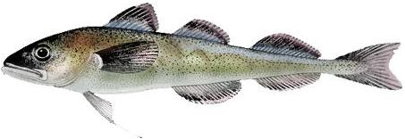
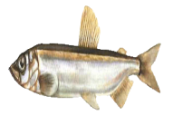
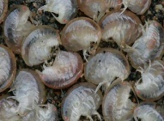
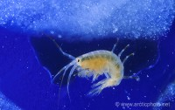
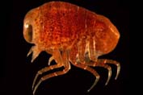
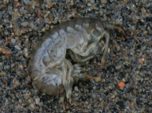
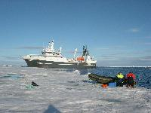
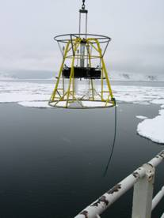
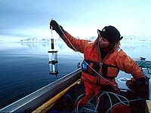
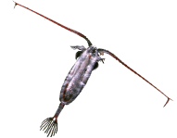
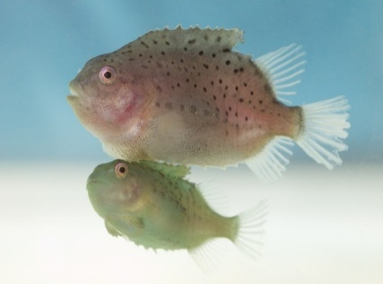
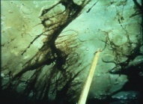
Connecting research to advisory services
Aquaculture
Climate and ecosystems
Biodiversity
Ecotoxicology
Environment & Petroleum
Physical oceanography & Modeling
Environmental monitoring
Impact & risk assessments
Emergency preparedness
Decision support services
Aquaculture design & management
Accredited technical services
Notes:
Aquaculture production and environment

Slide 10
Models support decision – making
Examine multiple what if scenarios
Extrapolate from individual to population level impacts
Link impacts to biological/ecological responses
Identify key sources of uncertainty
Quantify uncertainties
Examine different response options
Models provide the required quantitative capacity to examine processes on relevant spatial and temporal scales and to conduct numerical experiments when real experimentation is infeasible.
Notes:
Models are an essential tool for providing advisory services to support decision-making when it comes to the environment

Slide 11
Aquaculture
Norway`s second biggest export trade

Slide 12
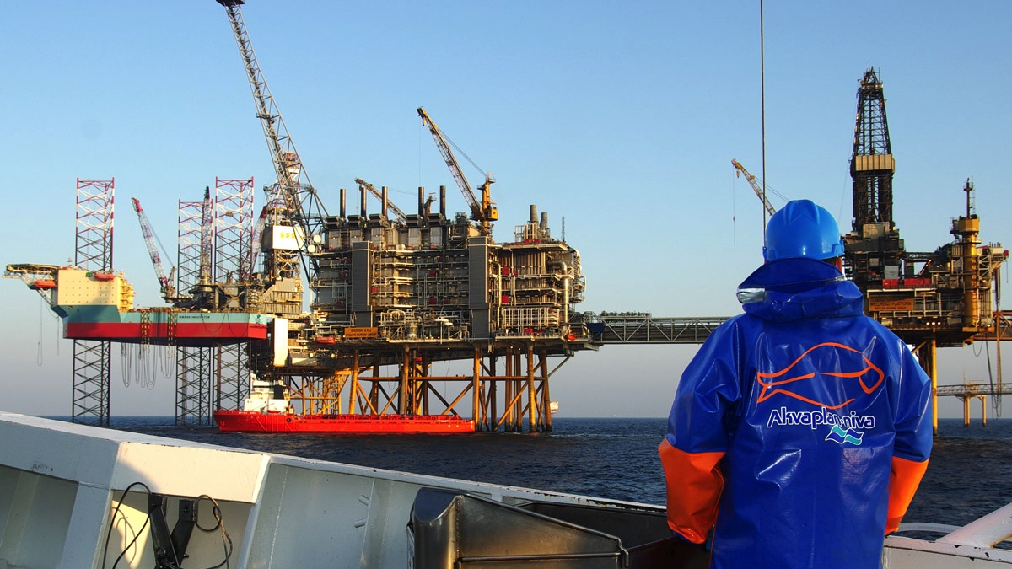
Offshore oil and gas
Norway`s biggest export trade

Slide 13
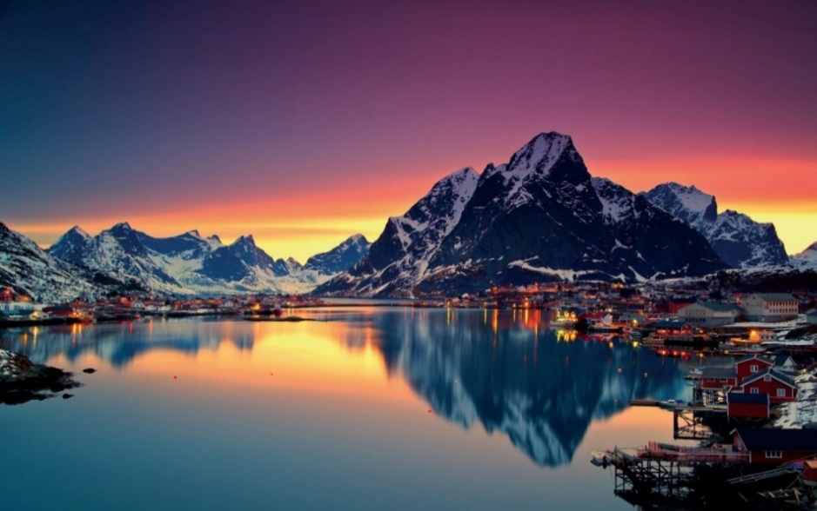
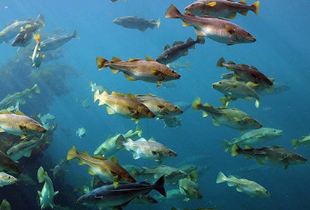
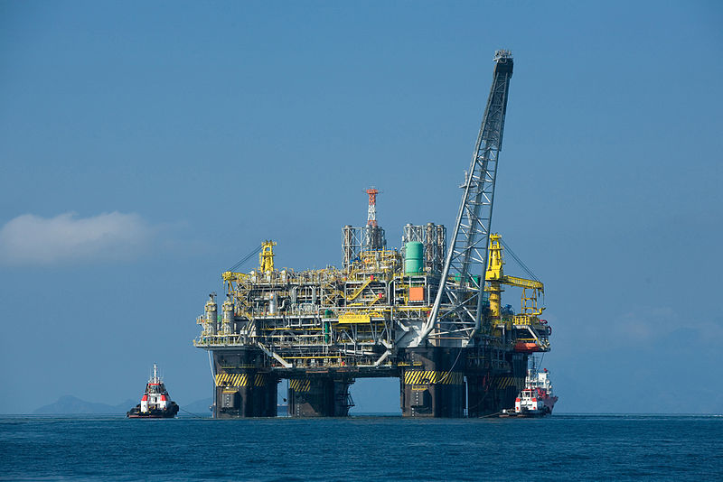
Welcome to the Lofotens!
Nursery grounds for
commercial fish stocks
Nature
Petroleum resources
Notes:
The region is well know for its natural beauty, and as an important source of natural resources. It is the key nursery area for the North Arctic cod stock and it contains considerable petroleum reserves below the seafloor.

Slide 14
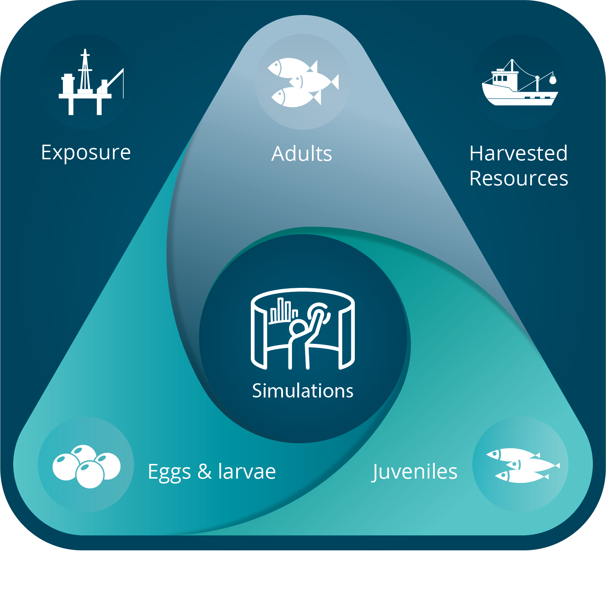
Simulating impacts of petroleum activities on the fisheries
What is the potential loss of cod larvae from the nursery grounds off the Lofoten islands?
What is the potential impact on the Northeast Arctic cod stock?
Notes:
EBM
Decision making
Need to be able to simulate many different scenarios – what if? Uncertainty, explore different outcomes
Models/modeling – need to be able to run scenarios, prognostics, multiple runs

Slide 15

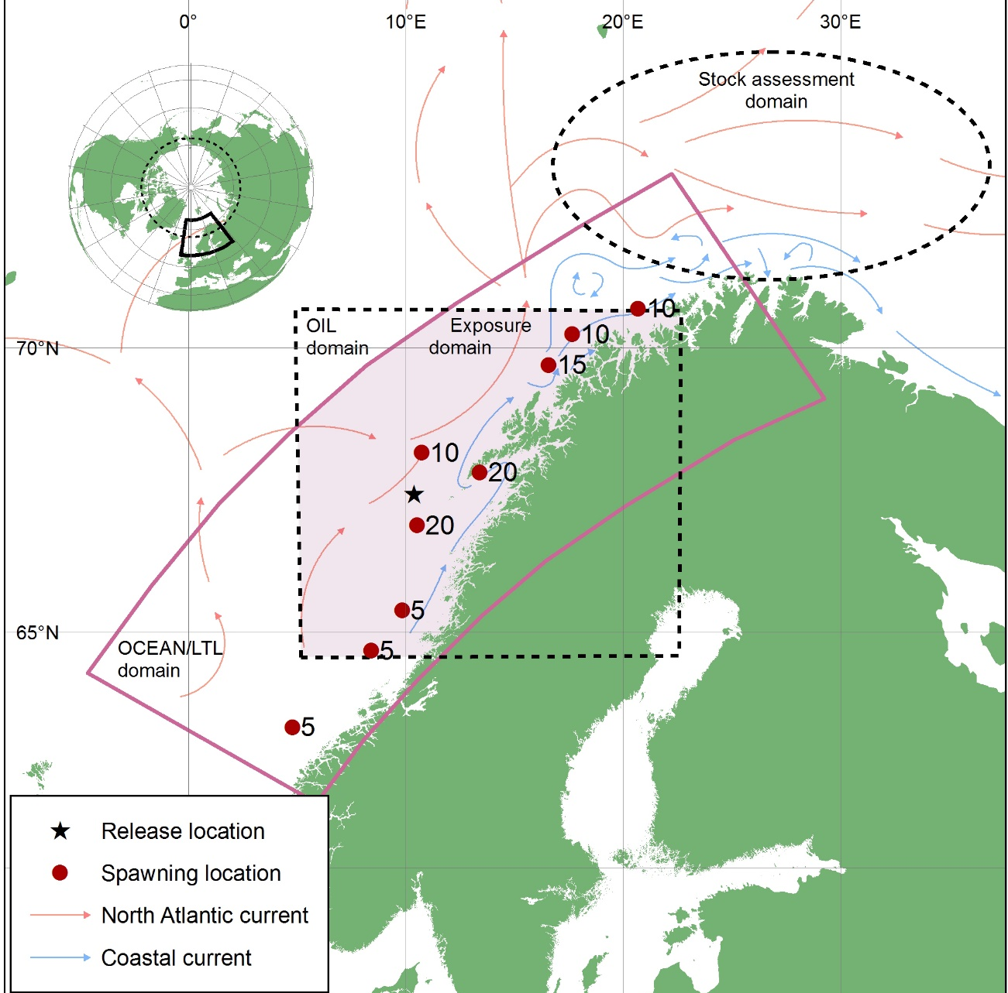





Model spatial domains
Barents Sea North Arctic cod population
Cod eggs & larvae in the nursery grounds
Notes:
Nordland 6/2 The Northeast Arctic cod stock is in the Barents Sea. This stock spawns in March and April along the Norwegian coast, about 40% around the Lofoten archipelago. Newly hatched larvae drift northwards with the coastal current while feeding on larval copepods. By summer, the young cod reach the Barents Sea, where they stay for the rest of their lives, until their spawning migration.
As the cod grow, they feed on krill and other small crustaceans and fish. Adult cod primarily feed on fish such as capelin and herring. The northeast Arctic cod also show cannibalistic behaviour.

Slide 16


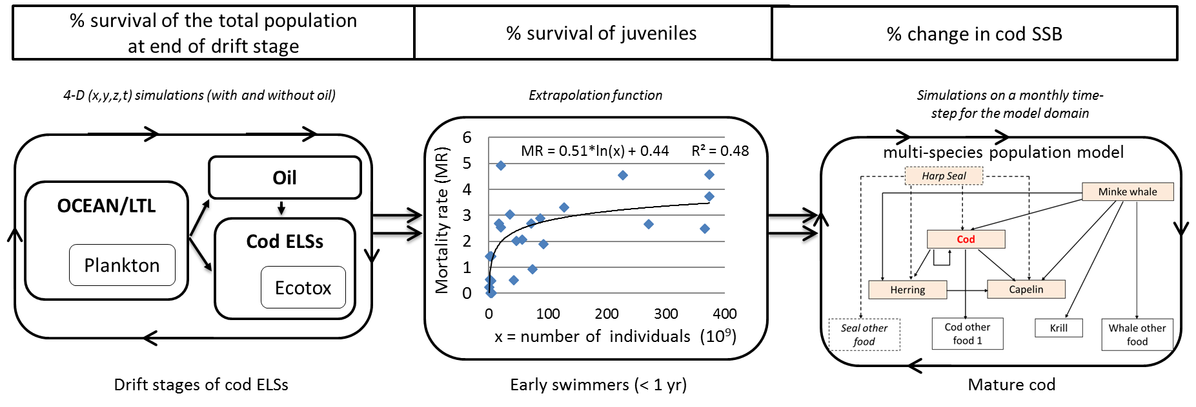
SYMBIOSES

Slide 17
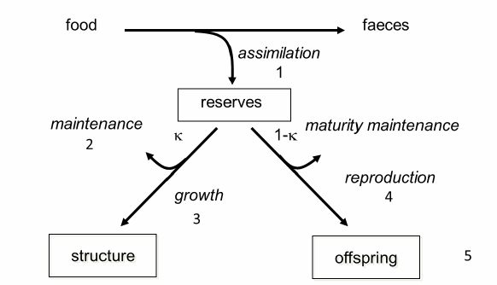
DEB in SYMBIOSES
Exposure Concentration
Mortality
Data
Parameters
Effects
Fathead Minnow
NEC
Killing rate
Elimination rate constant
Best estimate
SF = 50
Napthalene
C. Klok et al. 2014. Mar Environ Res 101:60-68.
Notes:
Describes the uptake and use of energy by an organism using simple mechanistic rules
Direct contact with contaminated seawater
Extroplated napthalene to 14 of the component groups

Slide 18




Comparison of our toxic effects model with literature LC50s
More Sensitive
Continuum of effects: acute to sub-lethal
Level 1
PAH2
Range of data
juvenile
Level 2
PAH1
polyaromatics
Level 3
NAPTH2
NAPTH1
Level 4
egg
C1-Benzene
0.1
ppb
1.0
ppb
larvae
Benzene
C7-sat
adult
C6-sat
LC50 (mg/L)
10⁻⁵
10⁻⁴
10⁻³
10⁻²
10⁻¹
10⁰
10¹
10²
10³
10⁴
10⁵
Notes:
Bio-available compounds induce effects when concentrations exceed a certain concentration in an organism, or threshold level
Comparison of LC50 values calculated with DEB parameters with the lowest LC50 values found in literature for fish in life stage groups egg/embryo, larvae, juvenile and adult for 8 pseudo groups.
Our thresholds with respect to the literature values/approach
Processes in time/dynamic model so LC50s aren't the best approach (Static)
MarineForsk Free project is moving in this direction – training experimentalists to carry out experiments that provide the required information for dynamic models
We apply four different sets of toxicity parameters to cover both immediate and delayed effects, i.e. narcotic, physiological and behavioral effects (P1-P2) and conservative benchmarks for total PAH exposure (P3-P4)²⁴

Slide 19
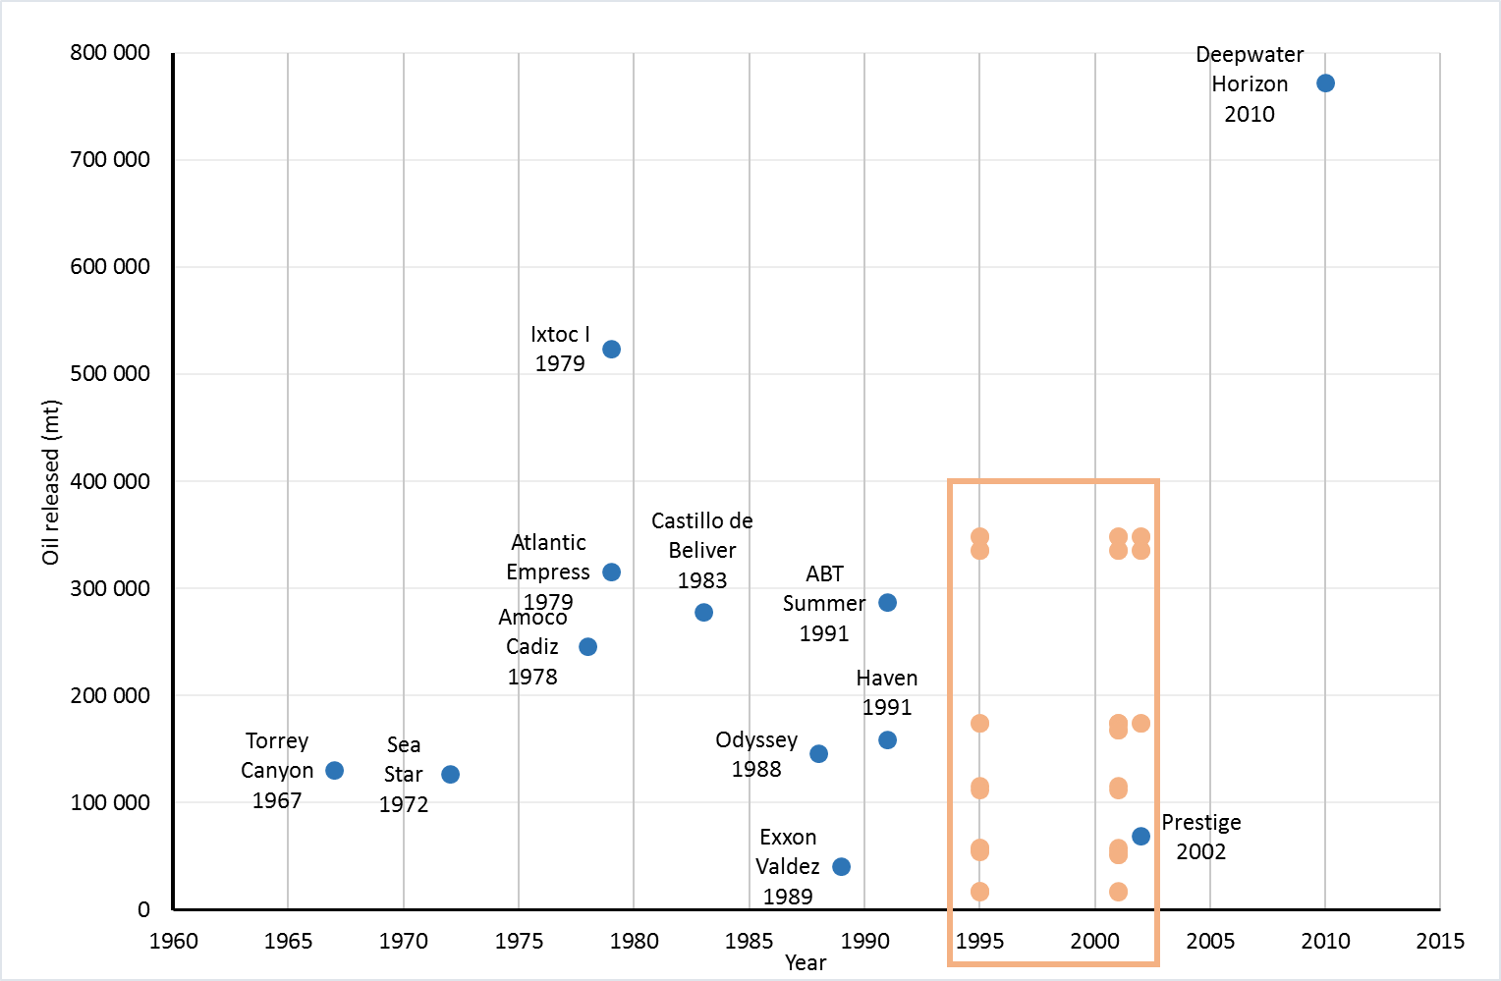
Oil spill simulations
Simulations
Durations: 14, 45, 90 days
Rates: 1500 m³/d, 4500 m³/d
Years: 1995,2000,2001
Notes:
Topside & Subsea discharge scenarios
We simulate oil spills with oil release rates of 1500 or 4500 m³/day, lasting 14,45, and 90 days from a single location on the Lofoten-Vesterålen shelf (67.700N 10.841E).
Oil release rates are controlled by reservoir characteristics, which for our study location, results in the release of approximately half the volume of oil as in the DWH spill
Year Cod Abundance 1995 high 2001 low 2002 average

Slide 20

RESULTS
Adult standing stock biomass (SSB)
Survival eggs and larvae
SSB
SURVIVAL
100%
100%
Increasing
impact
Increasing
impact
More Sensitive
Continuum of effects: acute to sub-lethal
0%
0%
Level 4
Level 3
Level 2
Level 1
%
%
%
%
Notes:
Survival is relative to a no oil simulation - High % = minimal impact; Low % = high impact
These are Maximums. Factor of 4-5 decrease in losses of adult cod relative to reductions in survival of eggs & larvae. Buffer effect observed as a result of the lag between recruitment and adult maturation (7 yr lag)

Slide 21
Results
Level 4
Level 3
Level 2
Level 1
Adult standing stock biomass (SSB)
≥ 88 %
≥ 97 %
100 %
100 %
≥ 57 %
≥ 86 %
100 %
100 %
Survival eggs and larvae
  Most scenarios give minor losses of eggs and larvae
  Some scenarios give larger losses of eggs and larvae
  Impact on the biomass of the adult stock is limited for all scenarios
  No impacts on reproduction
  Variability depends on yearclass and age structure of the stock
Notes:
Minor losses of eggs and larvae for most scenarios
Impact on the biomass of the adult stock is limited
Management actions (reduced fishing) can be taken to mitigate impacts due to the lag between recruitment and fish maturation gives time for

Slide 22
Multi-year stock buffers losses
2005
2000
2010
Notes:
On average, only 6 out of 1 million of a new generation of eggs reach the age of recruitment to the fishery (3yr). There are lots of reasons why stocks vary (not well understood)
Climate, cannabilism, density-dependent mortality,

Slide 23
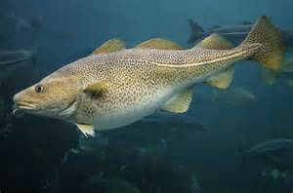
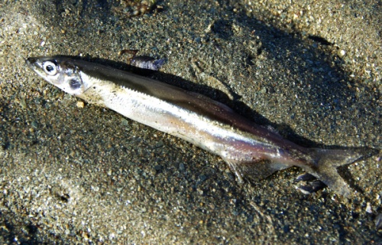
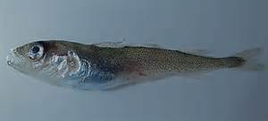
Future directions
Different fish species
Compound mixtures
Parameter combinations
Transfer via food (prey)
Polar cod
Capelin
Atlantic cod
Long life span
Iteroparous
Several spawning year classes
Pelagic eggs
Short life span
Semelparous
One spawning year class
Demersal eggs
Relative short life span
Iteroparous
More than one spawning year class
Pelagic eggs
Notes:
Oil spill impact on fish populations may differ among species with other life history traits
Fish with shorter lifespans (e.g. capelin) or with more variable recruitment (e.g. herring or haddock) are more vulnerable to losses to a single good recruitment event

Slide 24
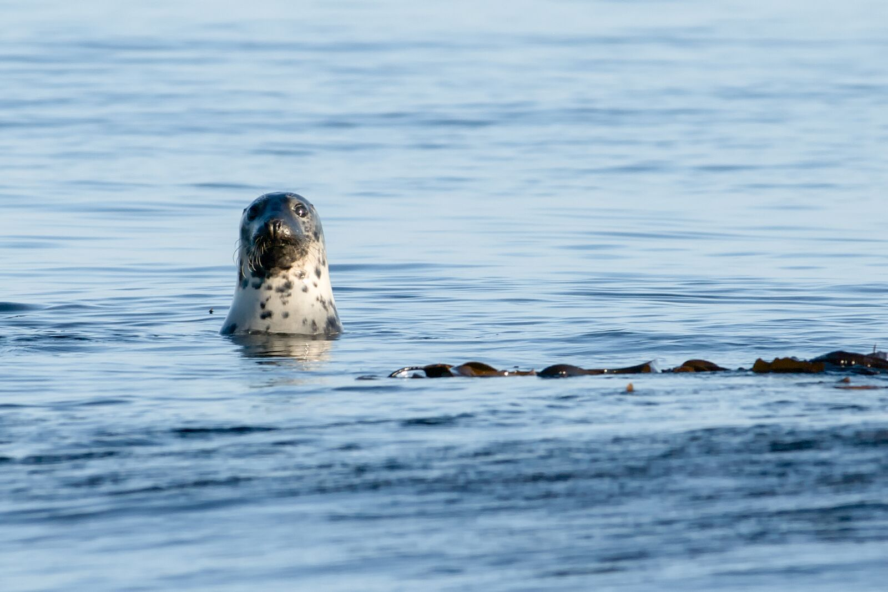
Combines expertise, models, and data into a simulation
system for hypothesis testing
Can integrate modelling fish management with oil risks and impacts
Not perfect but less wrong than we were before
Can explore key questions we couldn’t before
Can map where knowledge is missing
Methodology is generic, but results are species specific
© Geir Morten Skeie
Notes:
Exxon Valdez assessment. DWH working on it. Norway actually has such a tool. Further improvements and simulations will help to increase our understanding of potential impacts

Slide 25
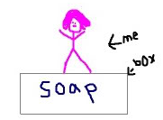
Lessons learned
Ecosystems are complicated
Models are also complicated
Experimentalists and modelers need to work together
Notes:
Need to use the best available knowledge and continually update, test, & modify – as expected in EBM
Build from other research advances not just a software but expert consortium that runs models and provides interpretations
Accept that there is a continuum of technology – 1) hardware, 2) software, 3) combinations of people, methods, software, hardware
Exp & Modelers: Fortunately starrlight has a project on this.FREE
FREE project Biologist training: from data to parameters

Slide 26
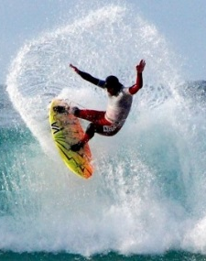
Welcome to the Lofotens!
Nursery grounds for
commercial fish stocks
Nature
Petroleum resources
Notes:
The region is well know for its natural beauty, and as an important source of natural resources. It is the key nursery area for the North Arctic cod stock and it contains considerable petroleum reserves below the seafloor.

Slide 27

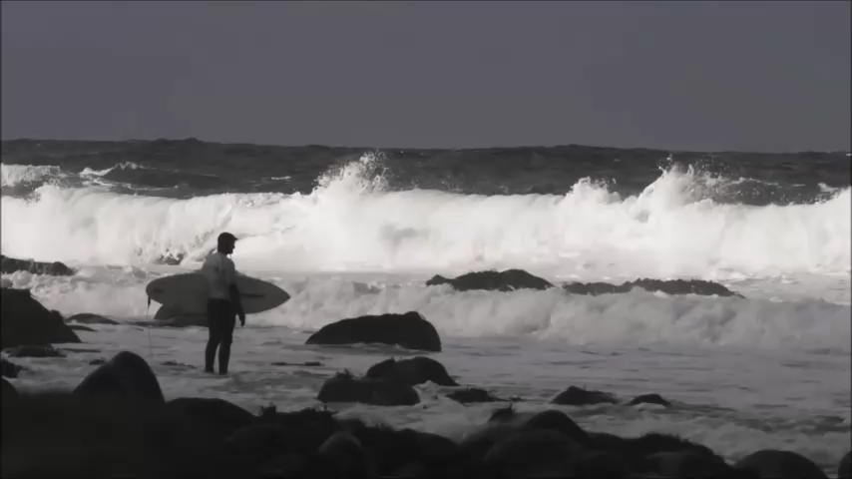
Lofoten Masters- world’s northernmost surf competition
https://www.youtube.com/watch?v=shWpN0_kONQ
Notes:
What you may not know, is that it is also the location of the world’s northernmost surf competition (Unstad). Lets take a minute to enjoy this. And while your watching, remember that the water temperatures are around 10 (50).

