Slide 1

Ecotoxicology from a different perspective
Jan Baas
Centre for Ecology and Hydrology, UK
(Sheets by Jan Baas, Tjalling Jager)

Slide 2

Contents
Introduction
Classical ecotoxicology
A different perspective
Outlook

Slide 3
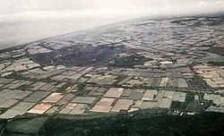
Why am I here: “Het Westland”
(Photo by Rob Hooft, Wikipedia)

Slide 4
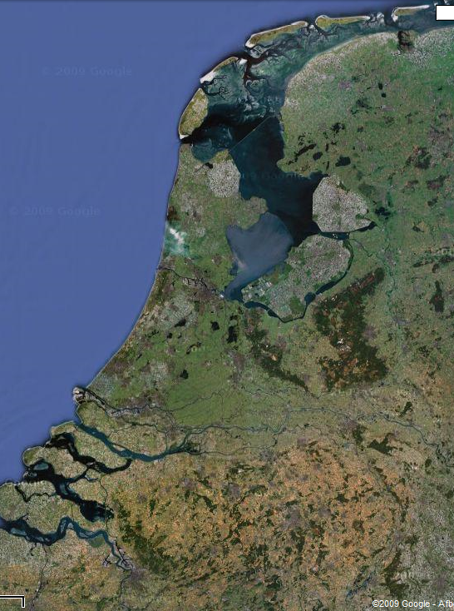
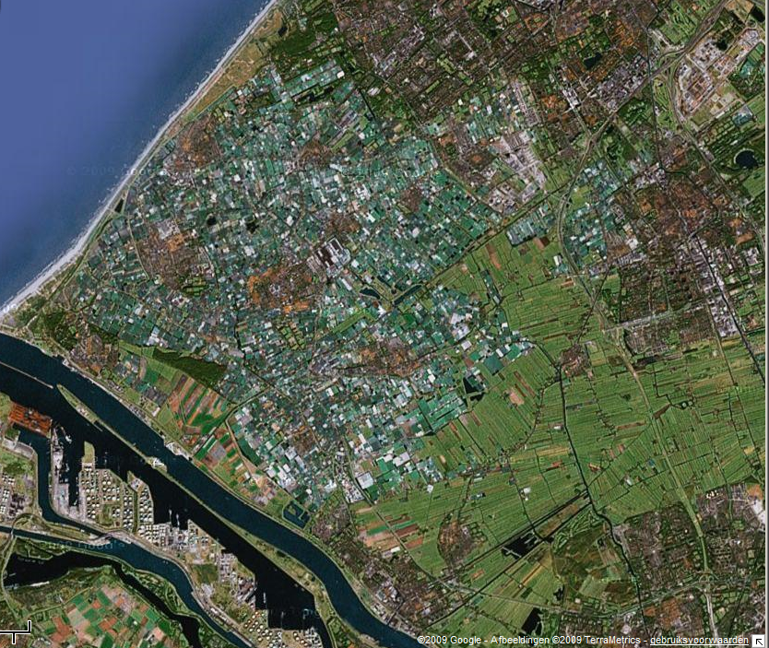
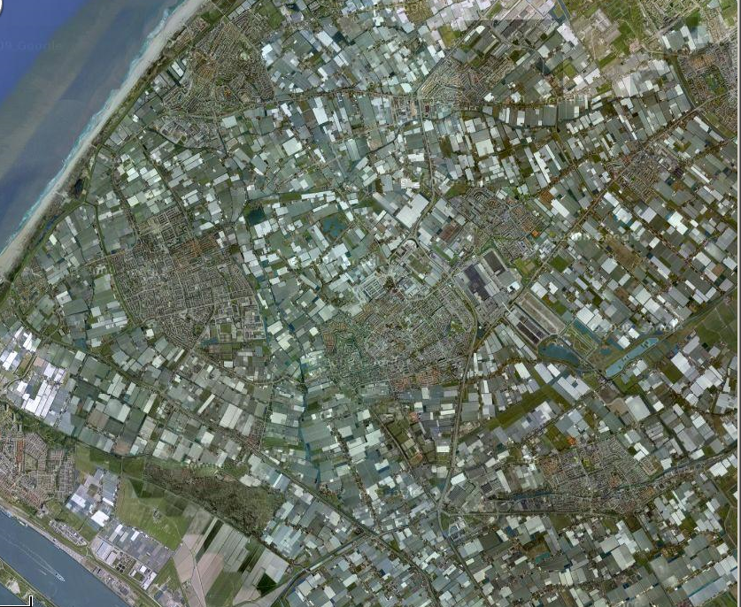
Westland
Maps by google

Slide 5
Measurements (Delfland Waterboard)
Surface waters contaminated with a mixture of:
Pesticides, Metals, PAHs, PCBs,
Nutrients/salts
measurement of survival of in situ exposed daphnids.

Slide 6
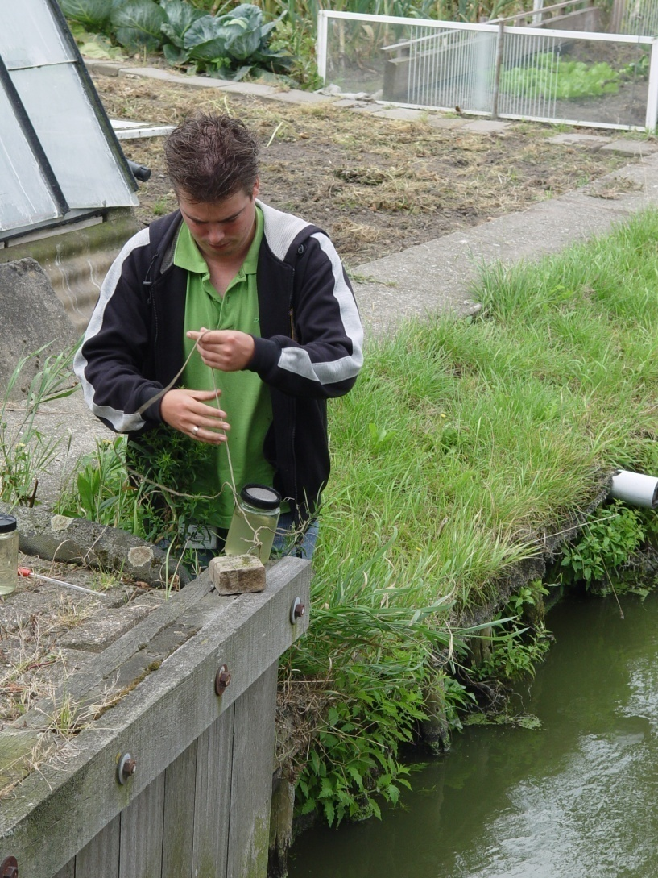
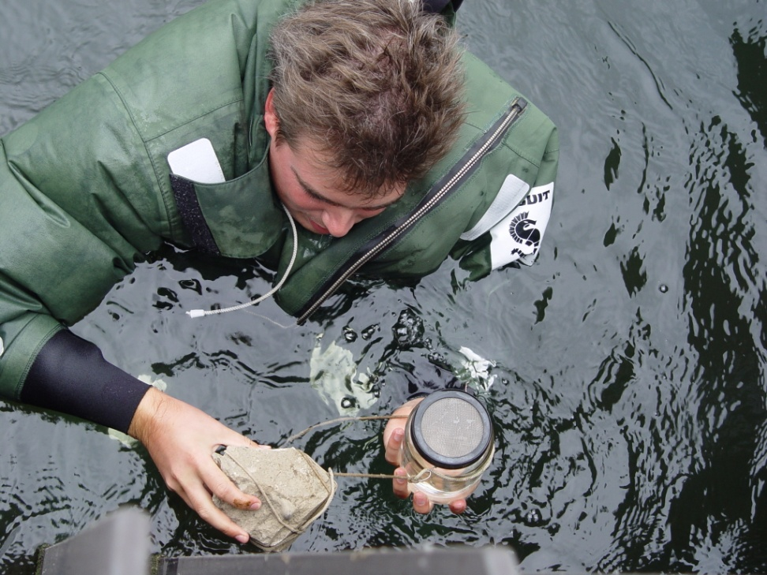
Daphnid exposure

Slide 7
Observations (base year 2000)
In about1/3 of the surface waters the daphnids go extinct within 1 week
In about 1/3 of the surface waters the daphnids are partially affected (>10% mortality);
In about 1/3 of the surface waters the daphnids are not affected.

Slide 8
Observations
(Almost) no correlation between daphnid mortality and exceedence of env. qual. std.
Linking the chemical contamination to daphnid survival statistically gave no reliable results

Slide 9
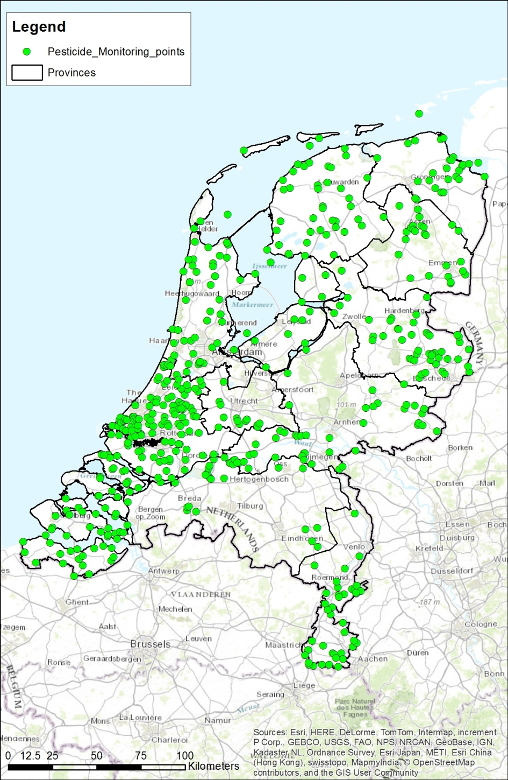
All Dutch data
App 500 sampling points
App 3500 samples
App 300,000 reported concentrations/yr
App 400 samples with >10 pest above DL

Slide 10
Conclusions based on all Dutch data
It proved impossible to deduce from these
measurements if we have ‘safe’ surface waters
Det Lim too high to exclude mixture effects

Slide 11
Conclusions
Apparently current approaches to assess toxic effects in real life give limited protection….
So let’s have a closer look at how risk assessment is carried out. And what DEB-based approaches can do

Slide 12
Risk assessment of chemicals
Derivation of ‘Safe’ concentrations for the workers, users or the environment (REACH)
Requires some measure of toxicity
But: Based on ‘scientific’ and political considerations

Slide 13
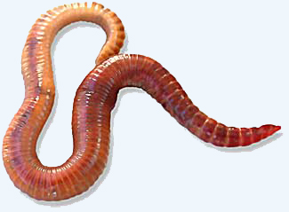
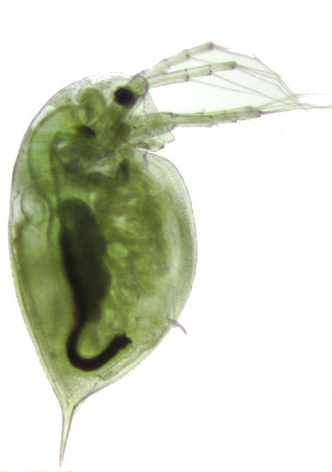
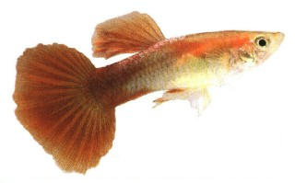
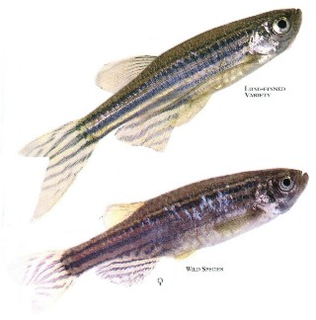

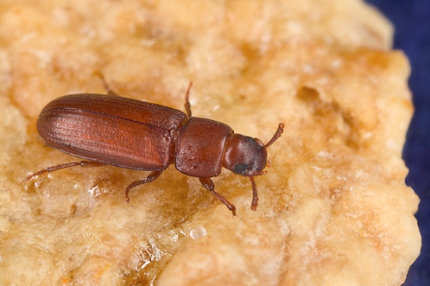
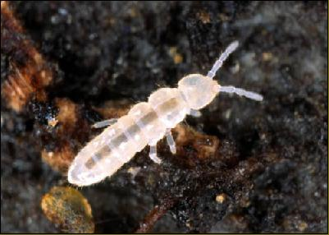
Typical Test Organisms

Slide 14
Standardisation of tests
Toxicity tests are highly standardised (OECD, ISO):
  species
  exposure time (chronic, acute)
  endpoints (growth, reproduction, survival)
  test medium, temperature etc.

Slide 15
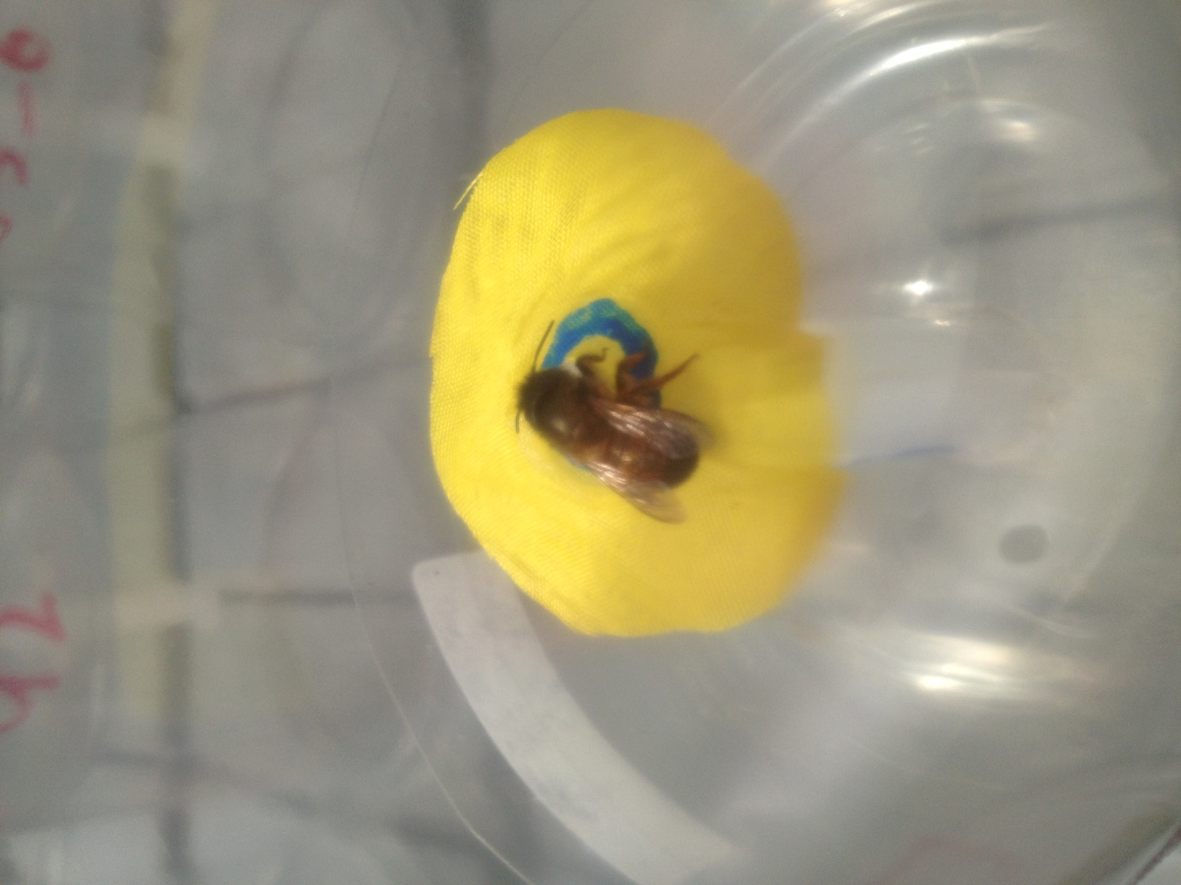
Example of a test with bees

Slide 16
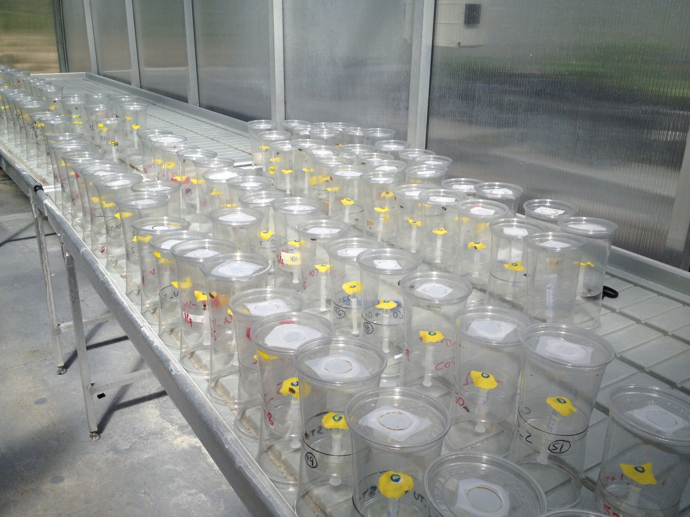
Lot’s of bees

Slide 17

Standard test set-up

Slide 18
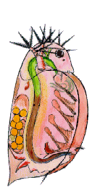
Survival test

Slide 19
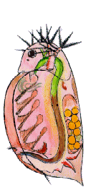
Survival test

Slide 20
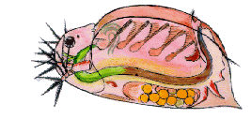
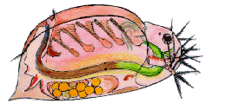
After 2 days …

Slide 21


Reproduction test

Slide 22
Reproduction test

Slide 23

After 21 days …

Slide 24
Range of Concentrations

Slide 25
Plot response vs. dose
What pattern to expect?
Response
log concentration

Slide 26
Standard approaches
Contr.
1. Statistical testing
2. Curve fitting
NOEC
*
LOEC
Response
assumes threshold
log concentration

Slide 27
Standard approaches
1. Statistical testing
2. Curve fitting
EC50
Response
no threshold
log concentration

Slide 28
Summary Statistics (what is reported)
NOEC
The highest tested concentration where effect is not significantly different from control
EC50 or LC50
The estimated concentration for 50% effect, compared to control

Slide 29
Environmental safe concentration (1)
Procedure:
Lowest EC50 or LC50 for different species
Divide by a safety factor
Gives environmental safe concentration

Slide 30
Where’s the science?
Available data | Assessment factor
3 LC50s | 1000
3 LC50s + NOEC | 100
3 LC50s + 2 NOECs | 50
3 LC50s + 3 NOECs | 10
No attempt to understand process of toxicity
Dose-response approaches are descriptive
Extrapolation through arbitrary ‘assessment factors’
Ignores that LC50/ECx/NOEC change in time

Slide 31
Environmental safe concentration (2)
Species Sensitivity Distribution, procedure:
plot an S-curve through observed summary statistics for a large number of species
Take the 5% cut-off
NB! Both procedures allow 5% of the species to be affected by the ‘toxicant’!

Slide 32
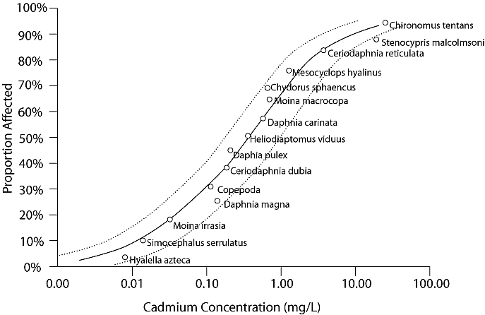
SSD
Source: EPA

Slide 33
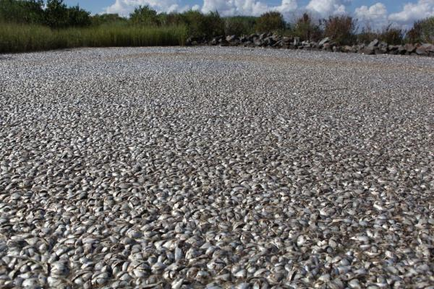
The real world

Slide 34

The real world

Slide 35
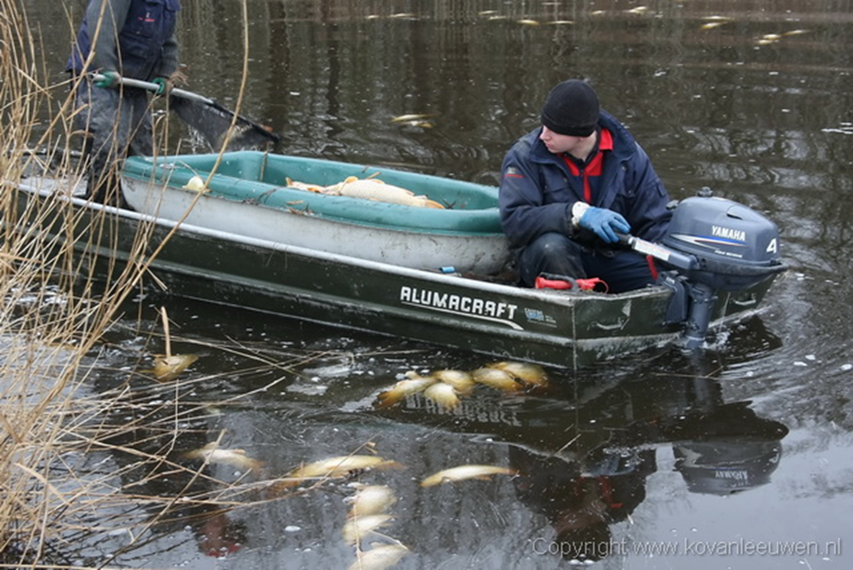
The real world

Slide 36


Challenge of ecotoxicity
Some 100,000 man-made chemicals
Large range of natural ‘toxicants’
For animals, 1.25 million species described
Complex exposure situations

Slide 37
A different perspective
Ask different questions:
  What is the process by which a toxicant affects an organism’s life history?
  How can we come from a lab test to real life conditions to predict population responses?

Slide 38
A different perspective
Central Questions:
How do we integrate toxic effects on different endpoints??
What is it that makes an organism sensitive to toxic poisoning??
How do we account for effects of mixtures??

Slide 39
Integrating different endpoints
Endpoints are linked, effects on:
  Growth
  Reproduction
  Respiration
  Survival
Are all aspects of the response of the same organism to toxic stress

Slide 40
Integrating different endpoints
Start from the organism!
Different endpoints can be interpreted within the same mechanistic framework
Effects are followed as processes in time
Better extrapolation potential
Use the energy balance of the organism as a starting point to model effects

Slide 41
Potential targets
food
faeces
assimilation
reserves
somatic maintenance
maturity maintenance
κ
1-κ
structure
maturity
offspring

Slide 42
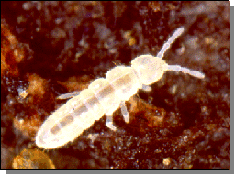
Potential targets
TPT
body length
cumulative offspring
time
time
Crommentuijn et al. (1997), Jager et al. (2005)

Slide 43
Potential targets
food
faeces
assimilation
reserves
somatic maintenance
maturity maintenance
κ
1-κ
structure
maturity
offspring

Slide 44
Potential targets
food
faeces
assimilation
reserves
somatic maintenance
maturity maintenance
κ
1-κ
structure
maturity
offspring

Slide 45
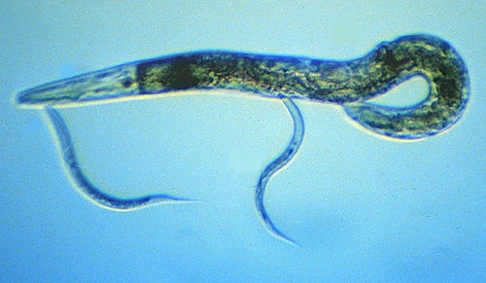
Potential targets
Pentachlorobenzene
body length
cumulative offspring
time
time
Alda Álvarez et al. (2006)

Slide 46
Potential targets
food
faeces
assimilation
reserves
somatic maintenance
maturity maintenance
κ
1-κ
structure
maturity
offspring

Slide 47
Potential targets
Chlorpyrifos
body length
cumulative offspring
time
time
Crommentuijn et al. (1997), Jager et al. (2007)

Slide 48
Integrating endpoints
Toxic effects can be integrated and understood within the DEB framework
Great extrapolation potential:
Extrapolation to different compounds
Extrapolation to different species
Extrapolation to mixtures
Extrapolation to population effects

Slide 49
Species sensitivity
Trait based approaches using DEB theory
Combining Add-my-pet data with toxic effect data
Specific somatic maintenance rate drives species sensitivity at least for some pesticides

Slide 50
SPECIES SENSITIVITY AND Sp Som Maint RATE
Graphs
Specific somatic maintenance rate vs NEC

Slide 51
SPECIES SENSITIVITY AND Sp Som Maint RATE
SSD Carbofuran (based on NEC) (R² = 0.941)

Slide 52
SPECIES SENSITIVITY AND Sp Som Maint RATE
SSD Carbofuran (based on p_M) (R² =0.907)

Slide 53
Species sensitivity
Trait based approaches to understand species sensitivity are promising!
But we are just ‘scratching the surface’
We are looking for funding to investigate the possibility to use a combination of traits to make predictions on species sensitivity, not only for toxic effects but also for temperature effects.

Slide 54
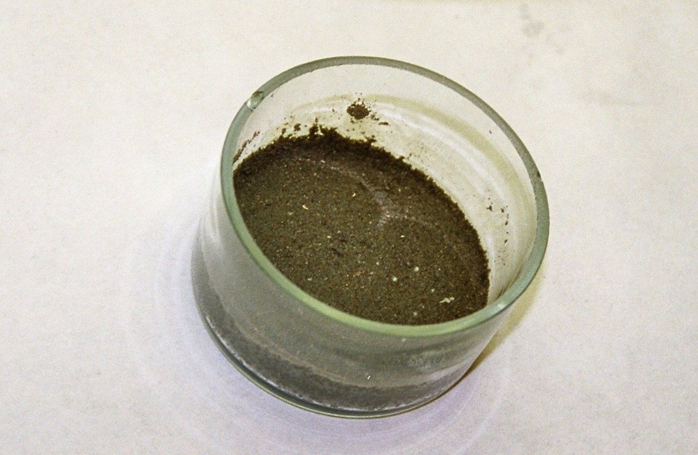
Effects of mixtures
Compounds in a mixture cooperate!
Survival experiment with Folsomia candida.
Exposure to a binary mixture of metals. Observation of survival during 21 days.

Slide 55
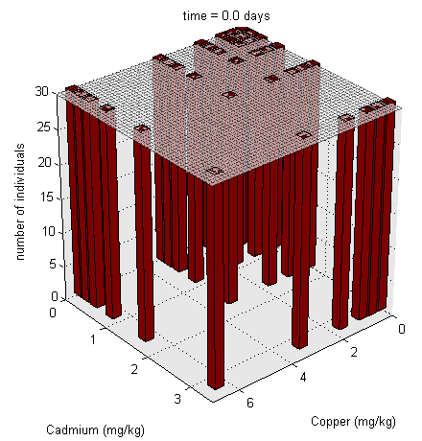
Effects of mixtures
Combined effect of Cu and Cd on F candida

Slide 56
Effects of mixtures
Combined effects of
Pesticides
Nutrients
Salts
Metals
PAH
On daphnid survival in ‘het Westland’ could be predicted using DEB based mixture approaches

Slide 57
Effects of mixtures
Combined effects of
  PAHs
  Cd and a PAH
On sub-lethal effects for different species could be understood using DEB based mixture approaches, including physiological interactions

Slide 58
Main conclusions
DEB based approaches are a natural way to interpret effects of toxicants and offer great possibilities to answer some still unanswered questions
DEB based approaches become more important
DEB based approaches are recognised by government

Slide 59
THANKS FOR YOUR ATTENTION!!!

